Slide 1

Ally Merrett
2025
…at your first job
Your First Day

Slide 2
AGENDA
1. HOW TO MAKE FRIENDS WITH COWORKERS
2. HOW TO DO YOUR BEST WORK
3. HOW TO BE A STUDENT OF EVERYTHING
1a. How to make conversation with people older than you
3a. How to End your First Day

Slide 3
HI

Slide 4
WAIT!
THIS TALK ISN’T JUST FOR DESIGNERS
THERE ARE MANY DIFFERENT PERSPECTIVES
EVERYONE HAS A FIRST DAY OF WORK

Slide 5
WAIT!
THIS TALK ISN’T JUST FOR DESIGNERS
THERE ARE MANY DIFFERENT PERSPECTIVES
EVERYONE HAS A FIRST DAY OF WORK

Slide 6
INTRODUCTION

Slide 7
HI

Slide 8
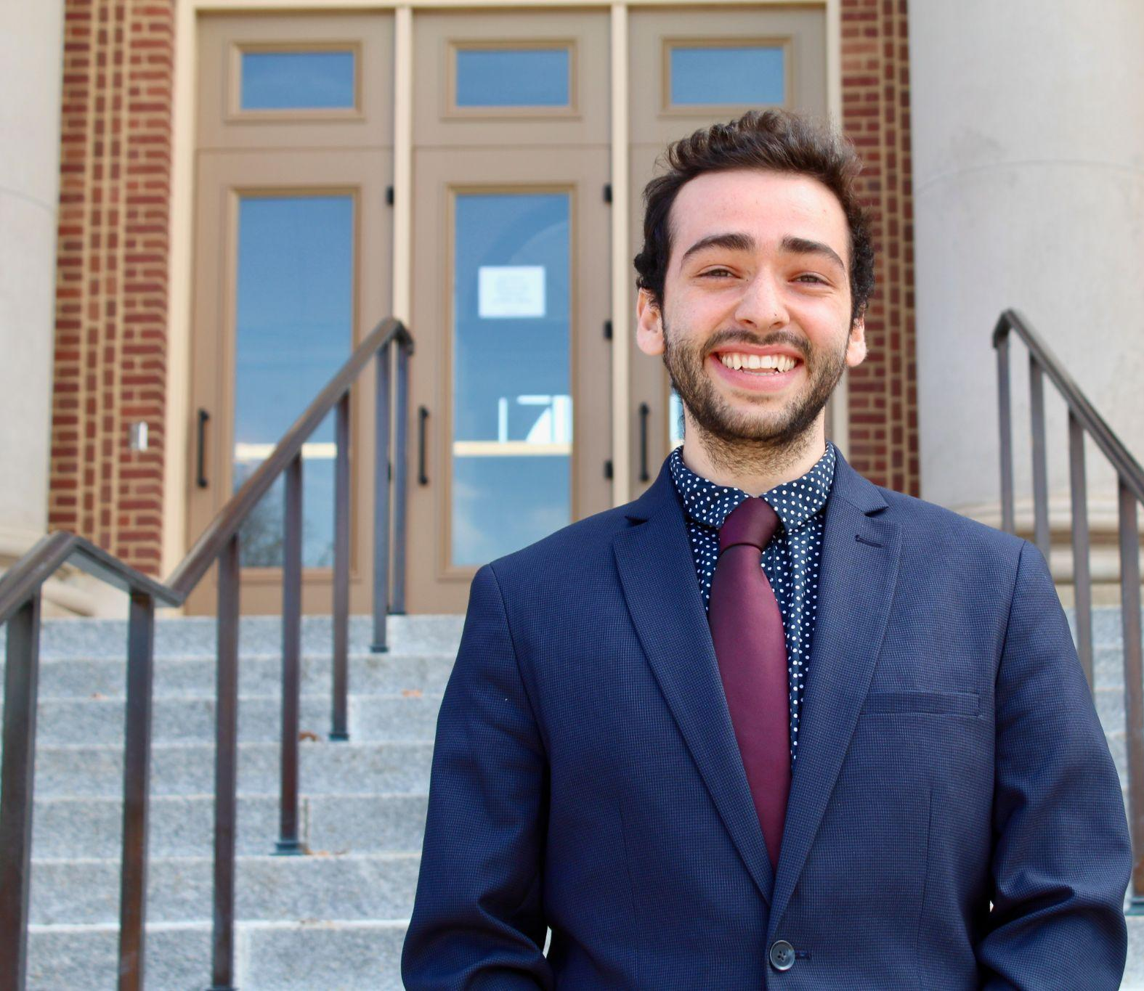
HI

Slide 9
HI

Slide 10
HI
I want to give two disclaimers:

Slide 11
HI
I want to give two disclaimers:
I am Young.

Slide 12

HI
I want to give two disclaimers:
I am Young.
I am Canadian.

Slide 13
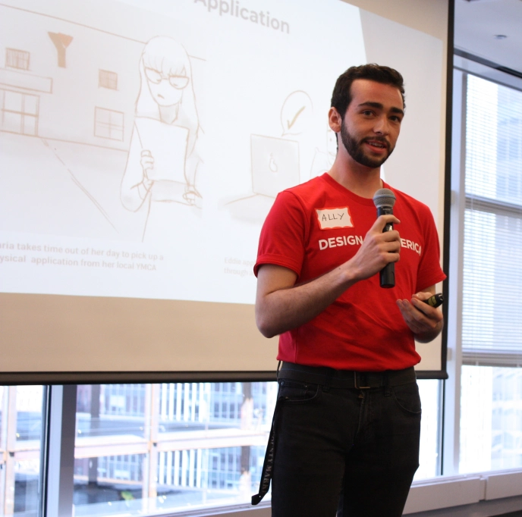
A BIT MORE
Graduated from UIUC in with degrees in Urban Planning and Sustainable Design
  Minors in Art & Design, Sociology, and Informatics
  Certificate in Undergraduate Research
    Nobody ever asks :(

Slide 14
A BIT MORE
Graduated from UIUC in with degrees in Urban Planning and Sustainable Design
  Minors in Art & Design, Sociology, and Informatics
  Certificate in Undergraduate Research
    Nobody ever asks :(
Program Coordinator at Design for America
Adjunct Lecturer at Western Illinois University
Worked here at the Siebel Center for almost 4 years!
  A few other places around Chicago
Big fan of indie rock, playing soccer, and games of all types!
Love design, sociology, and economics

Slide 15
LIGHTNING ROUND

Slide 16
DRUMLINE INSTRUCTOR

Slide 17
DRUMLINE INSTRUCTOR
PAY ATTENTION

Slide 18
SIEBEL CENTER FOR DESIGN

Slide 19
SIEBEL CENTER FOR DESIGN
COME PREPARED

Slide 20
NEMERA INSIGHT INNOVATION

Slide 21
NEMERA INSIGHT INNOVATION
DO WHAT YOU NEED

Slide 22
ROLE
PROJECTS
LESSON
RESULT
DRUMLINE INSTRUCTOR
Marching Band
Pay Attention
PASSED
SIEBEL CENTER
Molecule Maker Lab
Youth Summer Camps
Campus Sustainability
Building Experience
Come Prepared
PASSED
GLP-1 Devices
Anesthesiology
Hospital Signage
Birth Journey
NEMERA
Do What You Need
PASSED
Connect for Cancer Prevention
Chicago Multiethnic Population And Surveillance Study (COMPASS)
UCHICAGO
Set Boundaries
FAILED

Slide 23
HOW TO MAKE FRIENDS

Slide 24

Go into random offices and introduce yourself

Slide 25
Go into random offices and introduce yourself
People REMEMBER and APPRECIATE it
  Your coworkers won’t remember:
    What you wore
    If you forgot your lunch
    If you spilled coffee on yourself during a meeting
  They’ll remember that you were brave enough to chat with them
    And RESPECTED them enough to see them as another human

Slide 26
Grace

Slide 27
Grace
  Seattle, WA
  REI
    Curriculum Designer
    Outdoor Educator
    Program Manager

Slide 28

Grace

Slide 29
You might make a mistake or do something you didn’t mean to
  Your coworkers won’t freak out or punish you
    It might even turn out well!

Slide 30
Go into 1 office
Talk for just a few minutes
Take a break
  Don’t push yourself too hard!

Slide 31
HOW TO TALK TO THOSE OLDER THAN YOU

Slide 32
People in their 40s can talk about things that you like
You can talk about things that people in their 40s like
  If you can’t find something to talk about, ask about how they got here, about how they found their passion
Talk about your journey, your college experience, your background, and your academic passion

Slide 33


Slide 34
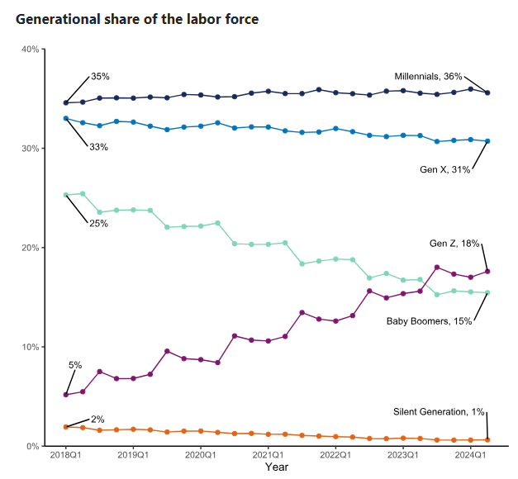

Slide 35
Gen Z Strengths
  Digital Native
  Interdisciplinary
  Work Life Balance

Slide 36
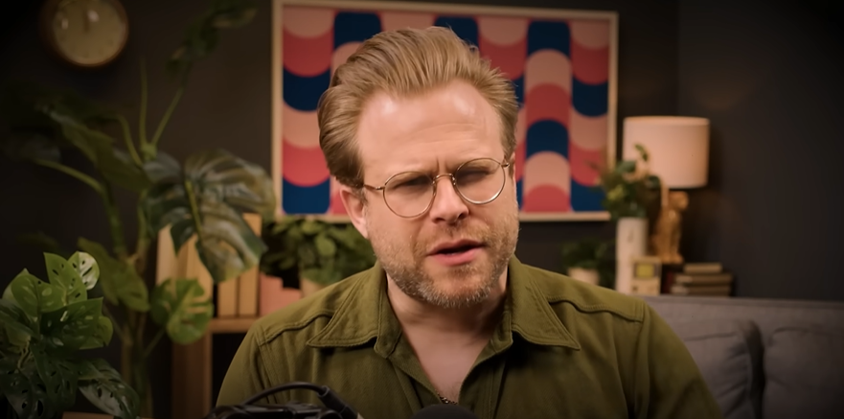

Slide 37
What if I don’t know what to talk about‽

Slide 38
THOUGHT 1
What can you talk about for an hour straight?

Slide 39
IDEAS?

Slide 40
Cartoons
Music
Student Success
MY THOUGHT 1

Slide 41
As a fallback, talk about why you’re passionate about this work!
  And what you want to do with it!
Your coworker will most certainly have thoughts on this topic
Talk about the change you want to make in this world

Slide 42
As a fallback, talk about why you’re passionate about this work!
  And what you want to do with it!
Your coworker will most certainly have thoughts on this topic
Talk about the change you want to make in this world
    What if I don’t know this change‽

Slide 43
THOUGHT 2
What is the change you want to see in this world?

Slide 44
IDEAS?

Slide 45
Understanding Different Perspectives
More Empathy
Time Spent Enjoying Everything
MY THOUGHT 2

Slide 46
HOW TO DO YOUR BEST WORK

Slide 47


If you have a new position, ask what coworkers similar to you have done to be successful
  Collect stories of times when your coworkers have been successful in their role

Slide 48
Audrey
  Columbia, MO
  Columbia Printing and Sign
    Graphic Designer

Slide 49
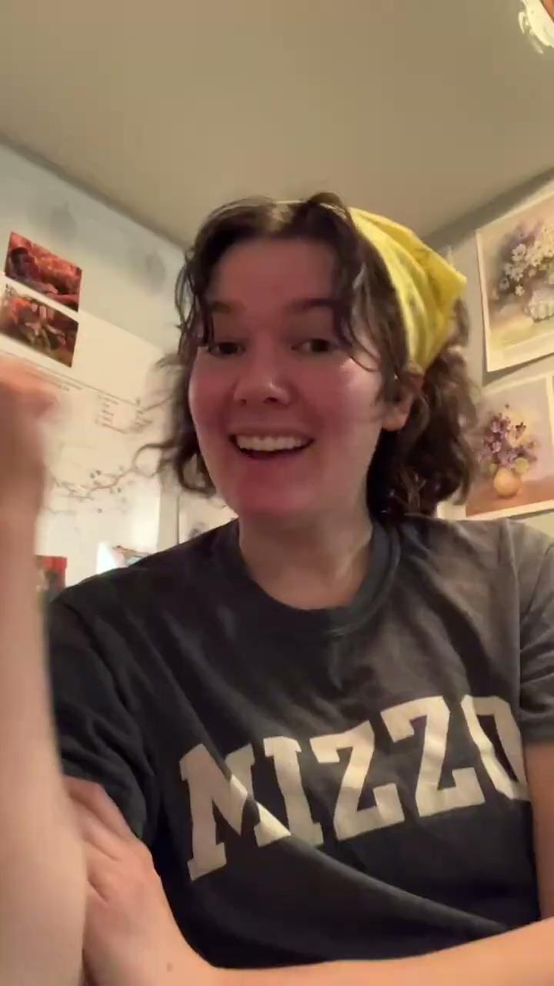
Audrey

Slide 50
Ask what the person before you did
  What did the previous employee do that was super successful?
  What did they do that you would prefer doesn’t continue?
  Are there formatting styles that the organization uses?
  How do you think that the previous employee could have been more successful?
  When was a time that the previous employee had a huge win?
  Who else did the employee work with closely to make their projects easier?

Slide 51

Work with your manager / director to set goals + performance review
  30 days out
  60 days out
  90 days out
Set up quarterly performance reviews with a coworker or manager
  Or every 10 weeks, whichever works best

Slide 52
Work with your manager / director to set goals + performance review
  30 days out
  60 days out
  90 days out
Set up quarterly performance reviews with a coworker or manager
  Or every 10 weeks, whichever works best
Keep a task tracker

Slide 53
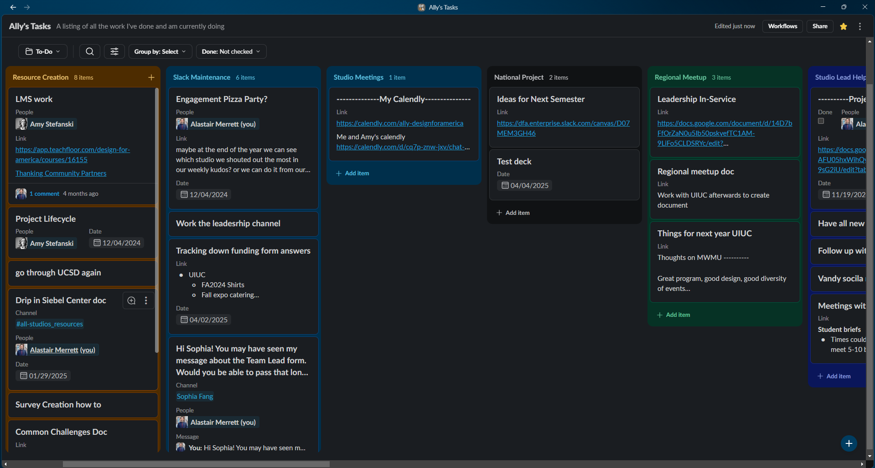
Notes:
A THIRD way to set yourself up for success is setting up a task tracker. I’ve pictured mine here. I grouped it by work category. So as I meet with my boss and she assigns me things, I just put them directly in here or transfer them from a notebook. Then I check them off as I’m done. At the end of each week, I submit a weekly report of the tasks that I’ve done to my manager. This is great way for me to stay accountable and also have proof of the work that I’m doiing. I can also ask for more work or prove that I’m overwhelmed / too busy to do other tasks because of the ones that I’m completing. The one i use is native to slack (and this is even better because I can automatically add messages as tasks.

Slide 54
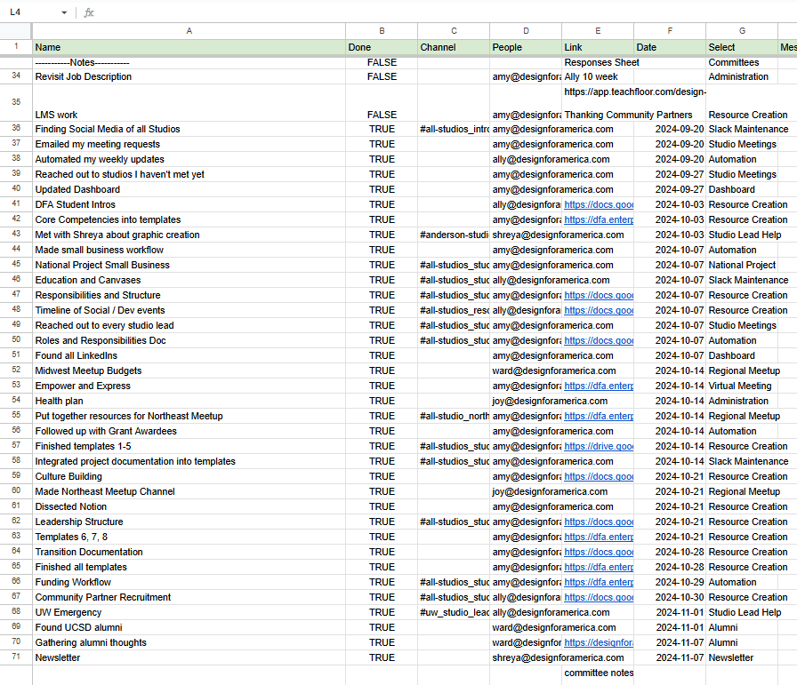
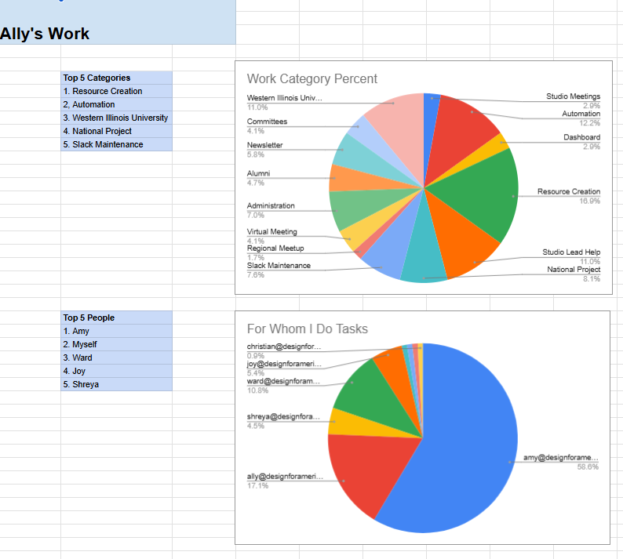
Notes:
You can also download that data and do your own data analyses: what categories of tasks do you do the most, which you do the least, and who assigns you the most work and who you could do to work more with.

Slide 55
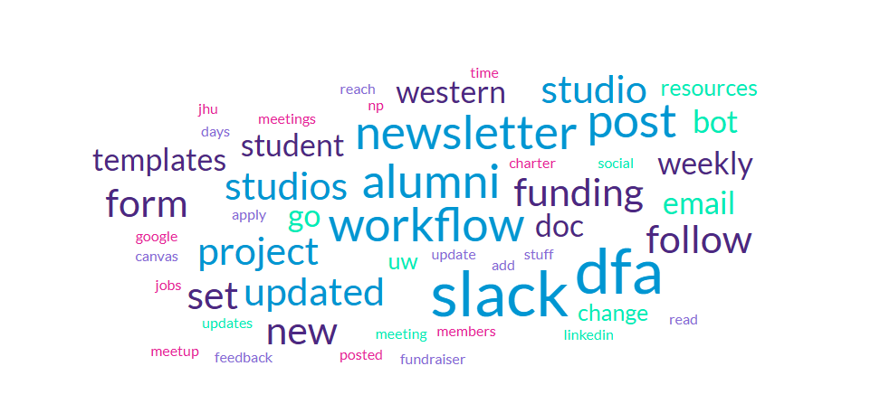
Notes:
Lastly, you can make a wordcloud! Which I love, it’s jus a quick look at your whole quarter of the work that you’ve done. And then it’s great to go through all your previous quarters and see how they compare.

Slide 56
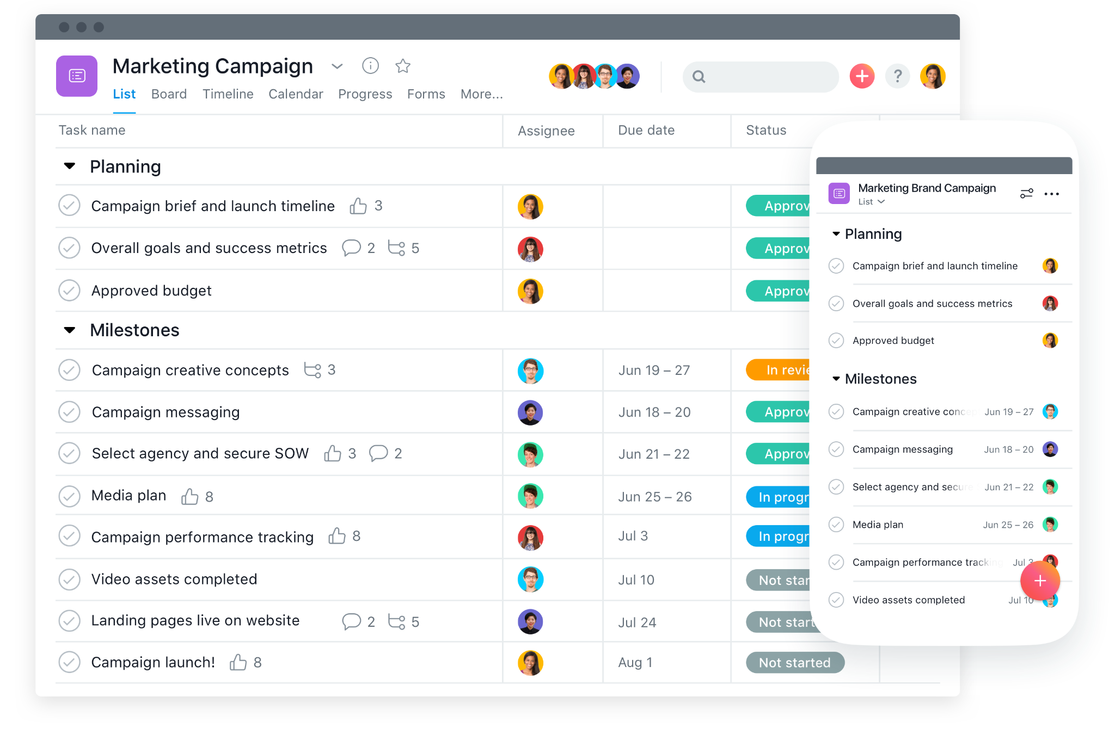
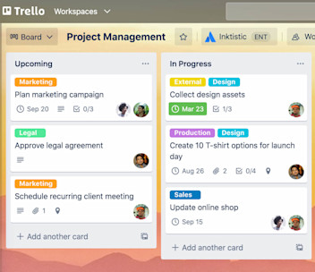
Notes:
There are other websites that you can use - Trello or Monday or Asana. If not slack, I would recommend asana over this because Asana and slack have functions called Workflows where you can automate tasks like reminders but also more complex things like everyday tasks or things to happen if you get a message. Make the machines work for you! However, read closely, I’m not saying to make AI use your job, that’s another conversation.

Slide 57
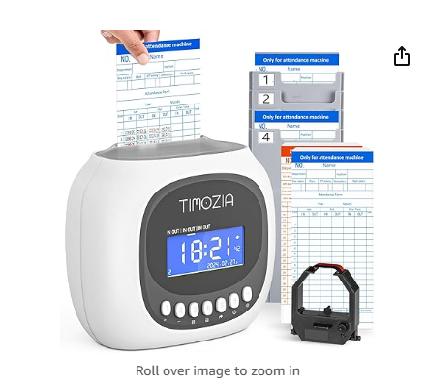
Notes:
I’ve talked about task tracking - now about time tracking. If you work in the office, this ma y be less of a probllem, but I work from home and it took me a long time to nail time tracking. I used to not be focused in the mornings and ended up workig late into the evening each day. I actually ended up buying a punch-in punch-out clock. This had made my life a lot easier, becuase I can much more easily differentiate my work life from my my regular life. Again, I think Severance is a good lesson here - it’s not good!

Slide 58

ASK QUESTIONS
  Do it!

Slide 59
ASK QUESTIONS
  Do it!
Transparency is the most important skill you can bring to your first day
You were hired because you’re skilled, smart, and capable
  You were not hired because you know all the idiosyncrasies of the workplace
It takes time to learn a workplace and no one expects you to get it 100% right on your first day
  In fact, DO NOT shoot for a perfect first day
    Shoot for showing up and being present and honest

Slide 60
By asking questions, you can show that you are ready to learn
  This skill is foundational for building your skill and expertise in your role
  It shows that you are willing to change and grow

Slide 61
By asking questions, you can show that you are ready to learn
  This skill is foundational for building your skill and expertise in your role
  It shows that you are willing to change and grow
Asking questions also begins to build relationships with coworkers and you begin to work together
You WILL make mistake in your first week
Maybe not your first day
Though if you ask questions before plunging into a big project, you’ll be more successful
  You won’t be bothering your coworkers
    They’d rather answer a 30 second question now than redo your 2 hour project

Slide 62
Sam
  Denver, CO
    Colorado Department of Public Health
      Director of Clinics

Slide 63
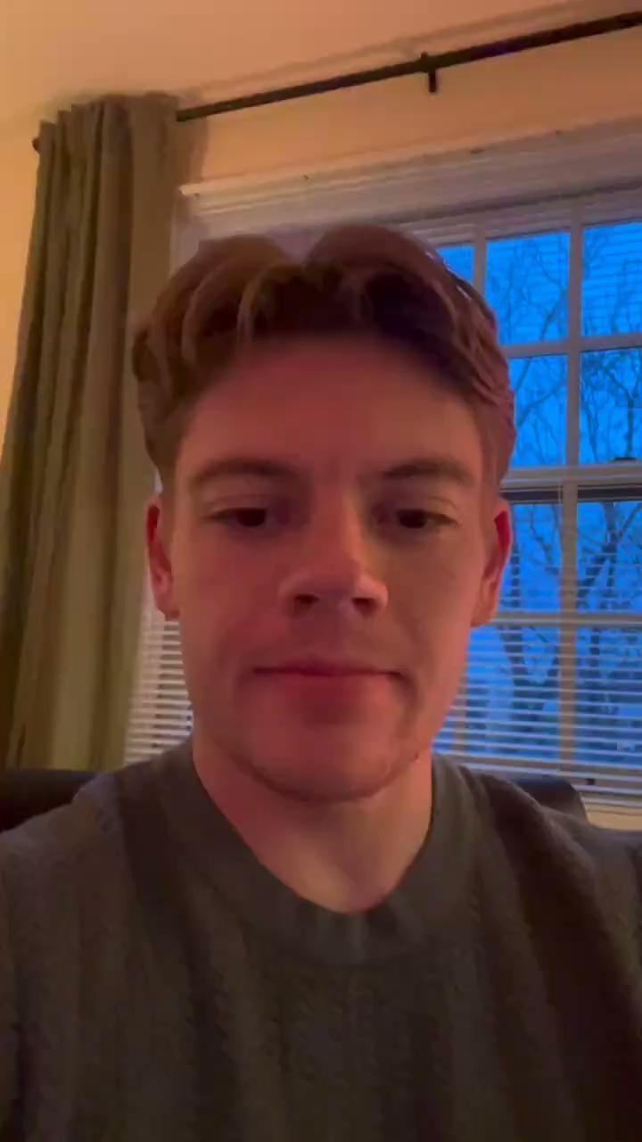
Sam

Slide 64
ASK QUESTIONS
  Do it!

Slide 65
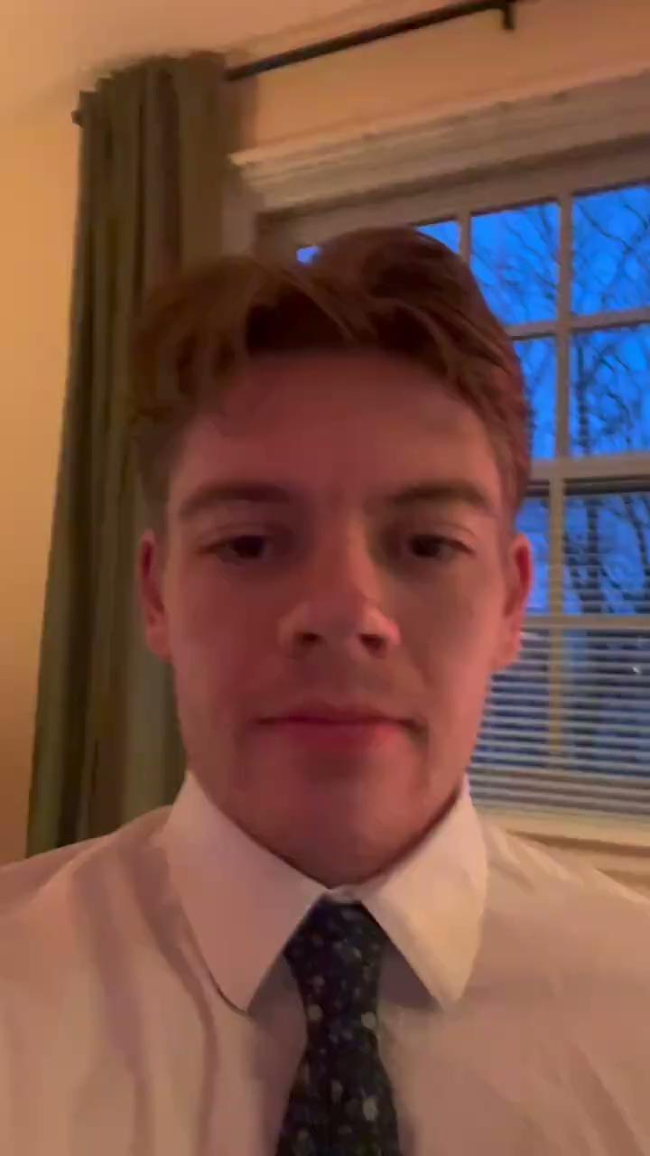
Sam

Slide 66
ASK QUESTIONS
  Do it!

Slide 67
HOW TO BE A STUDENT OF EVERYTHING

Slide 68

Learning what other people do in their departments

Slide 69
Learning what other people do in their departments
Learning who your stakeholders are

Slide 70
Learning what other people do in their departments
Learning who your stakeholders are
Learning who your clients are

Slide 71
Learning what other people do in their departments
Learning who your stakeholders are
Learning who your clients are
Learning who changes out the toilet paper in the office

Slide 72
As you go through your first week, write down each task you do
  Take notes on onboarding
    Helps your company improve the onboarding experience
At the end of the week, you can even check in with your manager and see if you’re missing anything!
  Don’t be scared to show them this, they’ll be impressed that you’ve taken this process so seriously

Slide 73
Ask what tasks you should start on
  Don’t be afraid to take on something big, as long as you’re being transparent and asking a lot of questions!

Slide 74
Chris
  Chicago, IL
  Galit (1 Michelin Star)
    Line Cook II

Slide 75
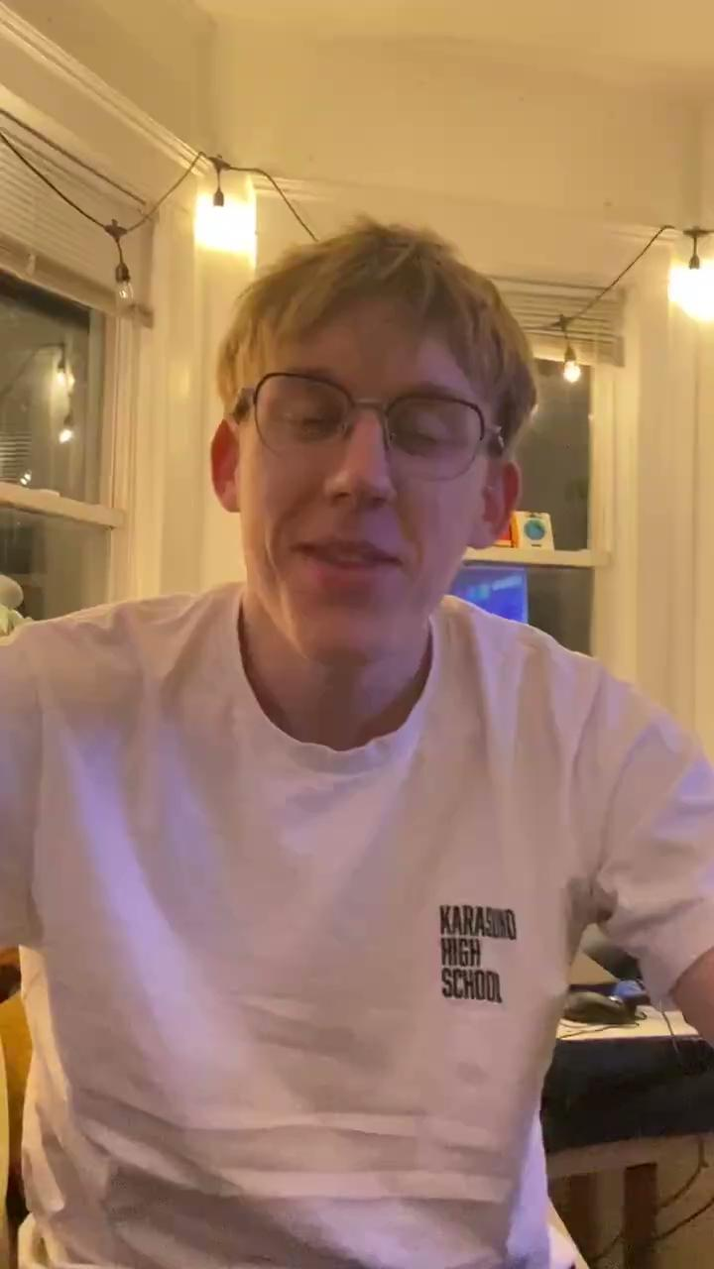
Chris

Slide 76
Do the scary stuff first
  Then you get to do the fun stuff afterwards

Slide 77


Slide 78
HOW TO END YOUR FIRST DAY

Slide 79

In-person:
  Shake your boss’s hand and thank you!
Virtual:
  Message your boss a nice message saying that you appreciate their support

Slide 80
Take a notebook!
  Write a list of all the questions that you have
You will be overwhelmed
  Take time to write a reflection

Slide 81
Be reflective
  It’s important to reflect on your work
  Keeping track of your work is great to track your growth short- and long-term
Your work will evolve
Use design-thinking on your first day
  Object mapping
  How to be human-centered
  Breaking through creative blocks
  Prototyping

Slide 82

Do not forget the little treat!

Slide 83

Pay Attention
Come Prepared
Do What You Need
Introduce Yourself
Use the Conversation Guide
Ask Questions
Keep Track of Your Work
Be A Student of Everything
Everything is a Prototype
Say Thanks and Get Ice Cream

Slide 84
Pay Attention
Come Prepared
Do What You Need
Introduce Yourself
Use the Conversation Guide
Ask Questions
Keep Track of Your Work
Be A Student of Everything
Everything is a Prototype
Say Thanks and Get Ice Cream
IMPLEMENT FEEDBACK

Slide 85
TAKE A BREATH

Slide 86
TAKE A SECOND BREATH

Slide 87
YOU’LL DO WELL

Slide 88
Katie
  Chicago, IL
  DePaul University
    Data Analyst

Slide 89
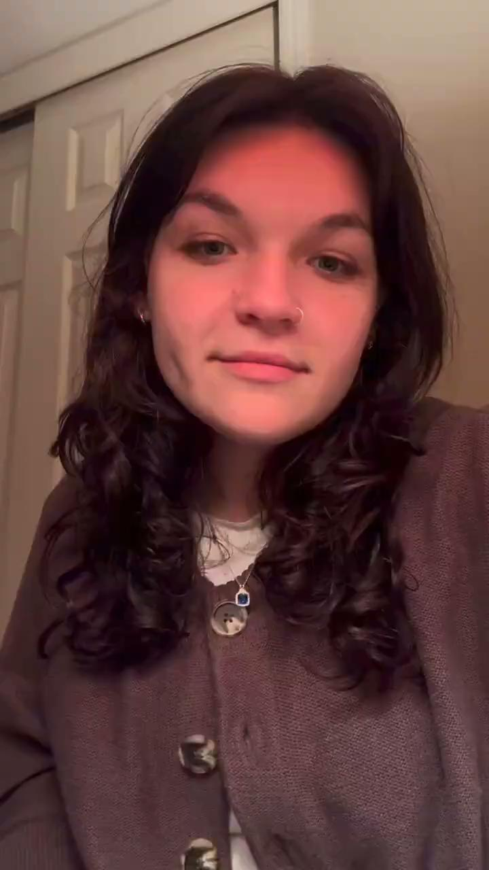
Katie

Slide 90
DO NOT

Slide 91
DO NOT
UNDER ANY CIRCUMSTANCES

Slide 92
DO NOT
UNDER ANY CIRCUMSTANCES
FORGET

Slide 93
DO NOT
UNDER ANY CIRCUMSTANCES
FORGET
THE

Slide 94
DO NOT
UNDER ANY CIRCUMSTANCES
FORGET
THE
LITTLE TREAT

Slide 95
YOU’LL DO WELL
:)

Slide 96
QUESTIONS?

