Slide 1
MWMU
Stoking Social Impact Across the Network
Sunday, 4.13.2025

Slide 2
Who am I?
Notes:
A lifelong community of people who believe in the power of design for social good.

Slide 3
DFA Journey
Graduated from UIUC!
  Urban Planning, Sustainable Design
  Minors: Sociology, Art & Design, Informatics
  Undergraduate Research Certificate
DFA for 8 years
  General Member, 2 years
  Managing Director, 2 years
  President, 1 year
  DFA UIUC Advisor, 1 year
  DFA Design Education Fellow, 1 year
  DFA Program Coordinator, 1 year

Slide 4

DFA Journey

Slide 5
DFA Journey
Social Benefits
  Great college social life
  Lifelong friends
    2 that I saw this week!
Skills
  Interdisciplinarity
  Collaboration
  Event Planning
  Leadership
  Project Management

Slide 6
Professional Journey
Jobs
  Design Strategist
    Siebel Center for Design 2019-2023
  Design Researcher
    Nemera Insight Innovation 2023-2024
  Design Consultant / Adjunct Lecturer 2024+
    Western Illinois University

Slide 7
Who is DFA?
Notes:
A lifelong community of people who believe in the power of design for social good.

Slide 8
Notes:
A lifelong community of people who believe in the power of design for social good.

Slide 9
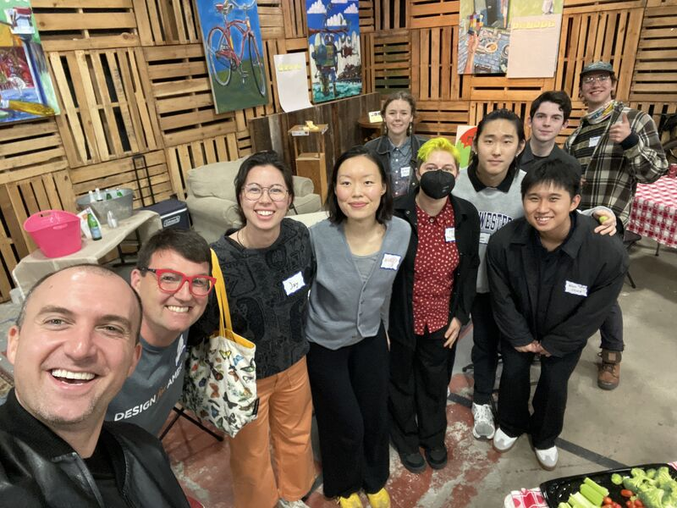
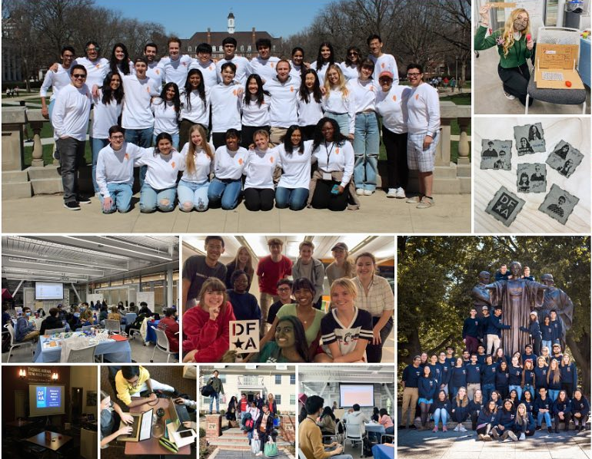
A Lifelong Community
SF Alumni Gathering 2025
Photos From Regional Meetups, 2022-2024

Slide 10
DFA by the Numbers
+1.5K
+10K
+81
Lifetime Institutions with a DFA Studio
Lifetime DFA Projects
DFA Alumni

Slide 11
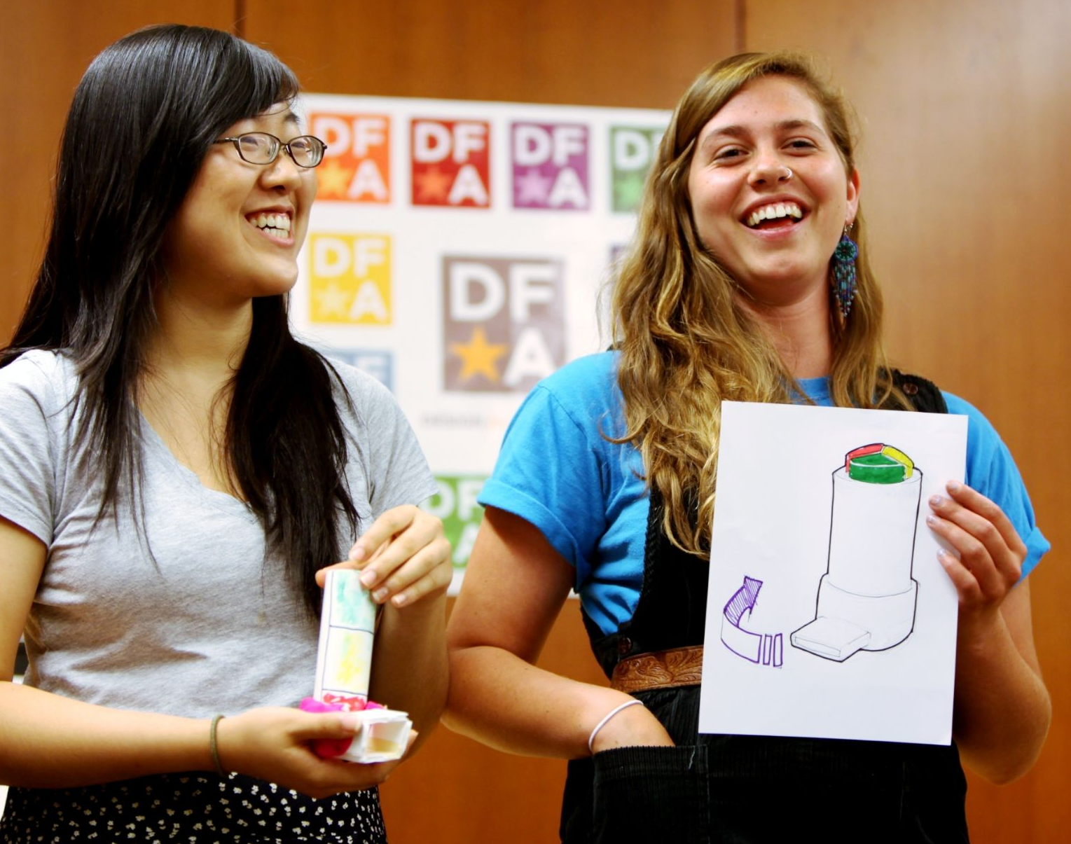
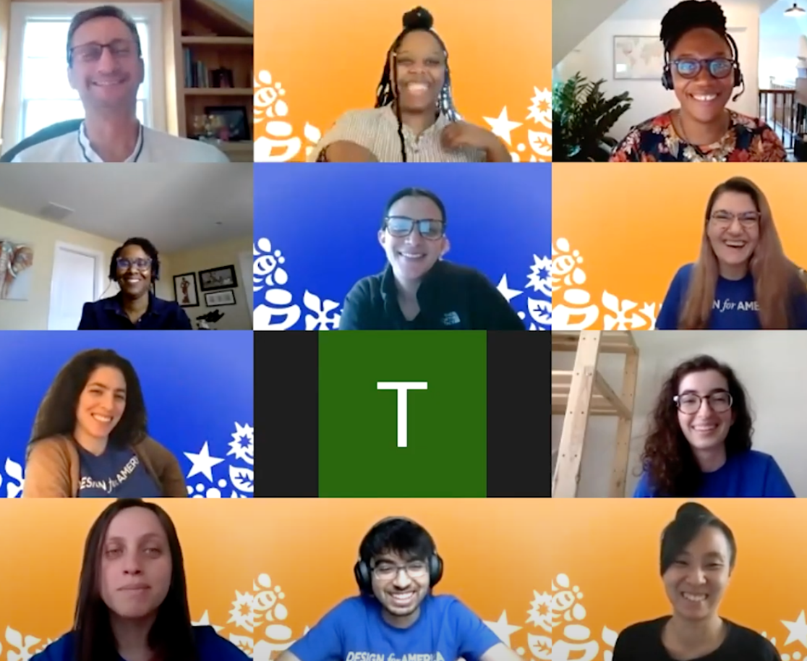


DFA Timeline
Founded at Northwestern University (2008)
Students want to be future-building changemakers
Based on community-centered, collaborative problem-solving
Organizations are hungry for emerging talent social innovators
Recognized and validated
Awarded 6 National Science Foundation grants 2012-2015
Affirmed DFA’s Logic Model and Theory of Change
Won 2018 National Design Excellence Award /
Cooper Hewitt Smithsonian Design Museum
Becomes a program of Watson Foundation (2020)
Mission alignment around confidence, perspective, and skills
Strategic planning - sustainability, broader reach and impact
Network stabilization and growth
Launches as an independent 501(c)(3) (2022)
Accelerating collaboration through a data-driven innovation platform
Sustained curiosity; reframing failure; comfort with ambiguity; systems thinking
Expanding campus model and deepening industry partnerships

Slide 12
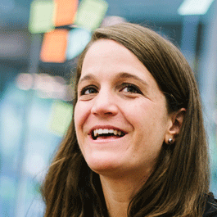
A Network for Impact
“Design for America is proof case for teaching across domains, that impact learning can happen 24/7, and not just in the classroom, and that the future of learning is networked and not contained to a single campus.
When Design for America started 10 years ago, we ambitiously called it that for two reasons: one, we wanted to design solutions to tackle social challenges across America and two, we wanted to do so by having teams across America working in their local communities.
We’ve imagined the day when our leaders use design for social good.”
Liz Gerber
DFA Faculty Founder
Notes:
Keep --
Campus
Community
Company

Slide 13
2024-2025

Slide 14
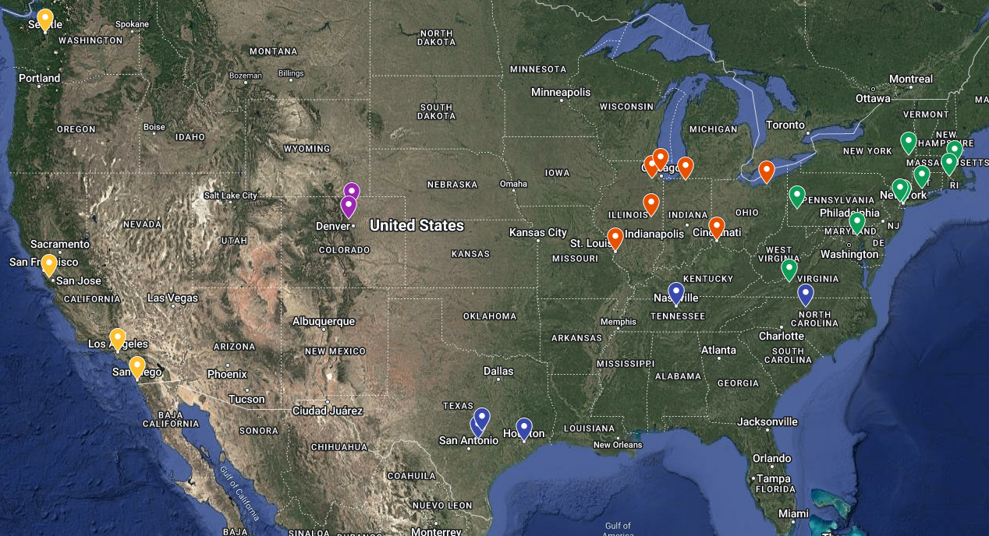
It starts with a college experience at one of our
25 (and growing) DFA campus studios
Anderson University
Carnegie Mellon U
Colgate University
CWRU | CIA
Barnard | Columbia
Illinois College
JHU | MICA
MIT
NYU
ND | HC | SMC
Northwestern
RISD | Brown
Rice University
Rutgers University
Stanford University
UC San Diego
U of Cincinnati
UI Urbana-Champaign
U of Notre Dame
U of Washington
Vanderbilt University
WIU
Yale

Slide 15
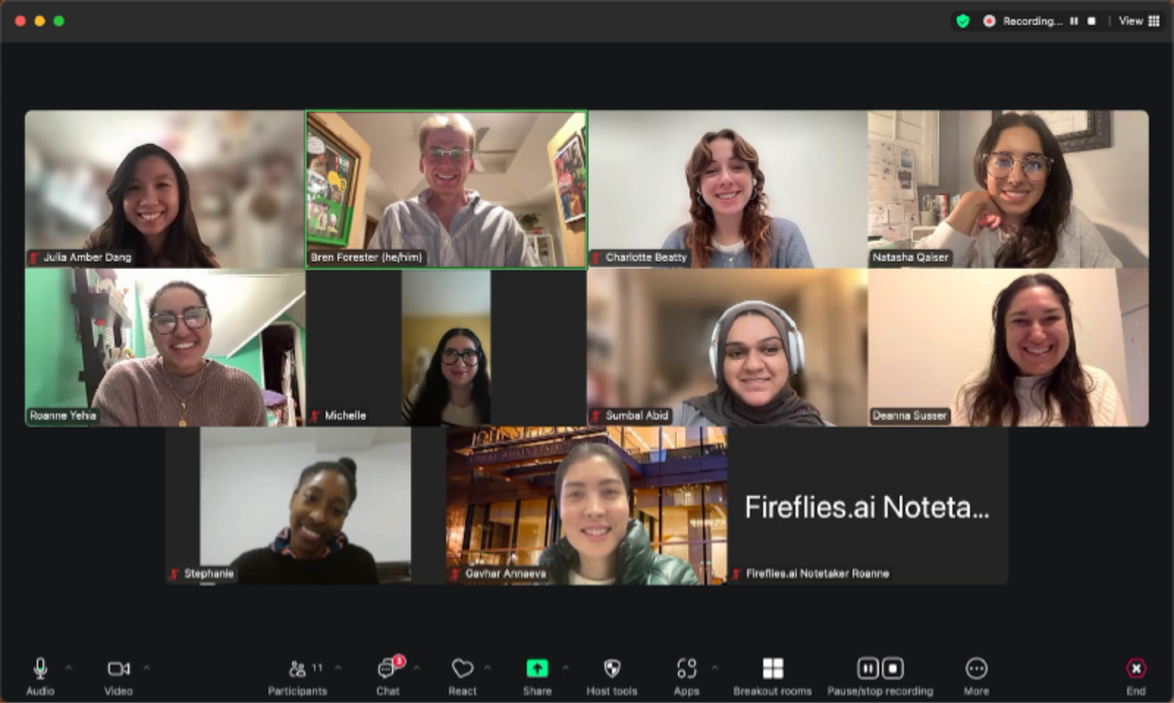
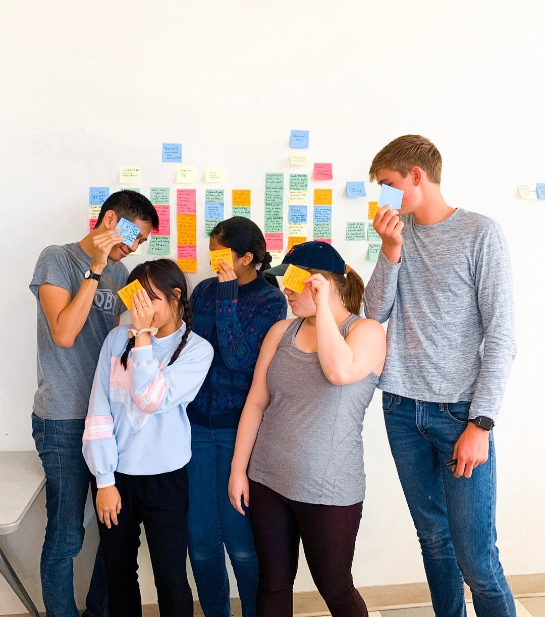
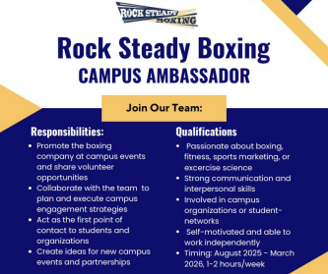
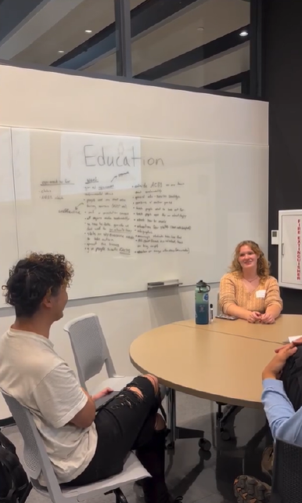
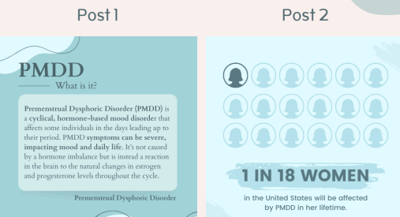

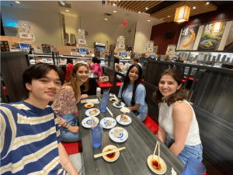
Over 50 Projects in Fall 2024!
Notes:
JHU | MICA, Notre Dame, Rice, UIUC

Slide 16
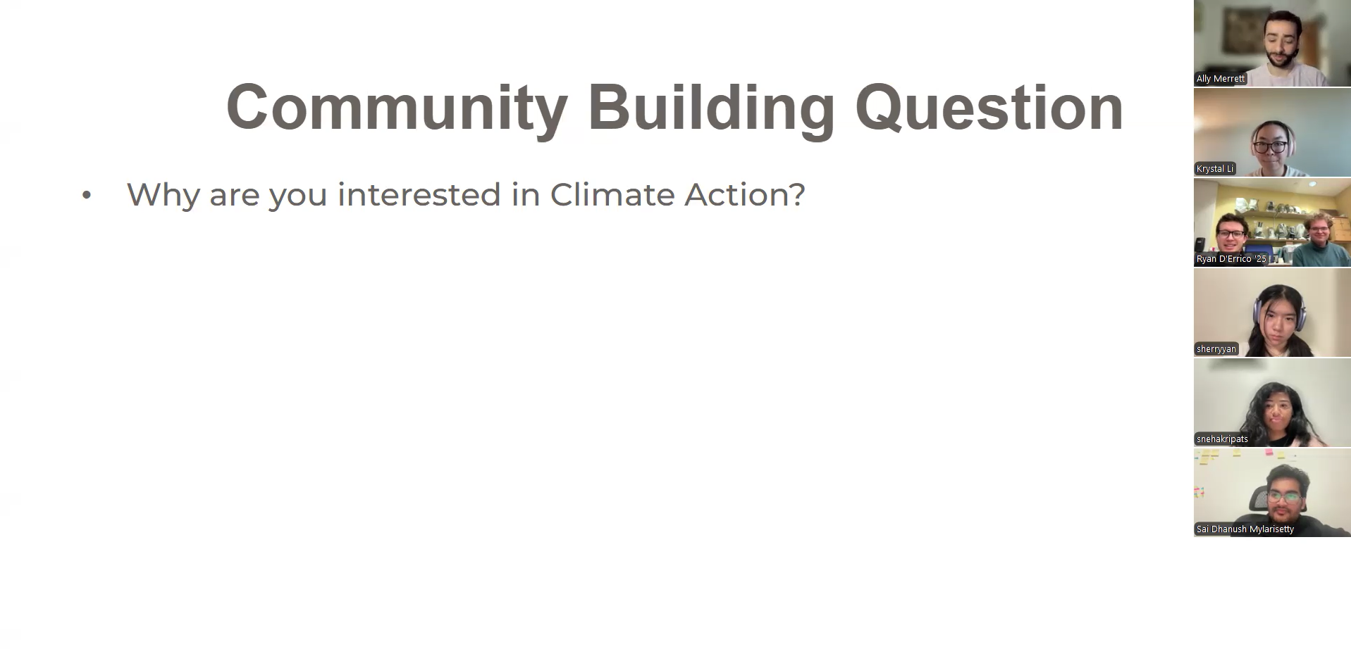
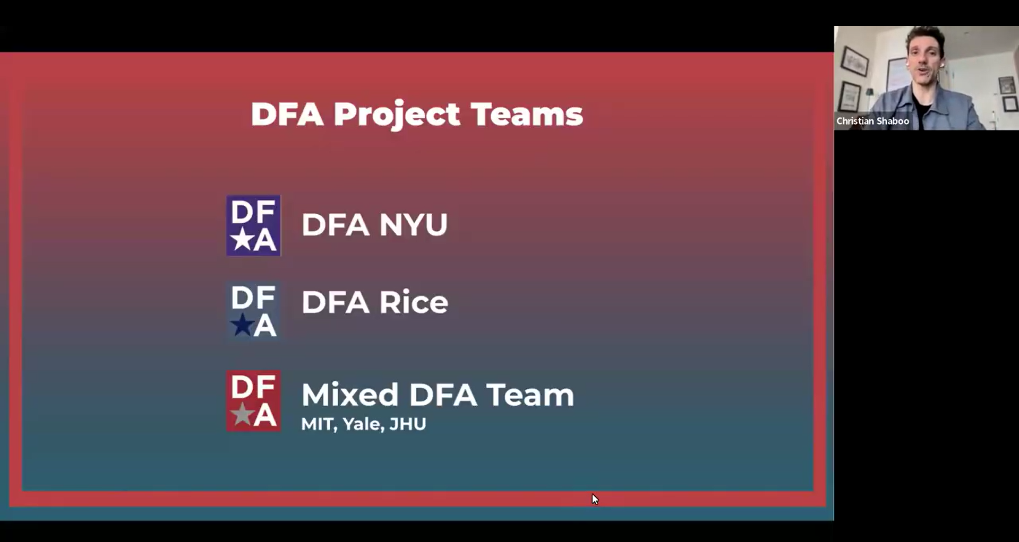
SP25 National Projects
Climate Action
MaineHealth
Notes:
NYU, Colgate, MIT, Stanford, Yale, JHU | MICA, Rice

Slide 17
SP25 National Projects
Studio Focused Project
Themed Challenges
Extra Funding
Robust Mentorship
Sponsored Projects
Specific Challenges
Stricter Timelines
External Partners
Addressing climate action on individual campuses through behavioral change, environmental clean-up, or awareness campaigns.
Explore and address inpatient mobility challenges, specifically focusing on adults over 50, within Maine Health’s medical psychiatric patient population.
Notes:
NYU, Colgate, MIT, Stanford, Yale, JHU | MICA, Rice

Slide 18
DFA Summer 25 Project with Falling Fruit
Design for America is excited to announce an 8-week national project with global nonprofit, Falling Fruit
  a massive, collaborative map of the urban harvest.
Ethan Welty co-created Falling Fruit in 2013 to promote urban foraging worldwide.
This project is open to current DFA members, DFA alums and DFA community members
  This project will begin the week of May 19th and wrap the week of July 14th

Slide 19
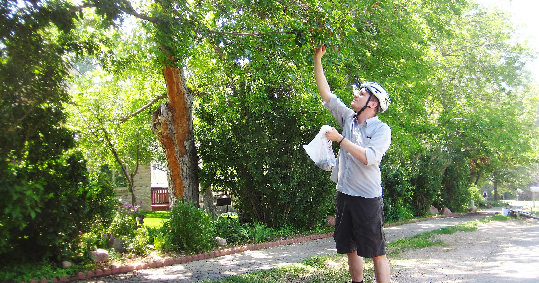
DFA Summer Project with Falling Fruit
Interested in learning more?
Complete this initial interest form and
we'll follow-up with additional information.

Slide 20


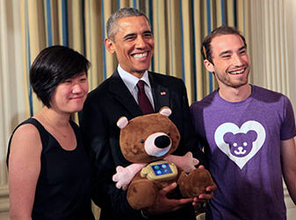
We Tackle Meaningful Challenges
Notes:
Pair eyeware - https://www.swipesense.com/
Swipe Sense - https://paireyewear.com/
Jerry the Bear - https://design.northwestern.edu/news-events/articles/2015/jerry-the-bear-white-house-demo-day.html

Slide 21

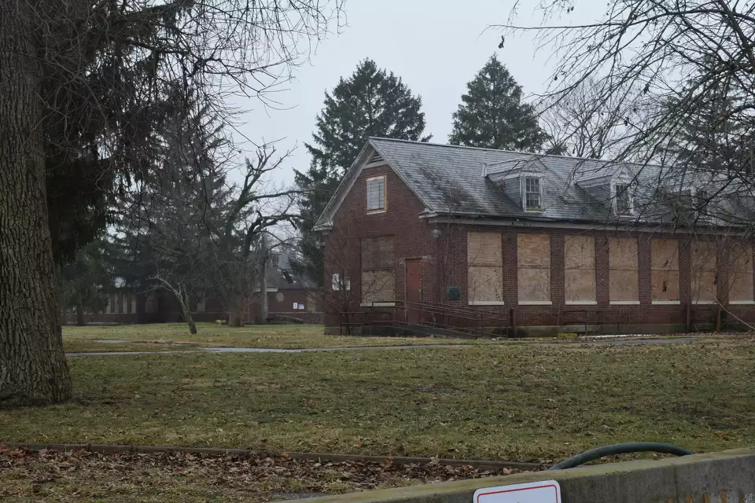

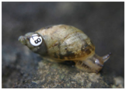
We Tackle Meaningful Challenges
Notes:
Colgate
Illinois College
Me!

Slide 22
Who’s Graduating Soon?

Slide 23
Legacy
What kind of legacy do you want to leave in DFA?
  At your school?
  With your friends?
  On the world?

Slide 24
What a busy weekend!

Slide 25
Step 1
Think about a relationship or an instance from this weekend that brought you joy

Slide 26
Step 1
Think about a relationship or an instance from this weekend that brought you joy
Discuss this in pairs

Slide 27
Step 2
Think about what kind of person you are in that moment

Slide 28
Step 2
Think about what kind of person you are in that moment
Discuss this in pairs

Slide 29
Step 3
Think about how you can bring that version of yourself back to your classes, your job, and your other relationships

Slide 30
Step 3
Think about how you can bring that version of yourself back to your classes, your job, and your other relationships
Discuss this in pairs

Slide 31
Step 3
Thoughts?

Slide 32
How has DFA Impacted You?

Slide 33
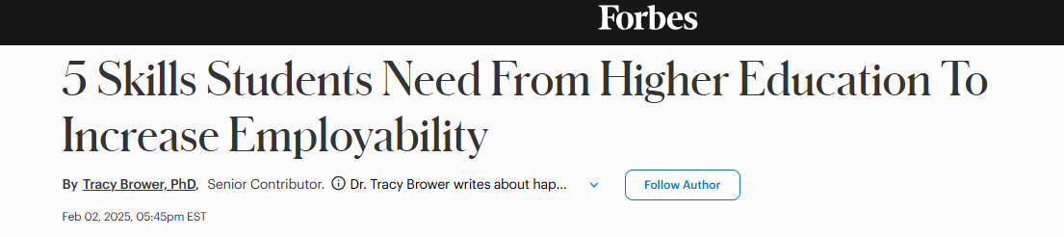
Real-World Experience
Global Mindset
Interaction Skills / Collaboration
Tech Fluency
Career & Degree Coaching
Notes:
https://www.forbes.com/sites/tracybrower/2025/02/02/5-skills-students-need-from-higher-education-to-increase-employability/

Slide 34
Real-World Experience
Global Mindset
Interaction Skills / Collaboration
Tech Fluency
Career & Degree Coaching
Notes:
https://www.forbes.com/sites/tracybrower/2025/02/02/5-skills-students-need-from-higher-education-to-increase-employability/

Slide 35
Real-World Experience
Global Mindset
Interaction Skills / Collaboration
Tech Fluency
Career & Degree Coaching
Notes:
https://www.forbes.com/sites/tracybrower/2025/02/02/5-skills-students-need-from-higher-education-to-increase-employability/

Slide 36
Real-World Experience
Global Mindset
Interaction Skills / Collaboration
Tech Fluency
Career & Degree Coaching
Notes:
https://www.forbes.com/sites/tracybrower/2025/02/02/5-skills-students-need-from-higher-education-to-increase-employability/

Slide 37
Real-World Experience
Global Mindset
Interaction Skills / Collaboration
Tech Fluency
Career & Degree Coaching
Notes:
https://www.forbes.com/sites/tracybrower/2025/02/02/5-skills-students-need-from-higher-education-to-increase-employability/

Slide 38
Real-World Experience
Global Mindset
Interaction Skills / Collaboration
Tech Fluency
Career & Degree Coaching
Notes:
https://www.forbes.com/sites/tracybrower/2025/02/02/5-skills-students-need-from-higher-education-to-increase-employability/

Slide 39
You Are The Important Ones!

Slide 40
National’s Vision
Without student leaders, there are no studios
Without the studios, there are no projects
Without projects, students are not building skills
Without building skills, students don’t become interdisciplinary and professionally-minded.
Without these interdisciplinary and professionally-minded students, what will happen to the world?
  Our goal is student success!
Notes:
https://www.forbes.com/sites/tracybrower/2025/02/02/5-skills-students-need-from-higher-education-to-increase-employability/

Slide 41
National’s Vision
Studio Sustainability
Career Ready Skills
Strong Alumni
Notes:
https://www.forbes.com/sites/tracybrower/2025/02/02/5-skills-students-need-from-higher-education-to-increase-employability/

Slide 42
National’s Vision
Studio Sustainability
Community & Engagement
  Students learn to tackle complex, ambiguous challenges using design thinking
  Strong relationships on campus / in the community keep the studio visible, supported, connected to real-world challenges
Notes:
https://www.forbes.com/sites/tracybrower/2025/02/02/5-skills-students-need-from-higher-education-to-increase-employability/

Slide 43
National’s Vision
Career-Ready
Human-Centered Skill Building
  Students learn to tackle complex, ambiguous challenges using design thinking
  They practice framing problems, generating insights, and testing solutions
    Skills that translate directly to innovation and strategy roles across industries.
Notes:
https://www.forbes.com/sites/tracybrower/2025/02/02/5-skills-students-need-from-higher-education-to-increase-employability/

Slide 44
National’s Vision
Career-Ready
Teamwork & Leadership
  Whether leading a team or contributing as a collaborator, students gain hands-on experience managing timelines, navigating group dynamics, and driving work forward
    All in real-world, often cross-disciplinary settings.
Notes:
https://www.forbes.com/sites/tracybrower/2025/02/02/5-skills-students-need-from-higher-education-to-increase-employability/

Slide 45
National’s Vision
Career-Ready
Communication & Stakeholder Engagement
  From presenting to partners to facilitating with community members, students build confidence in communicating ideas clearly and persuasively—both visually and verbally
  These soft skills are consistently among the top qualities employers seek
Notes:
https://www.forbes.com/sites/tracybrower/2025/02/02/5-skills-students-need-from-higher-education-to-increase-employability/

Slide 46
National’s Vision
Strong Alumni Base
They’re Career Ready
  DFA alumni graduate with in-demand skills in human-centered design, leadership, and collaboration
  Ready to make an impact in the workplace and beyond
Notes:
https://www.forbes.com/sites/tracybrower/2025/02/02/5-skills-students-need-from-higher-education-to-increase-employability/

Slide 47
National’s Vision
Strong Alumni Base
They’re Rooted in Purpose
  Alumni leave DFA with a deep sense of purpose and a commitment to using design for social good
  Values that continue to guide them long after graduation
Notes:
https://www.forbes.com/sites/tracybrower/2025/02/02/5-skills-students-need-from-higher-education-to-increase-employability/

Slide 48
National’s Vision
Strong Alumni Base
They Give Back
  Many alumni return to mentor, recruit, and support current students
  Creating a powerful cycle of support that keeps DFA growing and evolving across generations.
Notes:
https://www.forbes.com/sites/tracybrower/2025/02/02/5-skills-students-need-from-higher-education-to-increase-employability/

Slide 49
Q & A

