Slide 1
JHU | MICA Design-Thinking Conference
Ally Merrett, Studio Wizard
03.29.2025
Notes:
Intro activities:
Gather a marker and paper/stickies
Go to MURAL home page and play around, introduce yourself
Update zoom name: F Name _ University
Introduce in chat – where are you calling in from?
----
Hi, welcome!
So excited to be here
My name is ____ From the _____ studio. In my day-to-day work, I mentor students in design and leadership, I also work with students and faculty to launch new studios!
Typically I’d be flying out to visit all of the new campuses who are launching a DFA studio.
It’s great that we can gather virtually today, to show the power and diversity of the Network—you’re not just one student on one campus trying to make an impact. There’s an entire community of people just like you, who want to learn design and use your awesome talents and skills to make the world a better place.

Slide 2
Who is DFA?
Notes:
A lifelong community of people who believe in the power of design for social good.

Slide 3
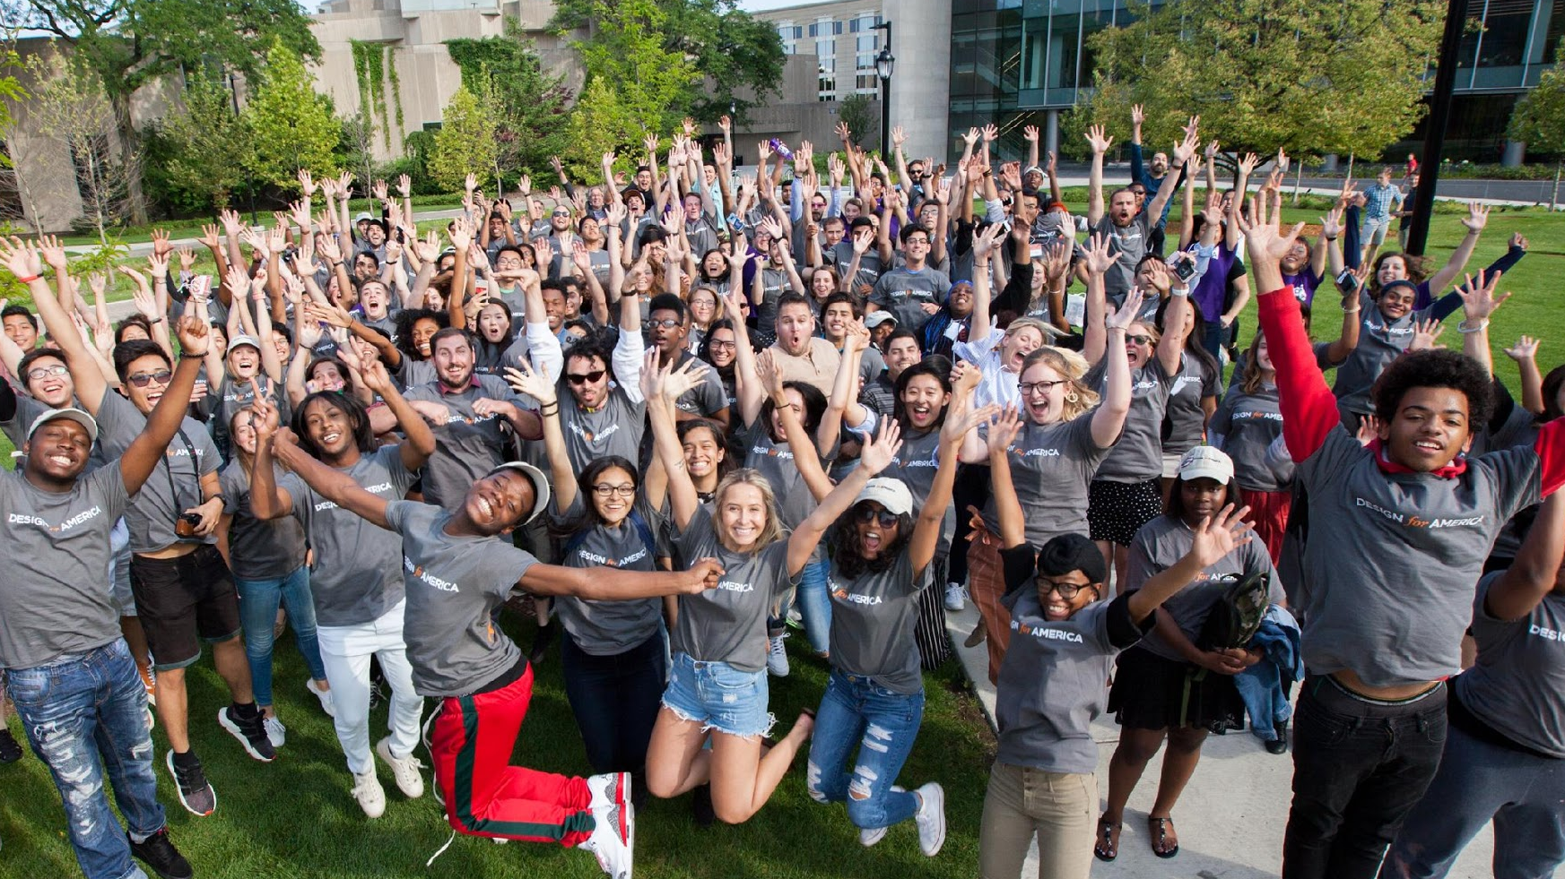
A lifelong community of people who believe in design for social good!

Slide 4
Design for America (DFA) is a registered non-profit organization that supports a nationwide network of student-led studios based at colleges and universities across the United States.

Slide 5
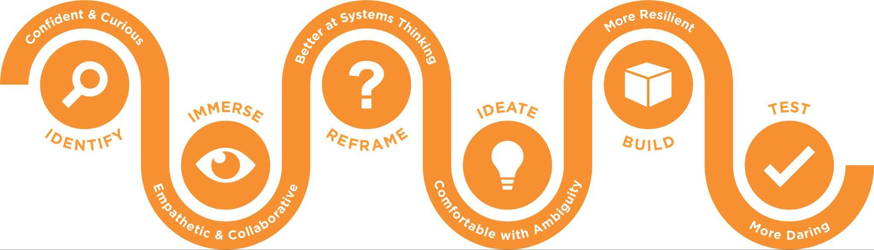
What We Do
Student-led studios are the heart of DFA, serving as nodes of community, design education, and impact across the U.S. Historically DFA-ers from 140 different majors use interdisciplinary design frameworks to tackle community challenges and co-create a better future with support from a network of over 10,000 mentors, partners, and fans.

Slide 6
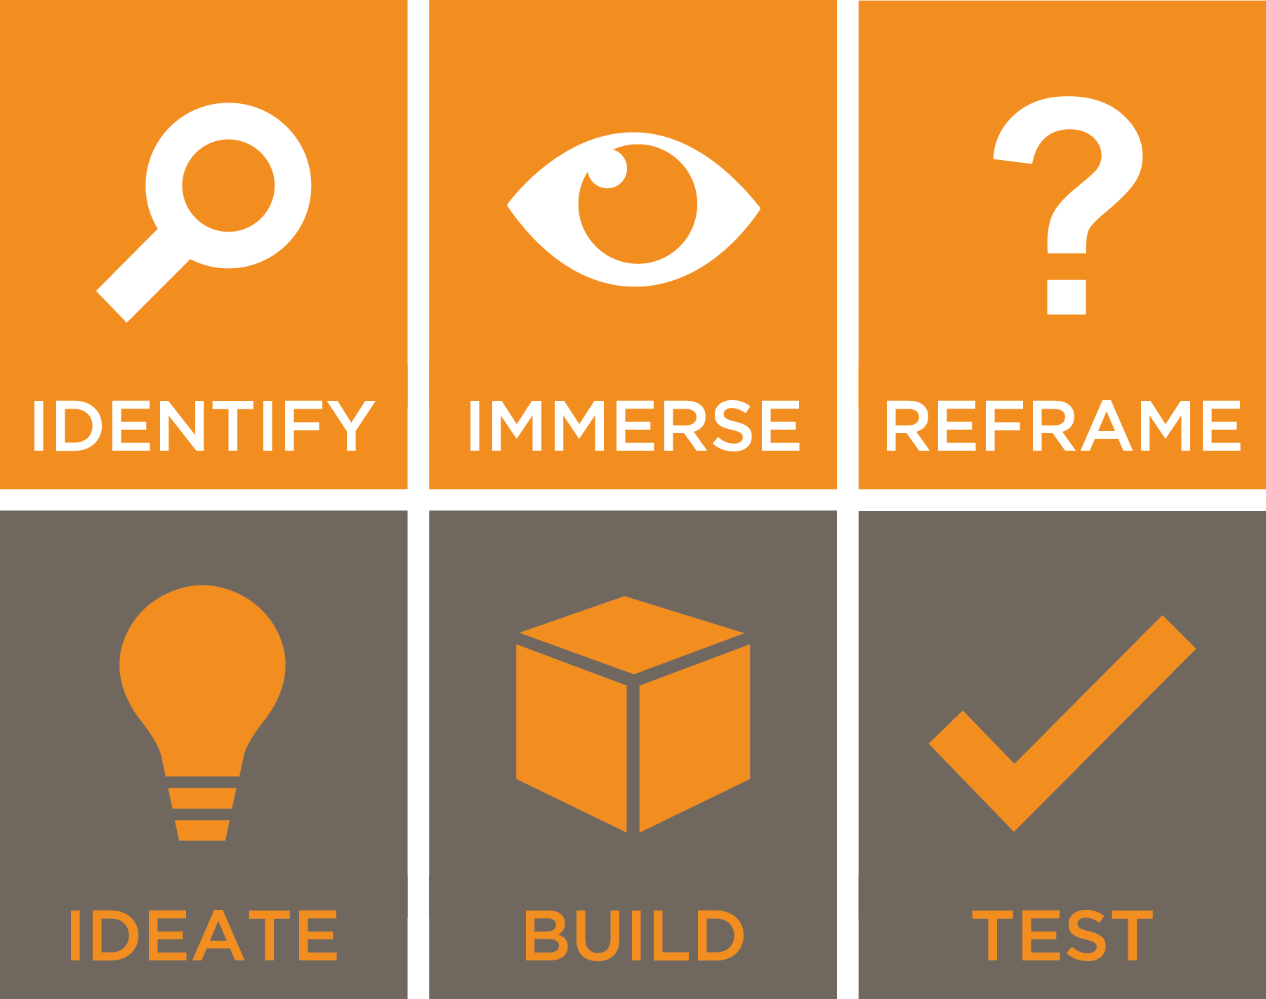
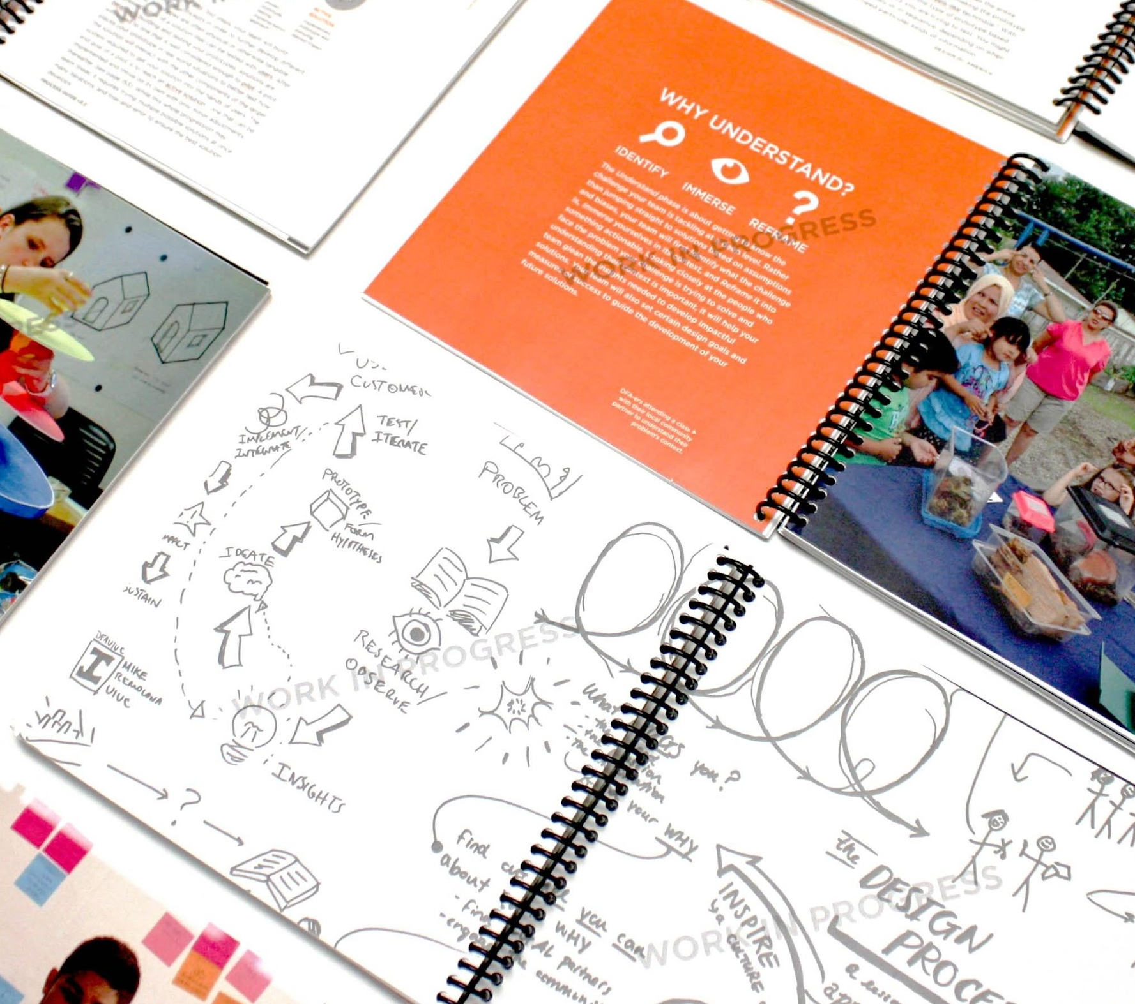
DFA Students Learn Design Thinking
Notes:
Picture of resources and tools

Slide 7

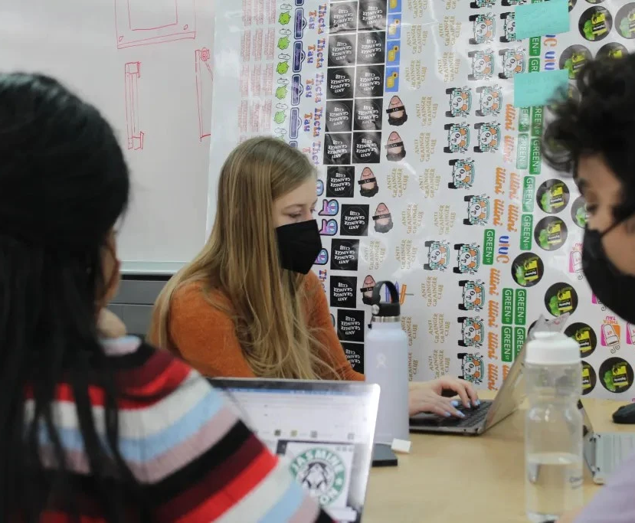
In Interdisciplinary Teams

Slide 8


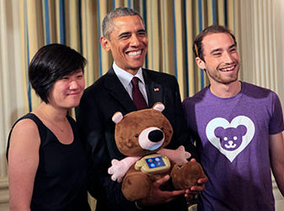
To Tackle Meaningful Challenges
Notes:
Pair eyeware - https://www.swipesense.com/
Swipe Sense - https://paireyewear.com/
Jerry the Bear - https://design.northwestern.edu/news-events/articles/2015/jerry-the-bear-white-house-demo-day.html

Slide 9
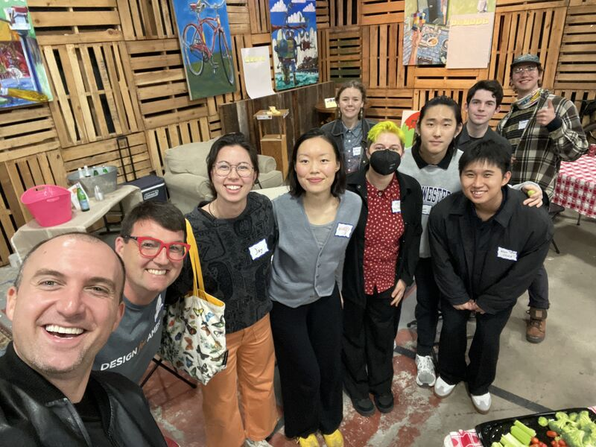
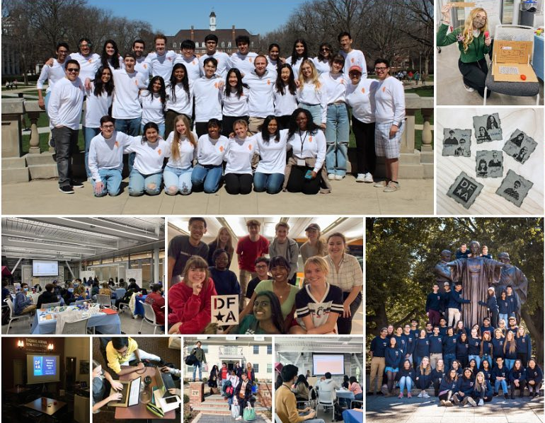
And Build a Lifelong Community
SF Alumni Gathering 2025
Photos From Regional Meetups, 2022-2024

Slide 10
DFA by the Numbers
+1.5K
+10K
+81
Lifetime Institutions with a DFA Studio
Lifetime DFA Projects
DFA Alumni

Slide 11
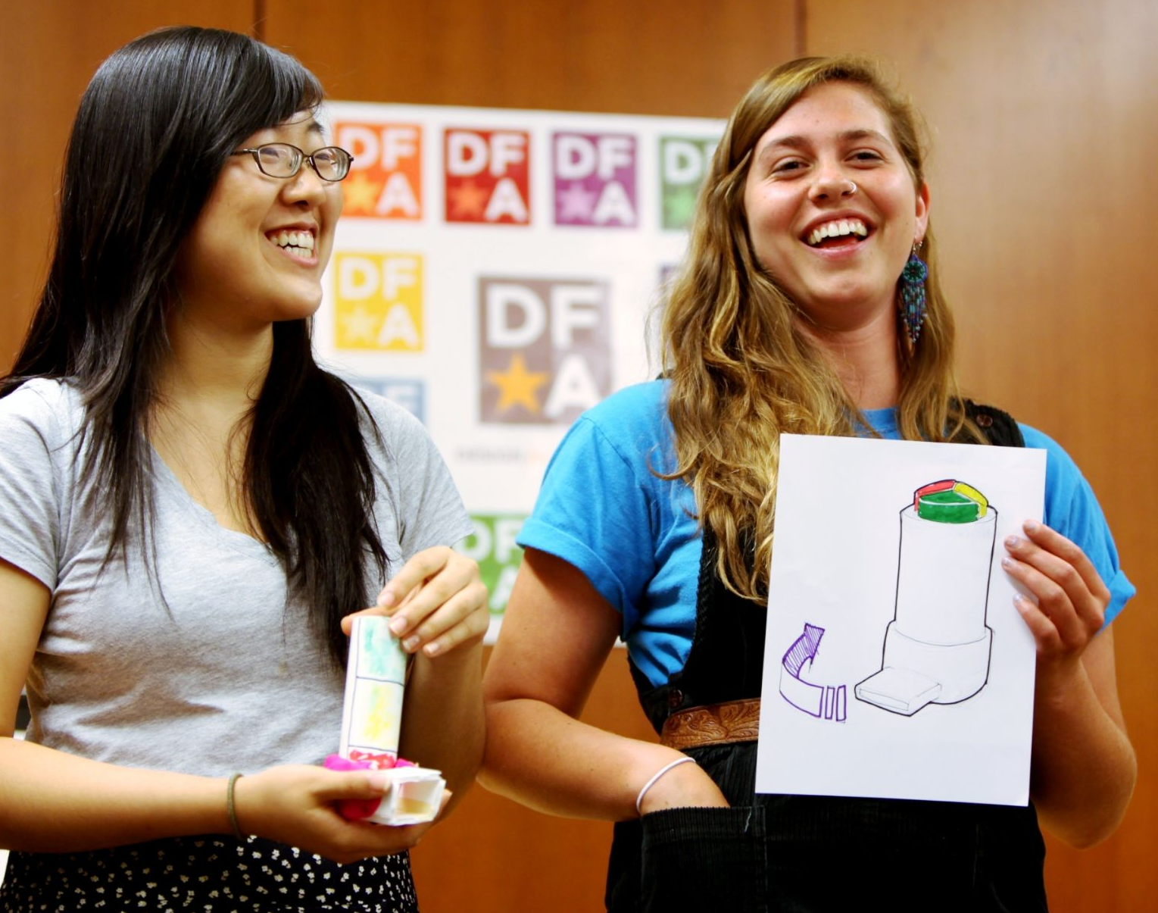
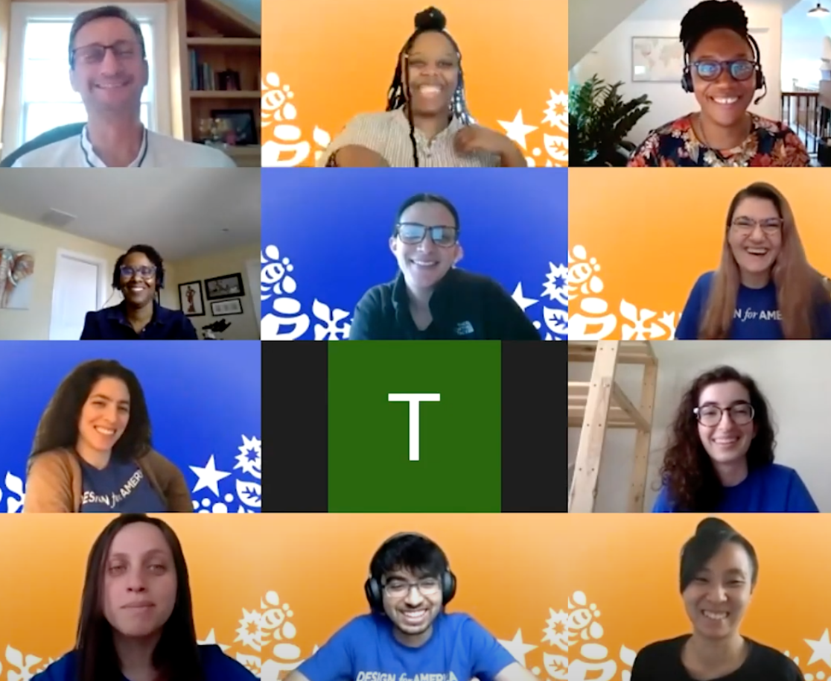
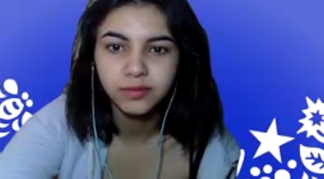

DFA Timeline
Founded at Northwestern University (2008)
Students want to be future-building changemakers
Based on community-centered, collaborative problem-solving
Organizations are hungry for emerging talent social innovators
Recognized and validated
Awarded 6 National Science Foundation grants 2012-2015
Affirmed DFA’s Logic Model and Theory of Change
Won 2018 National Design Excellence Award /
Cooper Hewitt Smithsonian Design Museum
Becomes a program of Watson Foundation (2020)
Mission alignment around confidence, perspective, and skills
Strategic planning - sustainability, broader reach and impact
Network stabilization and growth
Launches as an independent 501(c)(3) (2022)
Accelerating collaboration through a data-driven innovation platform
Sustained curiosity; reframing failure; comfort with ambiguity; systems thinking
Expanding campus model and deepening industry partnerships

Slide 12
DFA Competencies and Skills

Slide 13
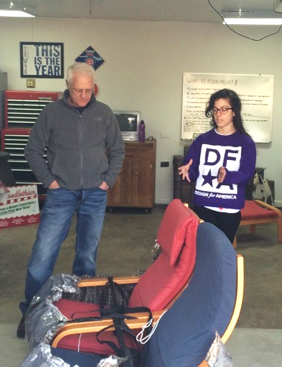
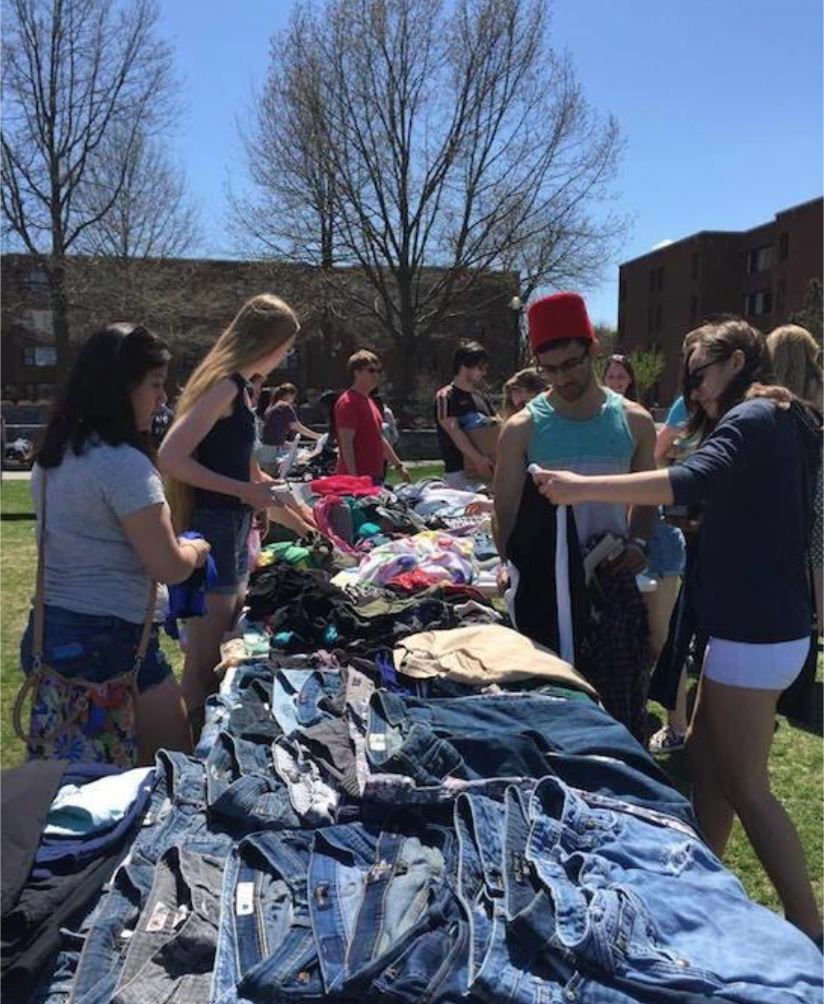
Curious
DFA-ers show interest in learning about community challenges and exploring root causes
Skills:
System Thinking
Comfort w/ ambiguity
DFA Student Projects

Slide 14
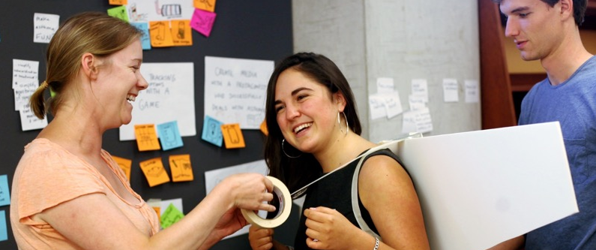
Collaborative
Works with diverse people to build trust and develop ideas together
Skills: Active Listening; dialog across diversity
A DFA team prototyping a backpack

Slide 15
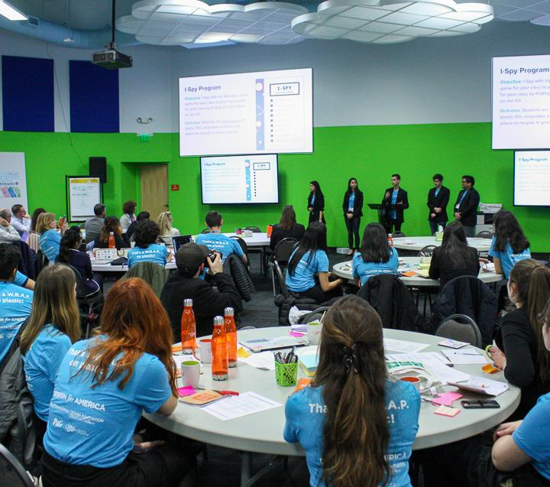
Courageous
Advances values, beliefs, and vision despite what might be expected
Skills:
Challenging assumptions
Taking risks
Left: SP19 YMCA Lifeguard Recruitment
Right: P&G|FFRG Plastic Recycling
Sponsored National Projects

Slide 16
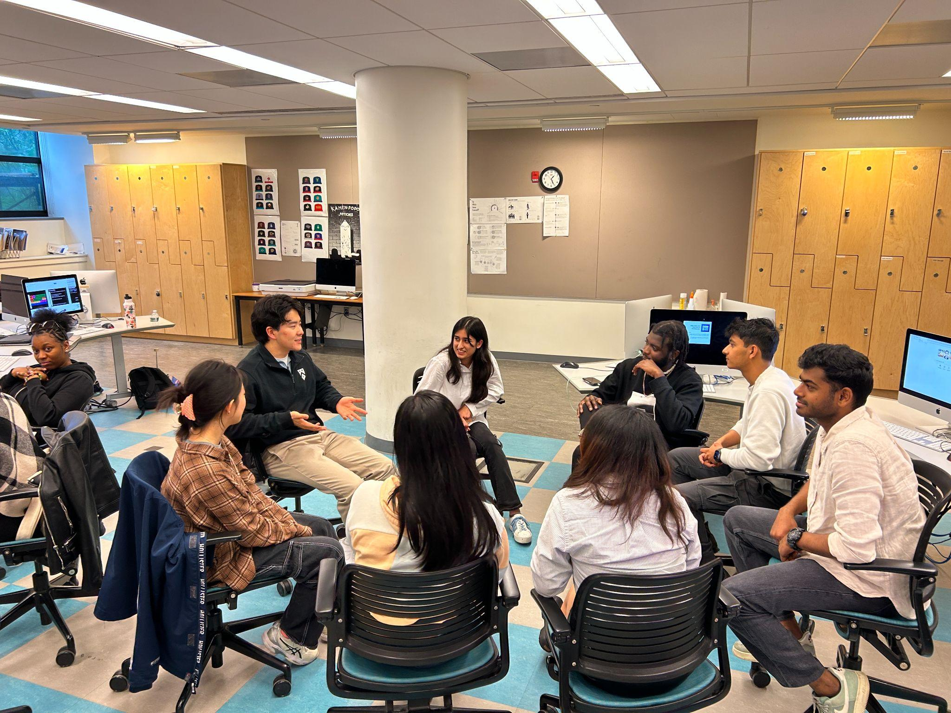
Catalyzing (Community Engaged)
Brings about positive change with community
Skills:
Situational awareness
Cultural inquiry
Taking action
Northeast Studio Meetup 2023

Slide 17

DFA Lasts Beyond the College Experience
36 Alumni Mentors
12 Alumni Fellows
6 DFA Initiatives
“I am a firm believer in the potential DFA has to nurture a new generation of thoughtful, socially-minded designers. It's an honor to help further the DFA mission and meet more people across the DFA network!”
Joel Yong
School: Rhode Island School of Design
Concentration: Industrial and Product Design
Specialty: Community Partnerships
Notes:
Fellowship Program

Slide 18
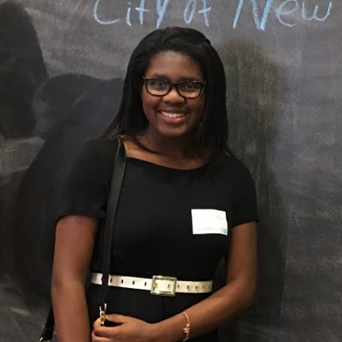
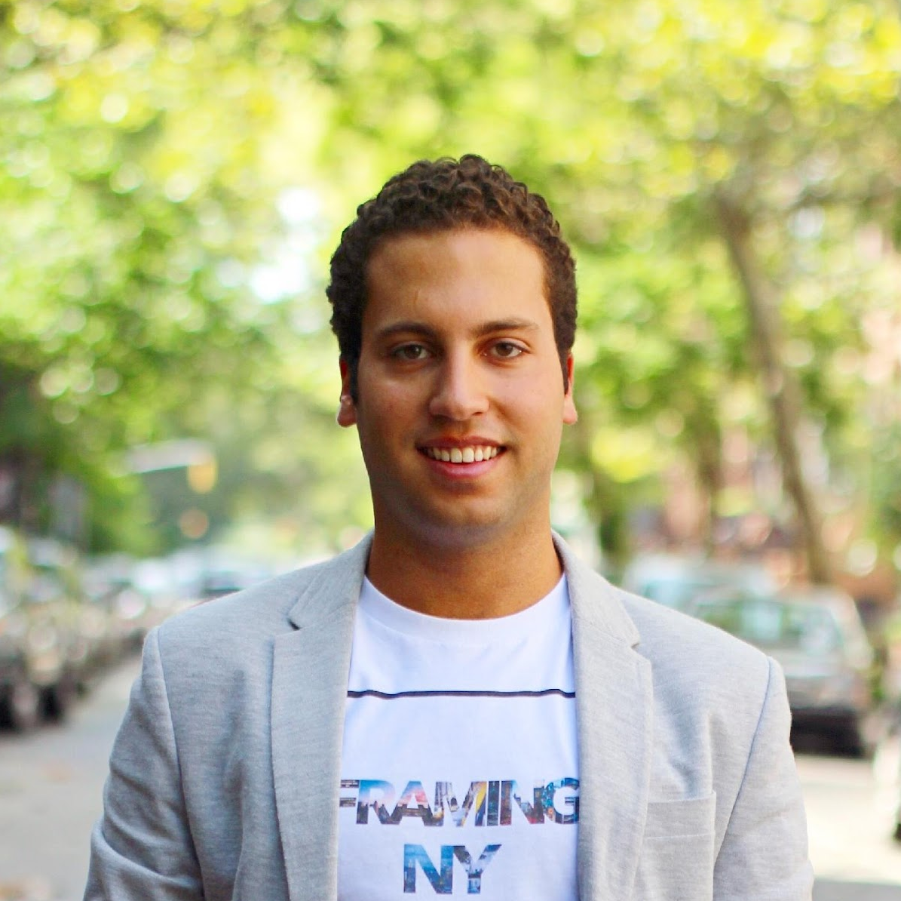

DFA Prepares the Next Generation for a Lifetime of Designing for Social Good
“Joining DFA was the best decision I ever made. It made me realize my love for social entrepreneurship and helped me discover my passion for design thinking.”
Bailee Irvine, DFA Barnard|Columbia
“DFA was the single-most pivotal learning experience I had in college.”
Andrew Demas, DFA Alum, Associate Partner, IBM ix
“DFA is the only national organization that gives students the skills of collaboration, communication, interdisciplinary work and making real impact in communities.”
Matthew Wettergreen, DFA Mentor and Associate Teaching Professor, Rice University

Slide 19












No Matter Where They Work
Notes:
And note range of roles - engineer to md! Teacher to xxx
Some are also entrepreneurs -- likely Liz to note SwipeSense + SC Johnson...

Slide 20
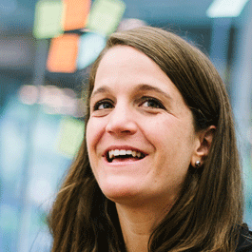
A Network for Impact
“Design for America is proof case for teaching across domains, that impact learning can happen 24/7, and not just in the classroom, and that the future of learning is networked and not contained to a single campus.
When Design for America started 10 years ago, we ambitiously called it that for two reasons: one, we wanted to design solutions to tackle social challenges across America and two, we wanted to do so by having teams across America working in their local communities.
We’ve imagined the day when our leaders use design for social good.”
Liz Gerber
DFA Faculty Founder
Notes:
Keep --
Campus
Community
Company

Slide 21
2024-2025

Slide 22
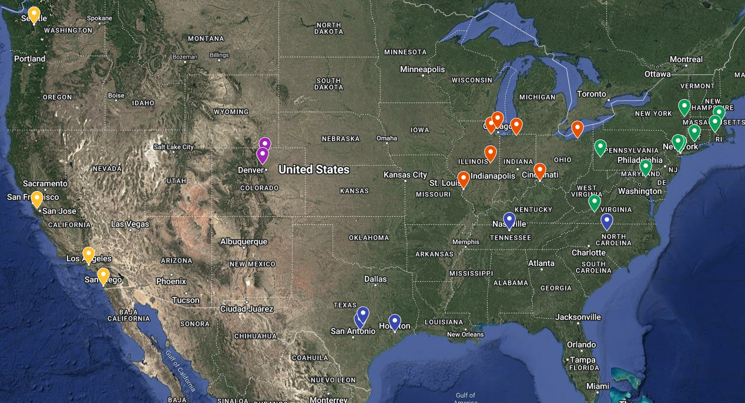
It starts with a college experience at one of our
30 (and growing) DFA campus studios
Anderson University
Beloit College
Carnegie Mellon U
Colgate University
CWRU | CIA
Barnard | Columbia
Elon University
Fordham University
Illinois College
JHU | MICA
MIT
NYU
ND | HC | SMC
Northwestern
Ohio State
RISD | Brown
Rice University
Rutgers University
Stanford University
Texas State
UC San Diego
U of Cincinnati
UI Urbana-Champaign
U of Notre Dame
U of Washington
UT Austin
Vanderbilt University
Virginia Polytechnic WashU in St. Louis
WIU
Yale

Slide 23
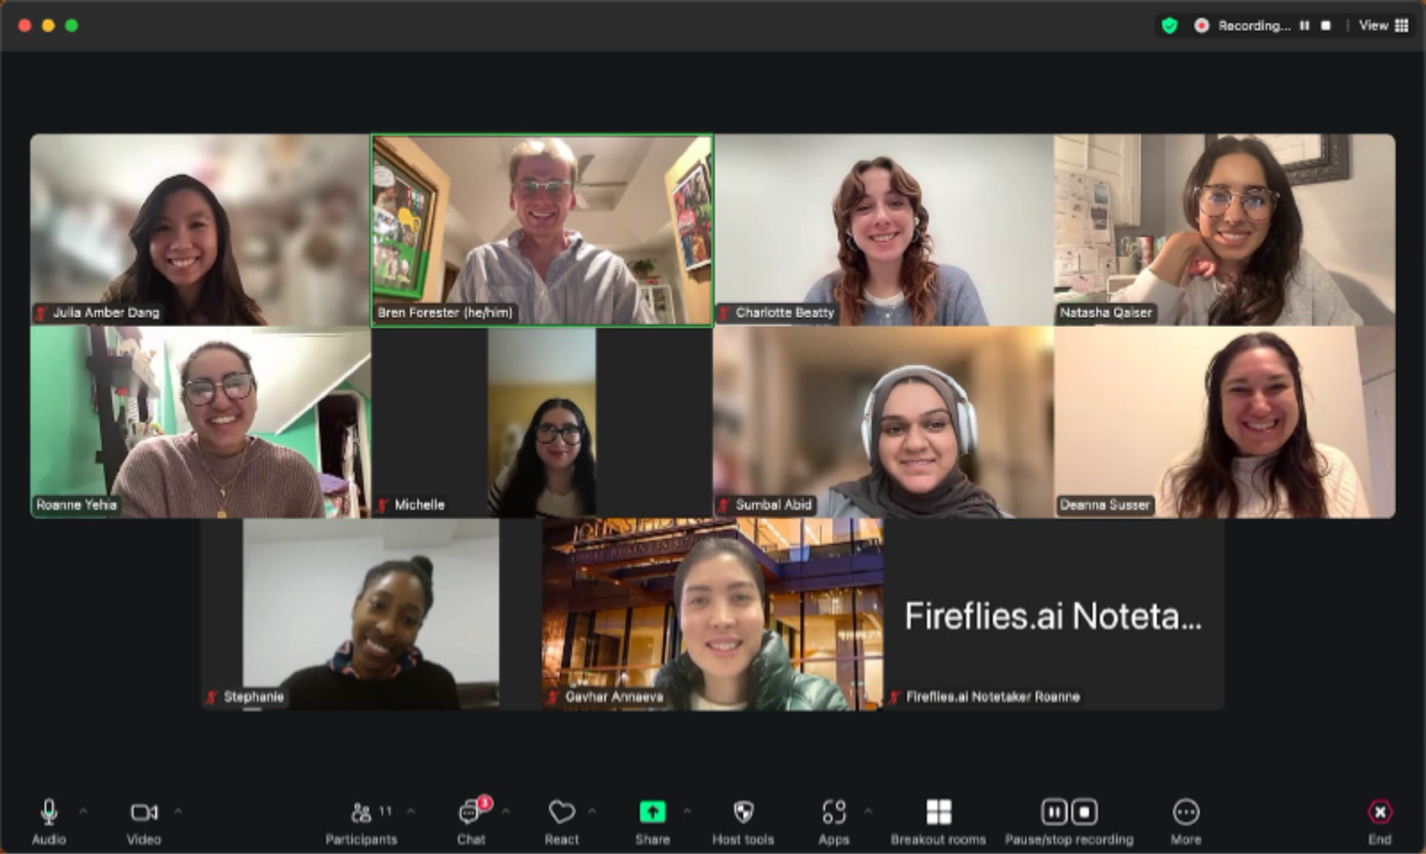
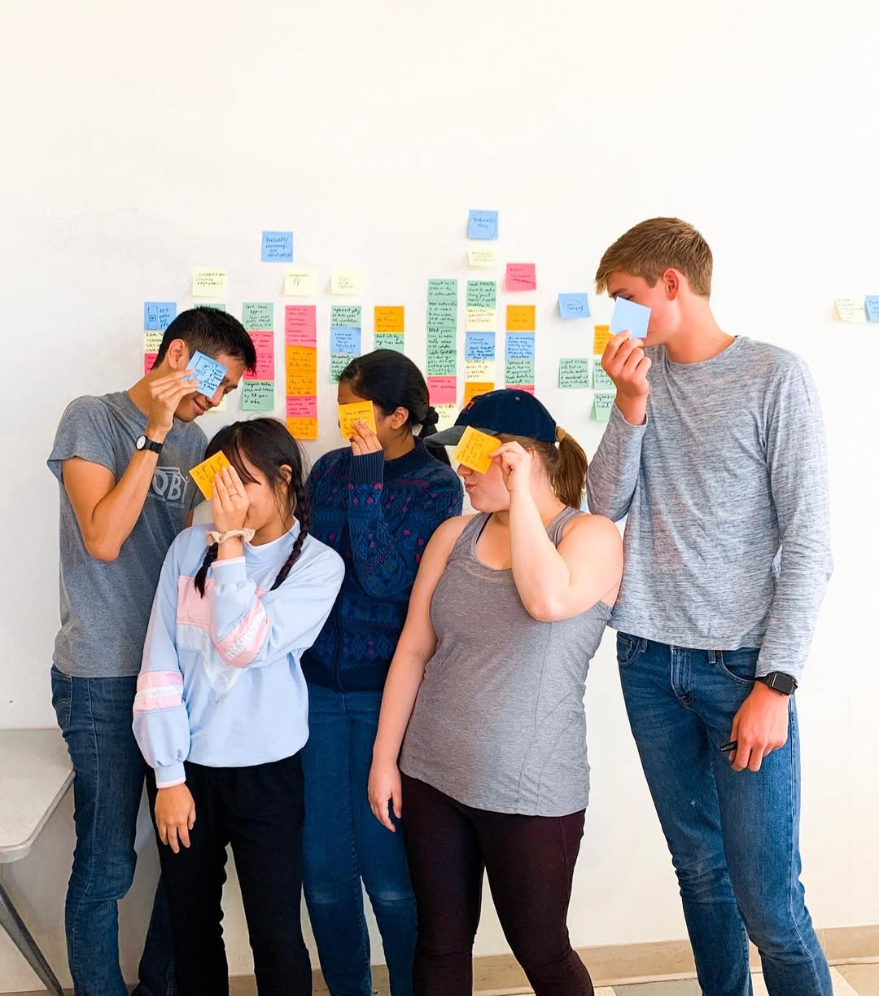
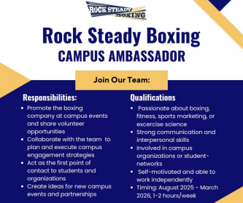
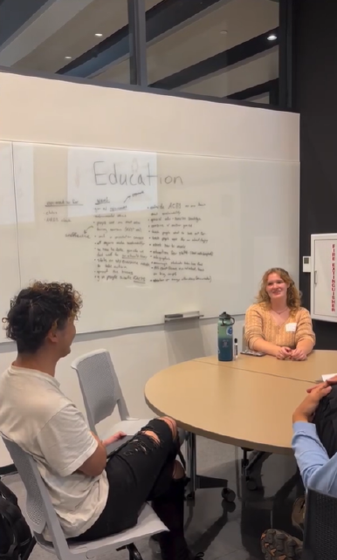
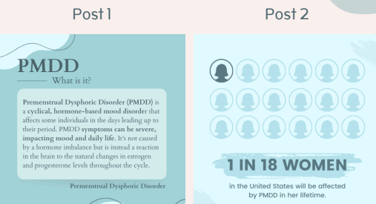

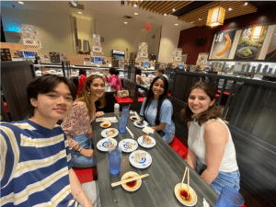
Over 50 Projects in Fall 2024!
Notes:
JHU | MICA, Notre Dame, Rice, UIUC

Slide 24

Holiday Gift Campaign
Notes:
We asked 81 people to help us unlock $50k match grant, and we had over 100 people donate.

Slide 25
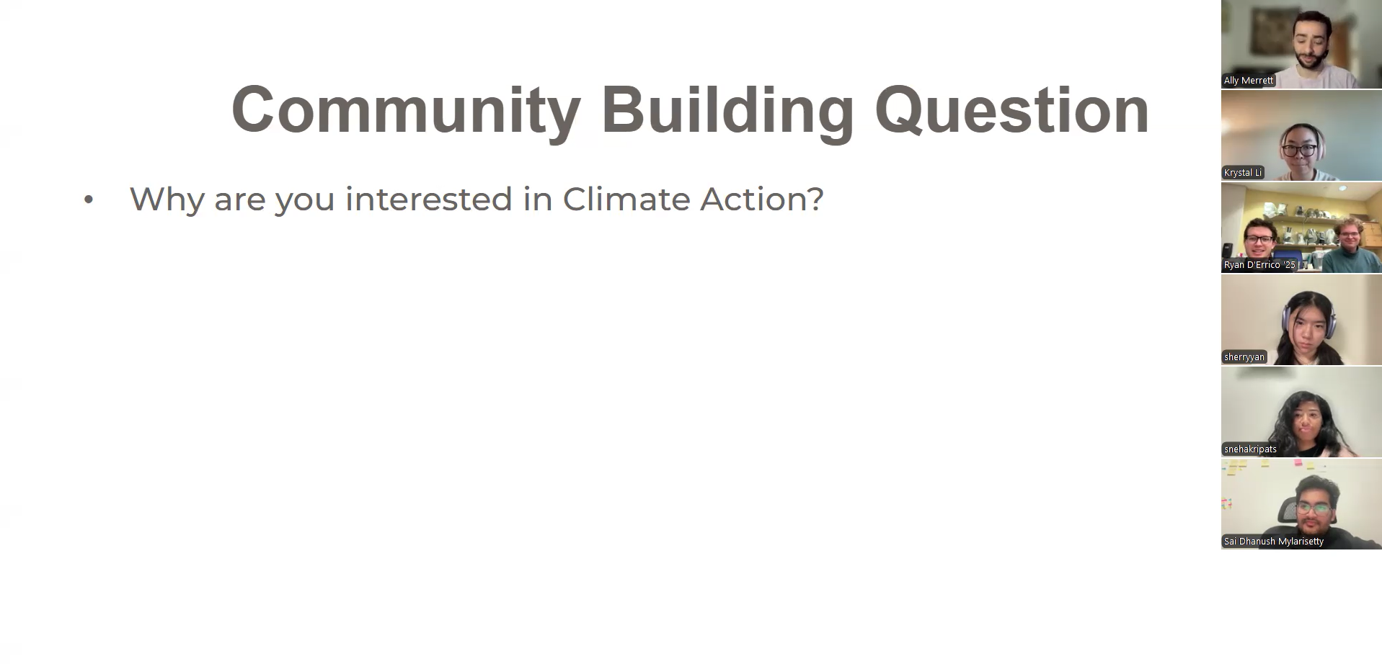
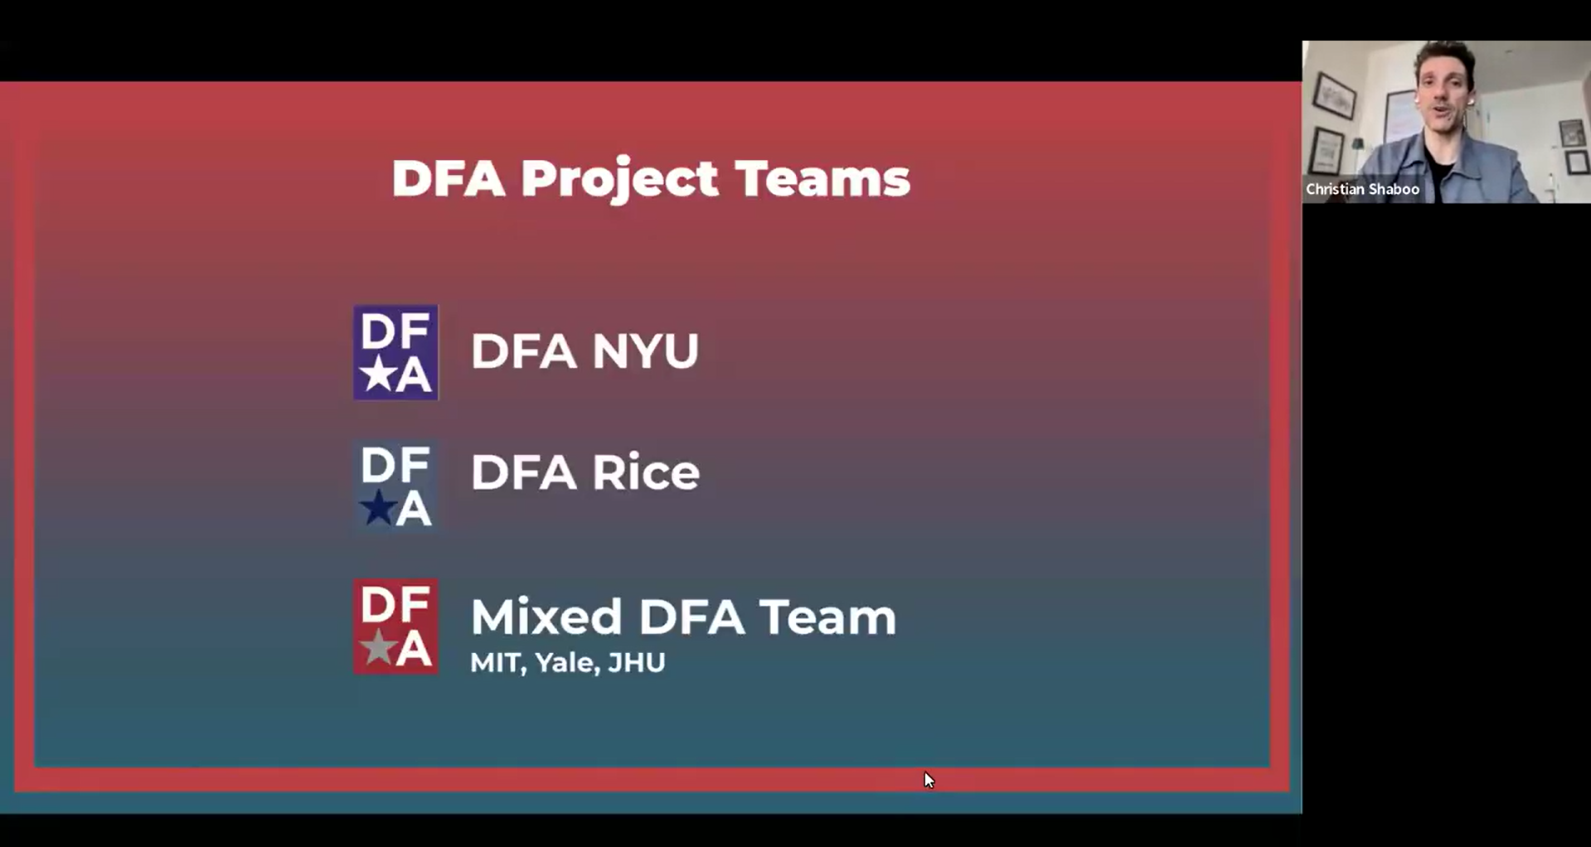
Current National Projects
Climate Action
MaineHealth
Notes:
NYU, Colgate, MIT, Stanford, Yale, JHU | MICA, Rice

Slide 26
Current National Projects
Studio Focused Project
Themed Challenges
Extra Funding
Robust Mentorship
Sponsored Projects
Specific Challenges
Stricter Timelines
External Partners
Addressing climate action on individual campuses through behavioral change, environmental clean-up, or awareness campaigns.
Explore and address inpatient mobility challenges, specifically focusing on adults over 50, within Maine Health’s medical psychiatric patient population.
Notes:
NYU, Colgate, MIT, Stanford, Yale, JHU | MICA, Rice

Slide 27
Thank you!

