Slide 1
DFA UW
Open Studio 3.7.2025

Slide 2
Upcoming Events
Building a Successful Career in Product Design
  With John Rodrigues from JP Morgan Chase
  Tuesday, March 11, 4 PM PT
DFA UIUC Midwest Meetup
  April 12-14 in Urbana-Champaign, IL
Certified Change Enthusiast Practitioner program
  A unique opportunity to build the mindset and skills to lead change with confidence, turn challenges into growth, and drive innovation in your work.

Slide 3
Overview
Introductions
Slack Information
Me!
Project Walkthrough
Project Feedback

Slide 4
Introductions
Ally Merrett, Program Coordinator
Amy Stefanski, Director of Programs
Ward Bullard, Director of External Engagement
Joy Mutimura, Director of Projects and Operations
Sharon Klotz, Executive Director

Slide 5
Introductions
Design for America was founded in 2008 by Liz Gerber at Northwestern University
Currently have over 35 active studios across the country
Over 700 current active members
Over 5000 alumni
  Our alumni slack is launching this month!
We have had studios at over 90 academic institutions in our history
Slowly expanding abroad with ventures like Design for Taiwan
Design for America recently raised $50,000 to help support studios

Slide 6
Slack Channels

Slide 7
Slack Channels
#all-studios_general
#all-studios_highlights
#all-studios_intros_networking
#all-studios_resources
#all-studios_opportunities

Slide 8
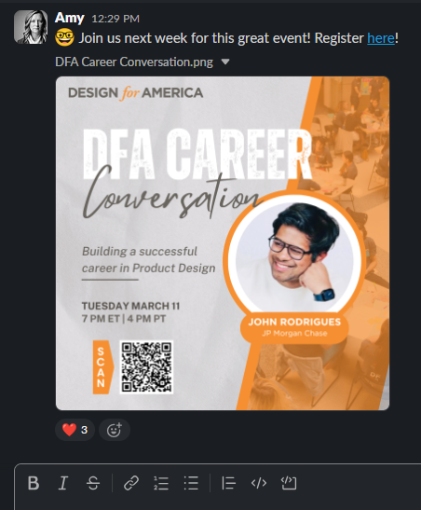
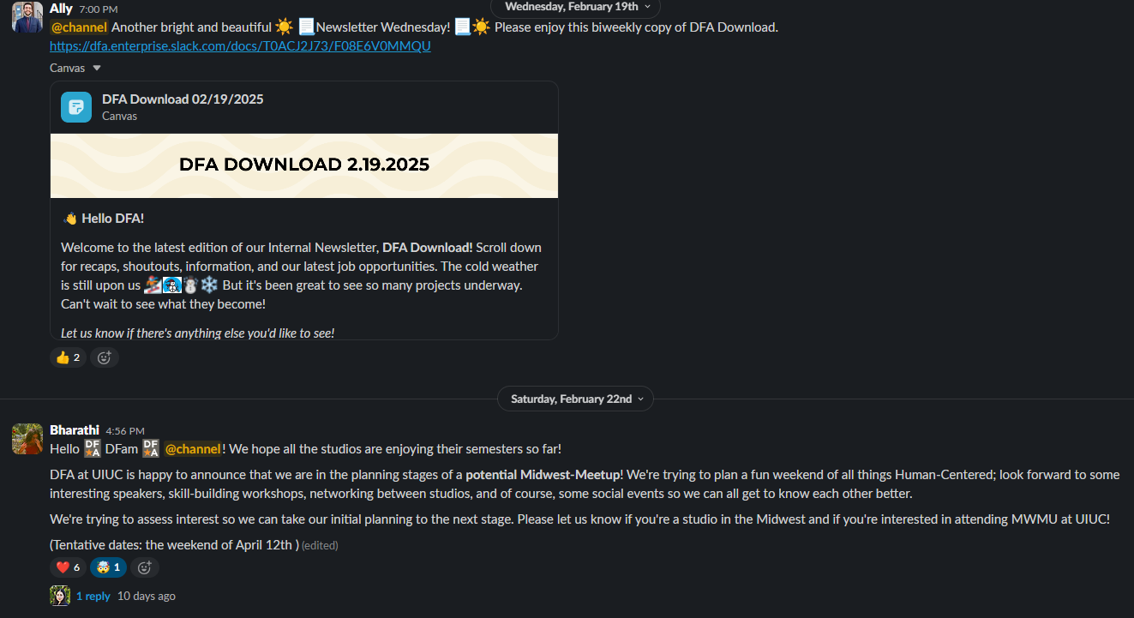
all-studios_general
Notes:
Overwhelming support and gratitude from the leads. Feels like something they are excited to use, something they have been waiting for, especially the new leads.
intuitive to navigate; aim to keep it simple
8-10 Week Project Guide was the most popular, will be used as a training tool for new team leads.
Notion Sign-Ups Analysis
24 sign-ups across 2 1-hour engagements with Ross

Slide 9
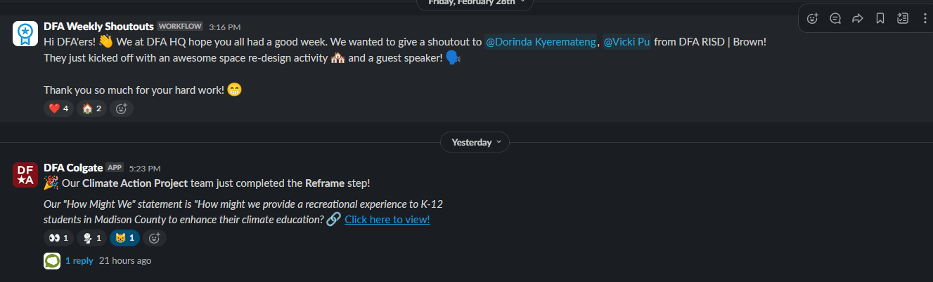
all-studios_highlights
Notes:
Overwhelming support and gratitude from the leads. Feels like something they are excited to use, something they have been waiting for, especially the new leads.
intuitive to navigate; aim to keep it simple
8-10 Week Project Guide was the most popular, will be used as a training tool for new team leads.
Notion Sign-Ups Analysis
24 sign-ups across 2 1-hour engagements with Ross

Slide 10
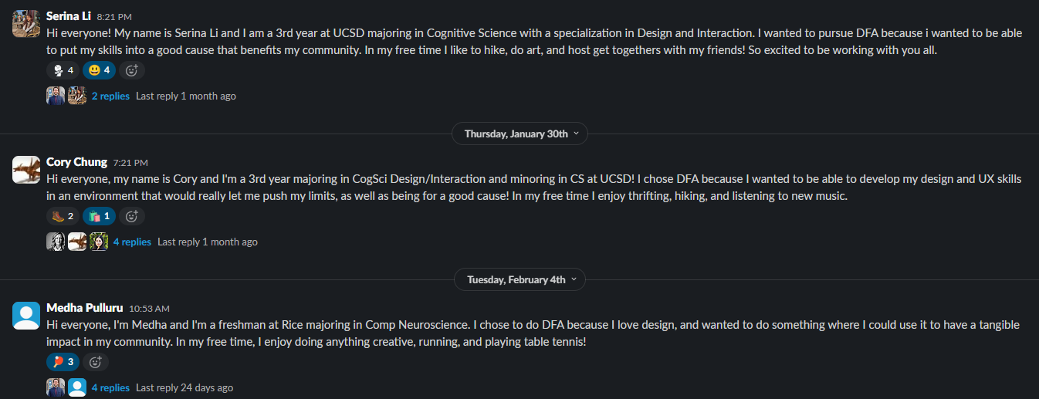
all-studios_intros_networking
Notes:
Overwhelming support and gratitude from the leads. Feels like something they are excited to use, something they have been waiting for, especially the new leads.
intuitive to navigate; aim to keep it simple
8-10 Week Project Guide was the most popular, will be used as a training tool for new team leads.
Notion Sign-Ups Analysis
24 sign-ups across 2 1-hour engagements with Ross

Slide 11
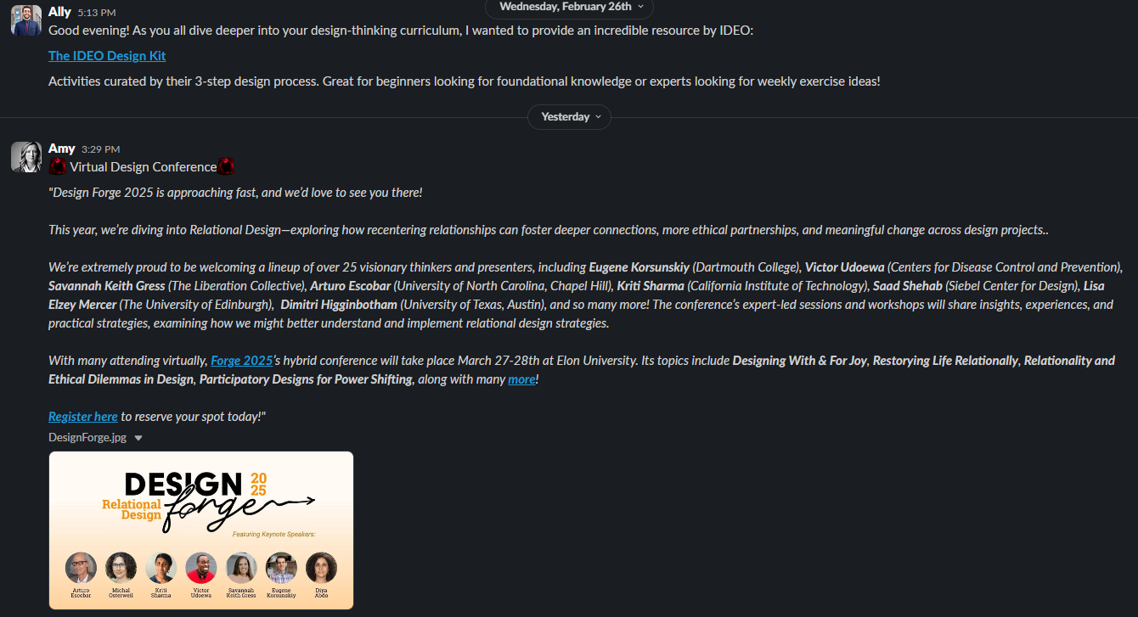
all-studios_resources
Notes:
Overwhelming support and gratitude from the leads. Feels like something they are excited to use, something they have been waiting for, especially the new leads.
intuitive to navigate; aim to keep it simple
8-10 Week Project Guide was the most popular, will be used as a training tool for new team leads.
Notion Sign-Ups Analysis
24 sign-ups across 2 1-hour engagements with Ross

Slide 12
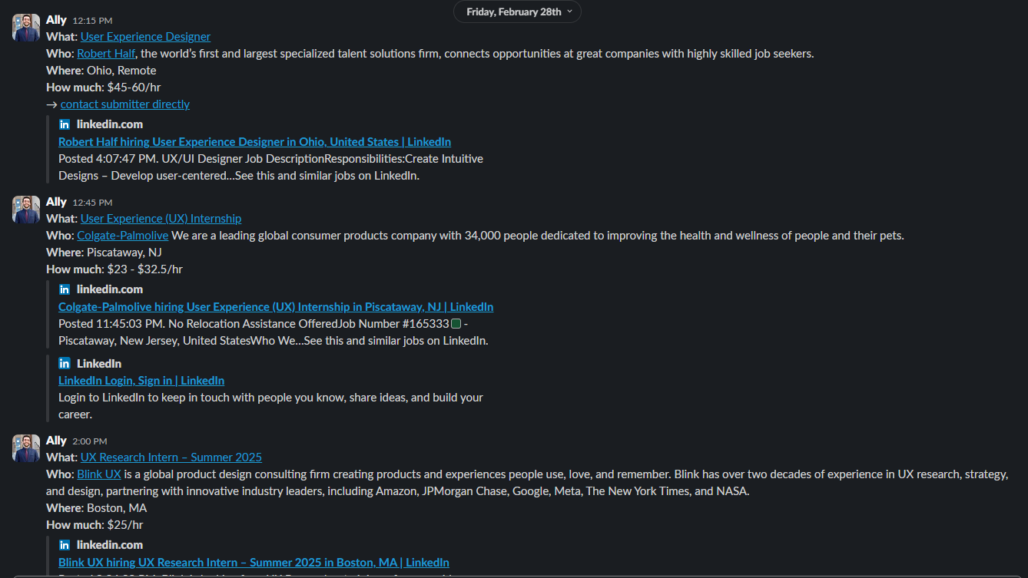
all-studios_opportunities
Notes:
Overwhelming support and gratitude from the leads. Feels like something they are excited to use, something they have been waiting for, especially the new leads.
intuitive to navigate; aim to keep it simple
8-10 Week Project Guide was the most popular, will be used as a training tool for new team leads.
Notion Sign-Ups Analysis
24 sign-ups across 2 1-hour engagements with Ross

Slide 13
National Projects
Individual External partners
NYU, Colgate, Stanford
Teams are working around the network on a variety of self-directed climate-themed projects with DFA HQ funding
MaineHealth
Climate Action
1 Single Shared Partner
NYU, Yale, Mixed Team
MaineHealth is working to prevent elderly patient falls in the psychiatric wards

Slide 14
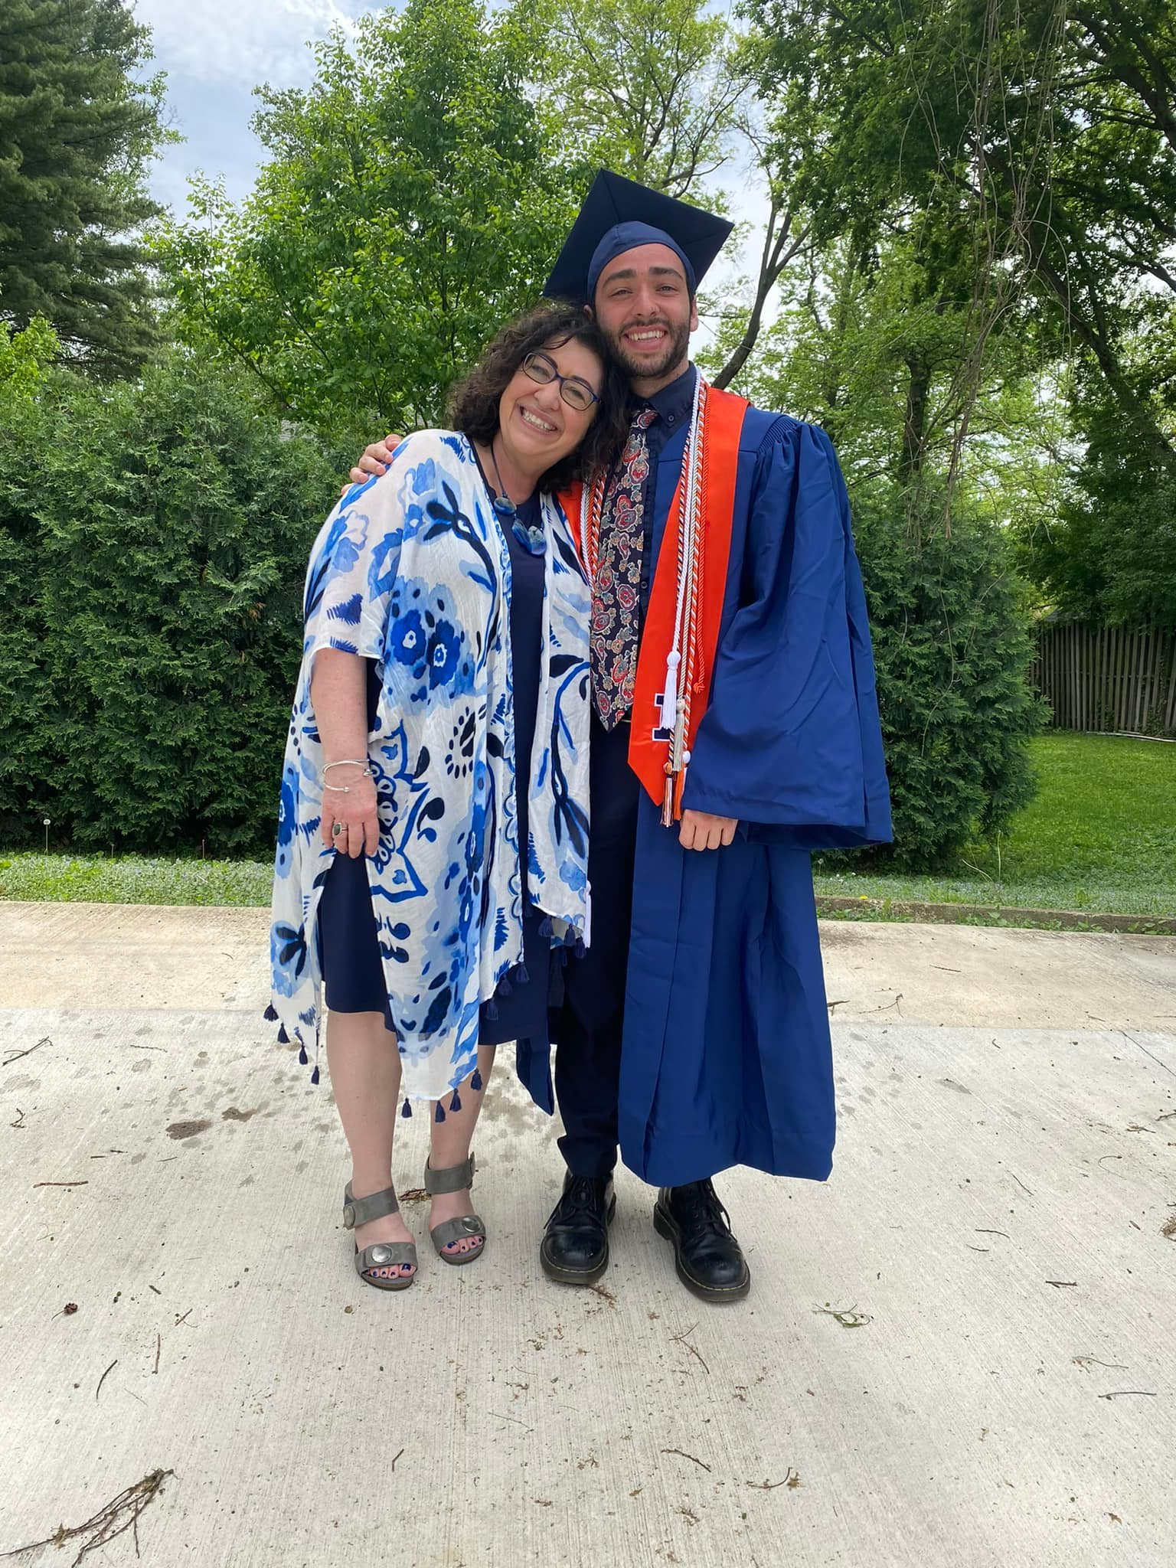
Ally!
Grew up in Macomb, IL
Graduated from University of Illinois at Urbana-Champaign in 2022
  Degrees in Sustainable Design & Urban Planning
    Minors in Art & Design, Sociology, and Informatics
      Certificate in Research!
Love music, exercising, and hanging with friends!
  The Strokes, OK Go, Vampire Weekend

Slide 15
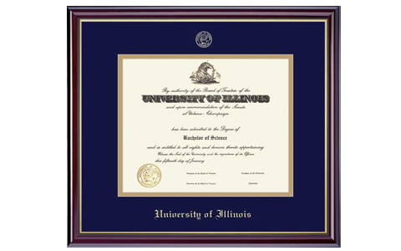
My College Journey
I changed my major 8 times (took 5 years to graduate)
  Urban planning to English to Music to Landscape Architecture to Sociology back to Urban Planning to Informatics to Art & Design and then I combined all of them
Still ended up fine!

Slide 16
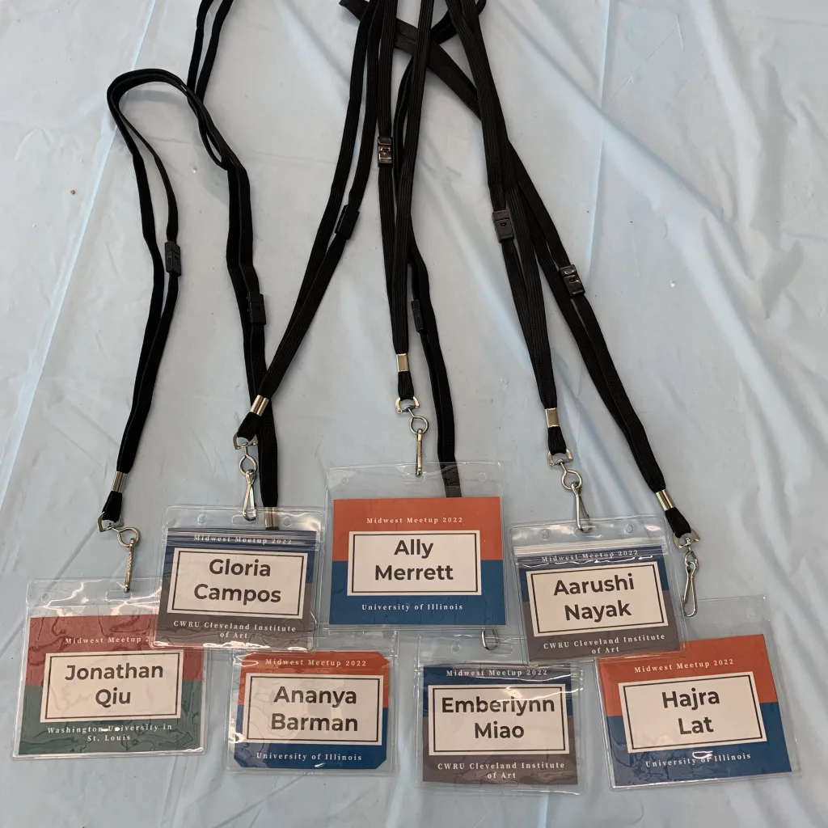
My DFA Journey
General member for 2 years
Next two years as project manager / education director
Final year as president
  Planned Midwest Meetup 2022
Went to 2 National Meetups
  We are planning for another one at the beginning of June!

Slide 17
How I Got into Design
The Siebel Center for Design
  4 years in Undergrad, 1 year post grad
  Great HCD Experience
Nemera Innovation Insight
  1 year post grad
DFA Fellowship
  1 year post grad
DFA National
  Current role!

Slide 18
After Graduation
I changed my major 8 times (took 5 years to graduate)
  Urban planning to English to Music to Landscape Architecture to Sociology back to Urban Planning to Informatics to Art & Design and then I combined all of them
Still ended up fine!

Slide 19
Thank You!

