Slide 1








Vanderbilt University

Slide 2
Vanderbilt University
Ally Merrett

Slide 3
Vanderbilt University
Ally Merrett

Slide 4
Post-college HCD
Vanderbilt University
Ally Merrett

Slide 5



PROJECTS
PORTFOLIOS
REAL-WORLD SKILLS
Post-college HCD
Vanderbilt University
Ally Merrett
Notes:
Can spend time on animations

Slide 6
PROJECTS

Slide 7

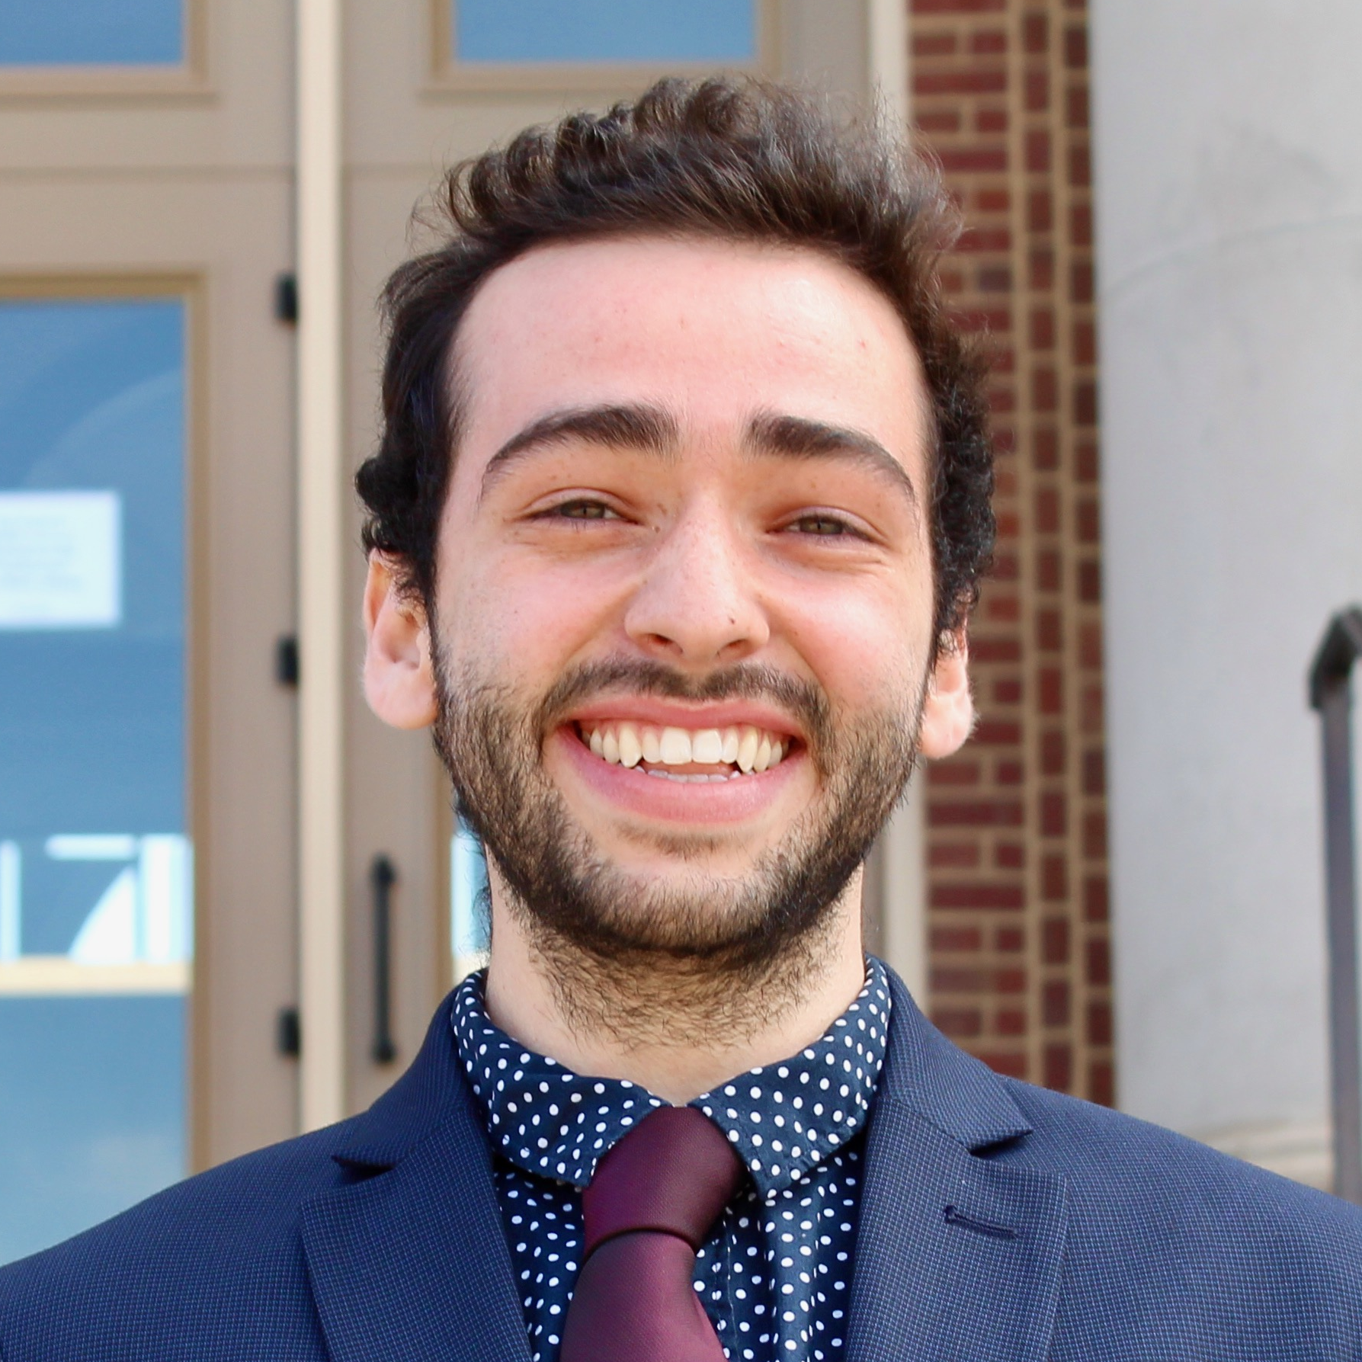



ABOUT ME
Adjunct Lecturer at WIU
Design Education Fellow at DFA
Design Researcher at Nemera Insight
Design Strategist at SCD
Content Developer at CollegeVine
President at DFA UIUC
Ally Merrett
Recent Roles
DFA Fellow and Adjunct Lecturer
B.S. in Urban Planning and B.S. HCD
University of Illinois at Urbana-Champaign
Notes:
I’m the one who did them!
Also talk about my role at DFA

Slide 8


PROJECT INFO
SKILLS
HOW TO APPLY THEM
SMART LABELS
GOAL: Help Type-2 diabetes patients better track their doses
SOLUTION: Use human-centered design to create digital “smart label” on medication
IMPACT: Learning preferences for potential device users
  DOCUMENTATION: Take notes, take videos, rewatch videos and review content
  CREATING A PROTOCOL: Heavy base of research, iteration, practice
  INTERVIEWING & MODERATING: Setting the tone, remaining neutral, guiding the conversation
  STORYTELLING: With enough research, it’s easier to tell more complex stories
  DESIGN BY COMMITTEE: Getting interdisciplinary input is critical
  KNOWING YOUR STRENGTHS: Are you a researcher, an interviewer, a designer, all 3?

Slide 9
Table of Contents
1. INTRODUCTION
 | Objectives | 3
 | Research Methods | 4
 | Research Sample | 5
 | Collateral | 6
 | Workflows | 9
2. EXECUTIVE SUMMARY
 | Executive Summary | 12
3. OVERALL CONCEPT FEEDBACK
 | Overview | 14
 | Perceived Benefits and Tradeoffs | 15
 | Envisioned Use | 16
4. PROTOTYPE FEEDBACK
 | Overview | 18
 | NFC | 19
 | QR Code | 21
5. UX INTERACTION
 | Overview | 24
 | UX Screens | 26
6. FEATURES
 | Preferences | 35
 | Features | 36
 | Design Recommendations | 41
7. | APPENDIX
 | AZ Smart Label Links | 44
 | Workflows | 45
 | Label Activation Success | 49
 | Participant Grid | 50
Notes:
Talk about creating a table of contents to keep the audience engaged through a longer presentation

Slide 10
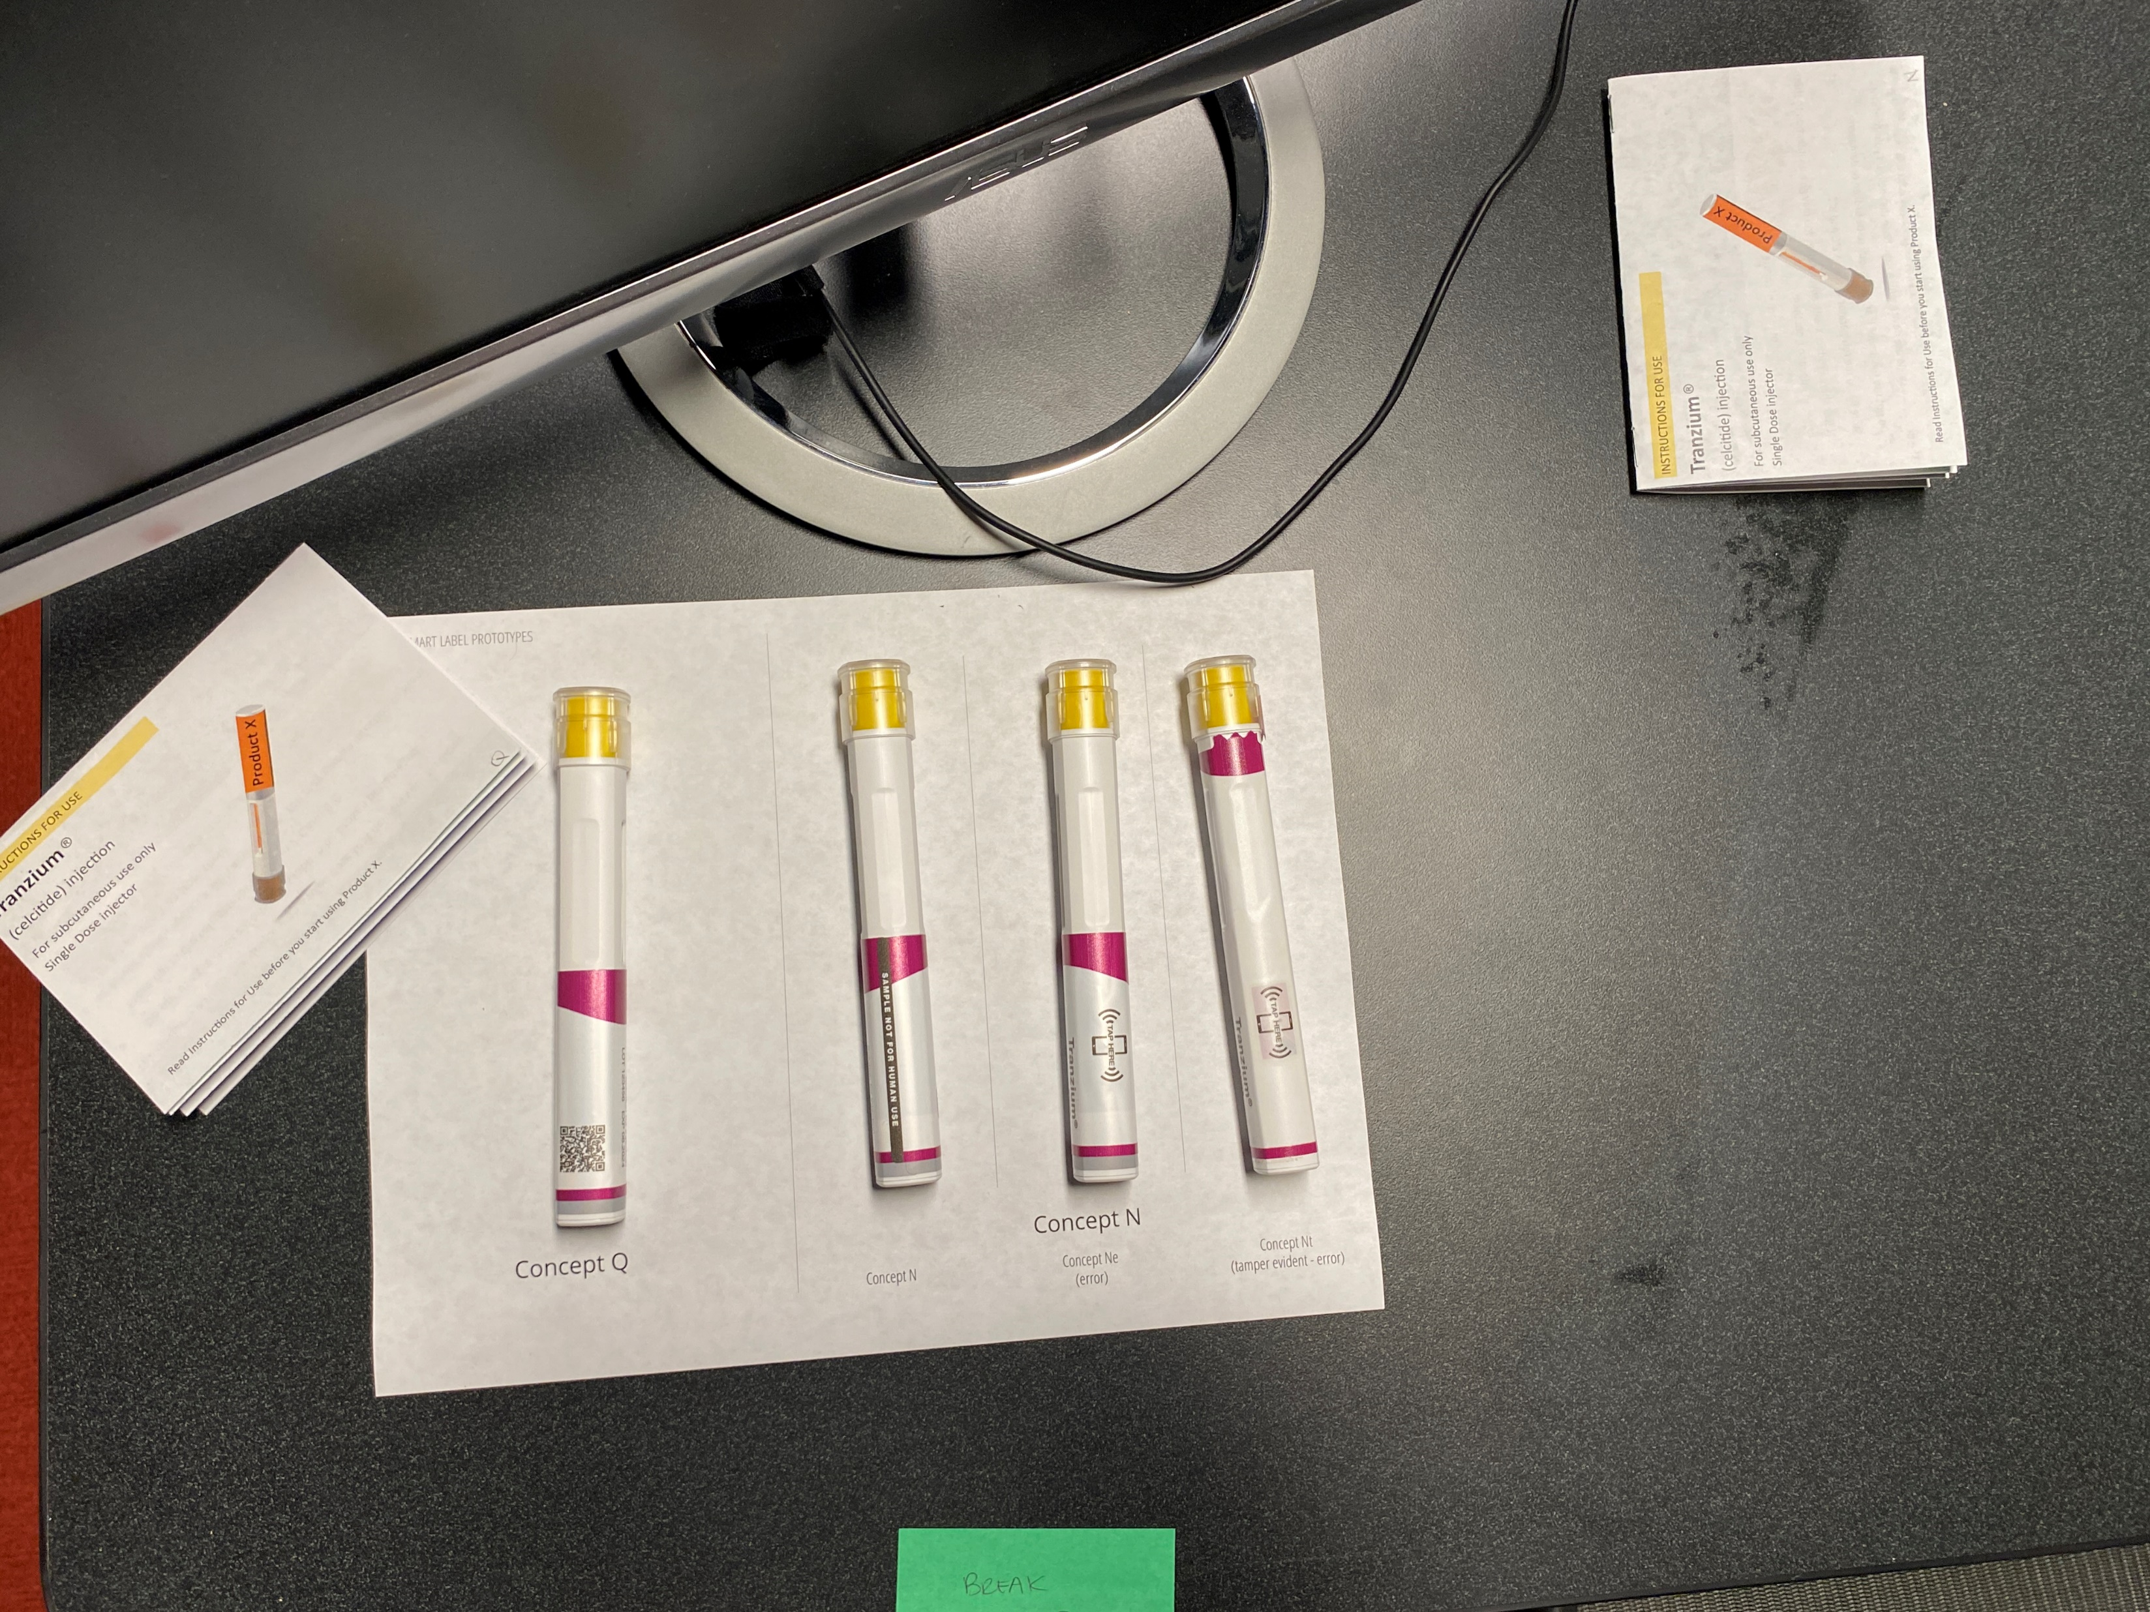
Objectives
Our research set out to answer four main questions around the use of smart labels and the future implementation of this technology:
How valuable is smart label functionality to patients / potential end users?
How do the two workflows (Workflow N and Workflow Q) compare from a user perspective?
  Workflow Q presents the dose logging flow associated with the use of a QR code. Note with QR codes, dose data (i.e., dose and expiration date) must be manually entered or captured via photo of the label.
  Workflow N presents the dose logging flow associated with the use of an NFC tag. Note with NFC, dose data (i.e., dose, expiration date and lot number) is automatically captured.
What additional functionality could a smart label app enable?
Would the use of smart labels require training?
Smart label devices and QRGs used during data collection.

Slide 11
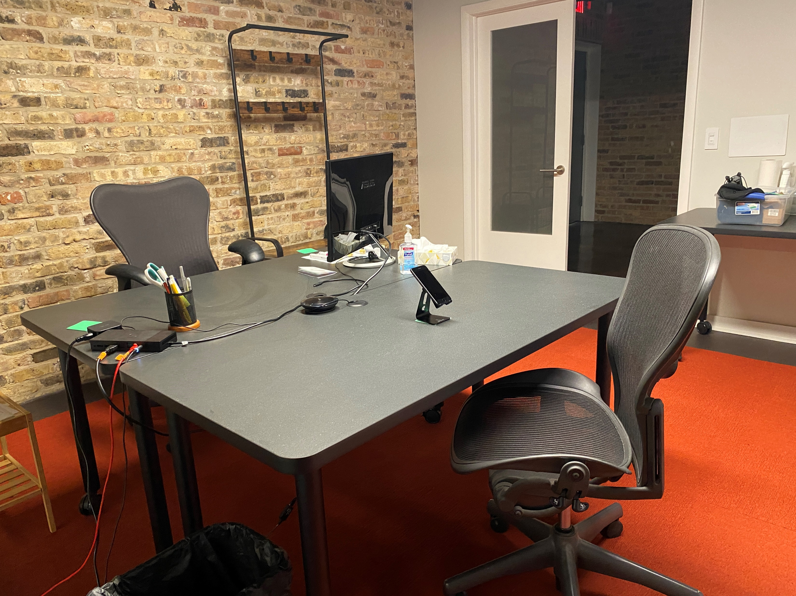
Methods
All interviews were 60-minutes and conducted in 1-1 sessions at Insight’s observation lab. The interview structure was as follows:
Introduction: We welcome the participant, present goals of the study, and briefly discuss their experience with diabetes (this is largely to confirm the recruit criteria).
Concept Introduction: We introduce the concept of smart labels and solicit first impressions, perceived benefits, concerns, and challenges.
Workflow Evaluation & Comparison: The moderator shares all four devices, asking the participants to use each. Participants think aloud and compare the two workflows.
Feature Menu: We go through each feature in the Feature menu to solicit feedback and understand perceived use.
Wrap-Up: Participants summarize their thoughts. Moderators also ask clarifying questions from listening team members.
The observation room set up for the study with participant across from moderator and smart phone facing the participant's chair.

Slide 12
Sample
32 total participants were included in the study, all with Type 2 diabetes.
The sample was split between injection experienced and injection naïve - 16 participants had injection experience (administering GLP-1s, not using insulin pens), 16 had no injection experience
These participants used a range of treatments, e.g., Trulicity, Metformin, Ozempic, Victoza, Mounjaro
A mix of gender identity, age, and history of diabetes (time since diagnosis) was also targeted
We required participants own a smartphone (Apple, Android, or other) and sought to understand comfort level with apps

Slide 13
Sample
P# | Age Range | Experience Injecting? | Types of Treatment | Types Administered | Smart Phone? | Smart Phone Confidence
1 | 50-64 | Yes | Oral & GLP-1 | Dulaglutide | Yes | High
2 | 30-49 | Yes | Oral & GLP-1 | Other : Mounjaro | Yes | High
3 | 65+ | No | Oral | N/A | Yes | High
4 | 50-64 | Yes | Oral & GLP-1 | Dulaglutide | Yes | High
5 | 65+ | No | Oral | N/A | Yes | High
6 | 50-64 | No | Oral | N/A | Yes | High
7 | 50-64 | No | Oral | Other | Yes | High
8 | 65+ | Yes | Oral & GLP-1 | Dulaglutide | Yes | High
9 | 65+ | No | Oral | N/A | Yes | Medium
10 | 50-64 | Yes | Oral & GLP-1 | Semaglutide | Yes | High
11 | 30-49 | No | Oral | N/A | Yes | High
12 | 30-49 | No | Oral | N/A | Yes | High
13 | 50-64 | No | Oral | N/A | Yes | High
14 | 50-64 | Yes | Oral | Dulaglutide | Yes | Medium
15 | 65+ | Yes | GLP-1 Injection | Semaglutide | Yes | Medium
16 | 30-49 | No | Oral | N/A | Yes | High
17 | 50-64 | No | Oral | N/A | Yes | High
18 | 30-49 | Yes | Oral & GLP-1 | Dulaglutide | Yes | High
19 | 50-64 | No | Oral | N/A | Yes | High
20 | 65+ | Yes | Oral & GLP-1 | Dulaglutide | Yes | High
21 | 30-49 | Yes | GLP-1 Injection | Liraglutide | Yes | High
22 | 50-64 | Yes | GLP-1 Injection | Semaglutide | Yes | High
23 | 50-64 | Yes | Oral & GLP-1 | Dulaglutide | Yes | High
24 | 30-49 | Yes | Oral | Other | Yes | High
25 | 65+ | Yes | Oral & GLP-1 | Semaglutide | yes | Medium
26 | 50-64 | No | Oral | N/A | Yes | High
27 | 50-64 | No | Oral | Other | Yes | High
28 | 30-49 | No | Oral | N/A | Yes | High
29 | 65+ | Yes | GLP-1 Injection | Liraglutide | Yes | High
30 | 65+ | No | Oral | N/A | Yes | High
31 | 65+ | Yes | Oral & GLP-1 | Semaglutide | Yes | High
32 | 50-64 | Yes | GLP-1 Injection | Other | Yes | High

Slide 14
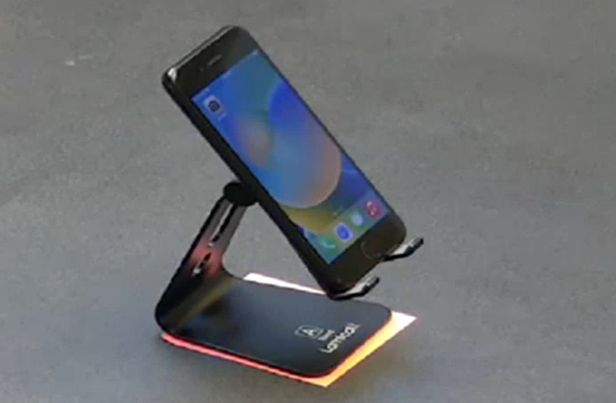
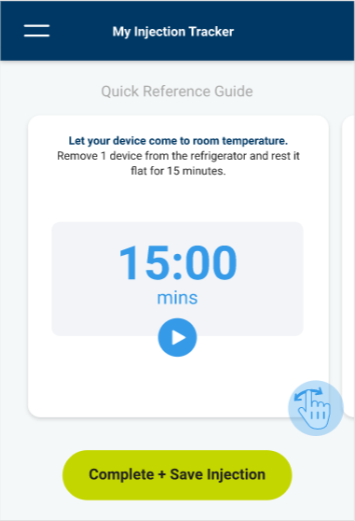
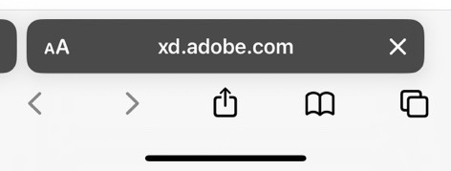
Collateral | Study Materials & Artifacts
Study Phone
Study phone was an iPhone 8 with a clickable home button
The iPhone used in the study was not always the same model and/ or type that the participant uses
Because of this, some participants experienced technological struggles. They often required extra help from the moderators to navigate the phone itself rather than the app.
Soft (Not Coded) Prototype
Both workflows ran on the Safari web browser on mobile version of Adobe XD
Some user errors occurred because participants used functions of Safari navigation rather than the Workflow navigation. These were corrected by the moderator.
Participants sometimes used the safari “back” button or accidentally hit the “share” button.
An iPhone 8 was used for this study
The prototype ran on the Safari web browser

Slide 15
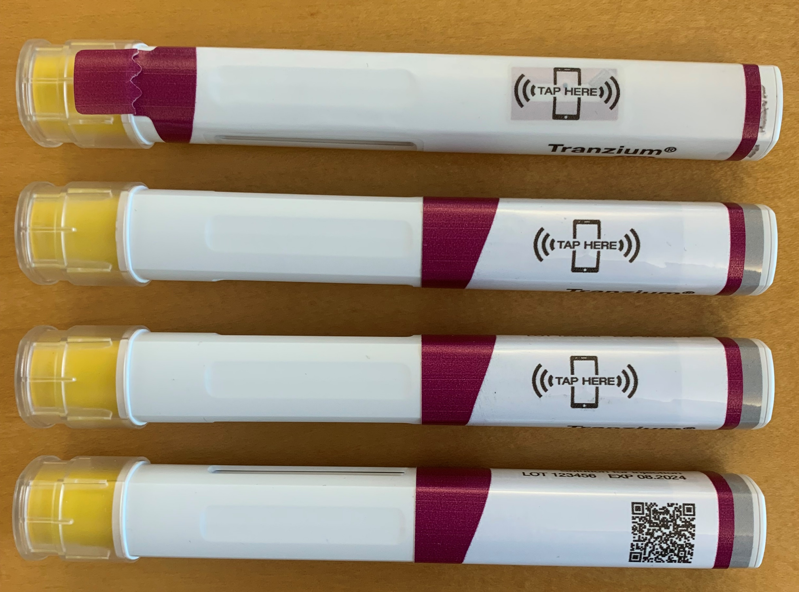
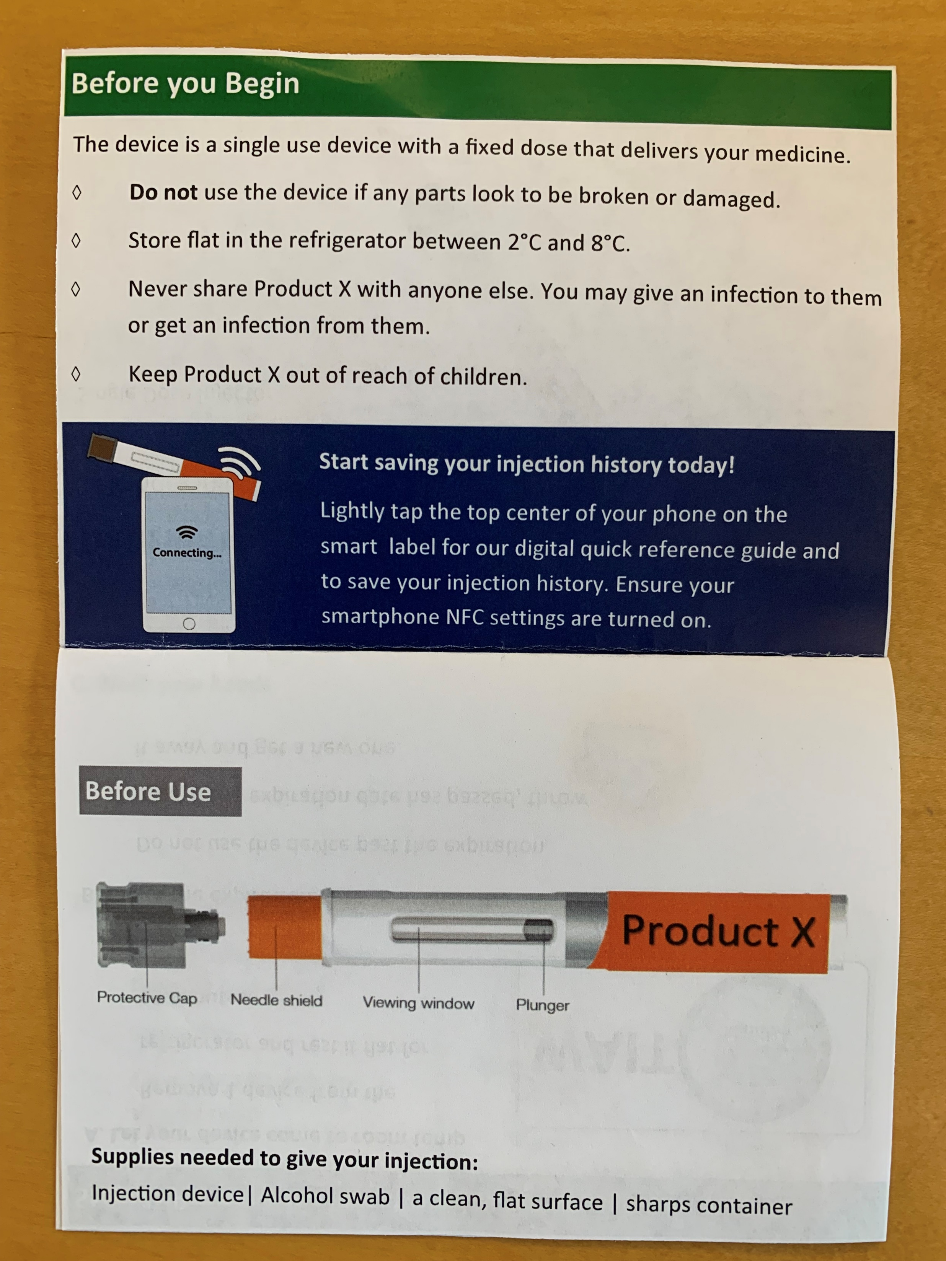
Collateral | Autoinjectors and QRG
Injector Trainers
There were four different autoinjectors used in this study.
Pictured top to bottom below, tamper evident workflow, redundant entry alert, NFC and QR code.
Printed QRG
The QRG included an introduction to smart labels.
However, full instructions on smart label use were not included.
Four autoinjectors with smart labels used throughout the study
NFC tap graphic embedded within the QRG

Slide 16
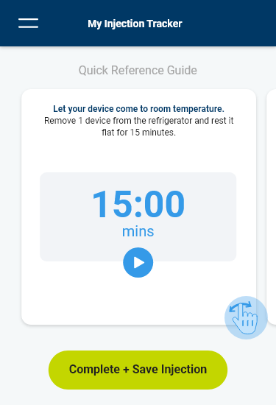
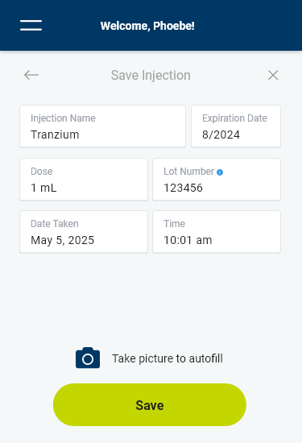
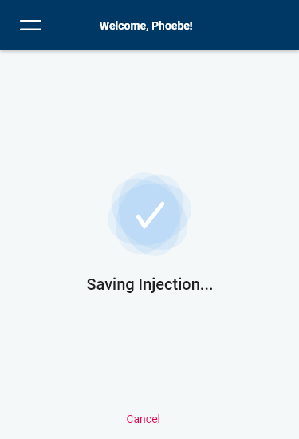
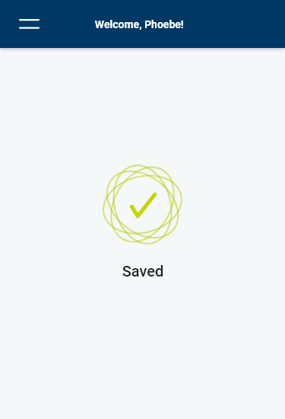
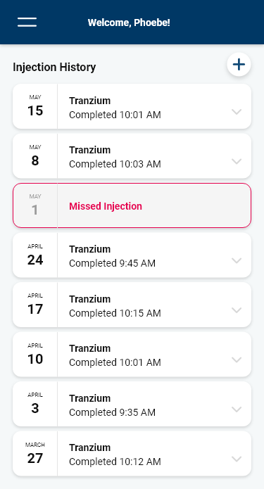
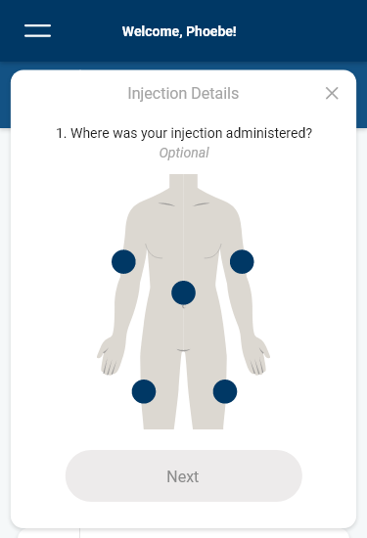
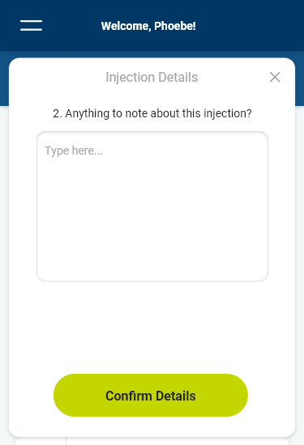
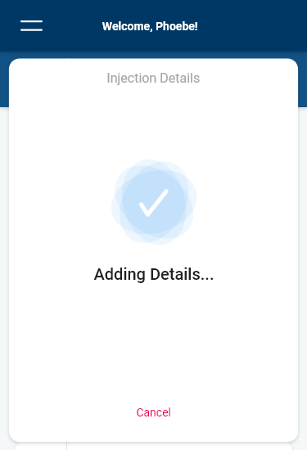
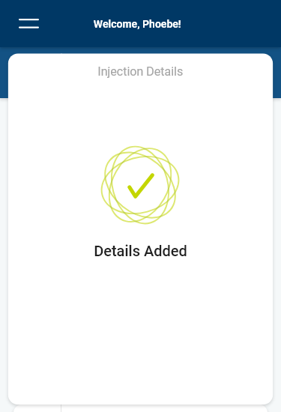
QR Code Flow
Pop up details on home screen
Default to home screen

Slide 17
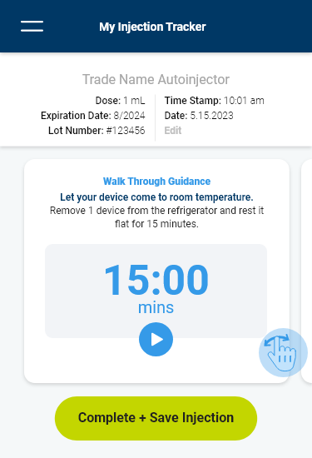
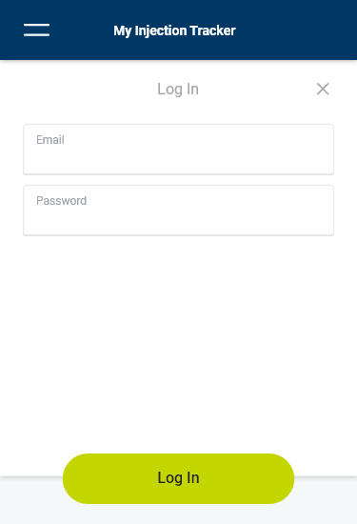
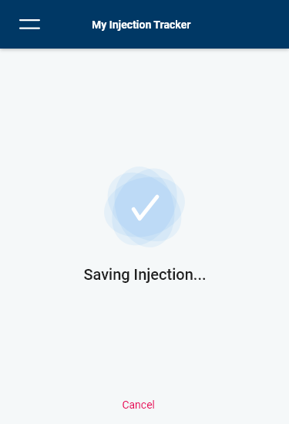
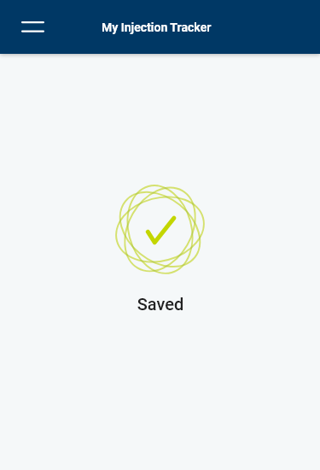
NFC Code Flow
Key
Button press navigation
On NFC Scan
Drop down sign in
Auto progression navigation
Pop up details on home screen
Default to home screen

Slide 18
EXECUTIVE SUMMARY

Slide 19
Executive Summary
How valuable is smart label functionality to patients/ potential end users?
How do QR code and NFC tag workflows compare from a user perspective?
What additional functionality could a smart label and app enable?
Would the use of smart labels require training and / or supervision or could this technology be successfully leveraged without?
Participants appreciated the benefits of smart label functionality, primarily to serve as a record for themselves (“did I take my medication?”) and their doctor (both to demonstrate adherence and identify patterns).
While this functionality wasn't perceived to be totally necessary, most felt they would likely use it if it were deemed “quick and easy.”
The NFC technology/ workflow was strongly preferred mostly due to the ability to automatically recognize/ populate necessary dose data (compared to manual entry or photo capture with the QR code), which would reduce the time required to use the app and eliminate any potential for error.
Participants unanimously felt tamper evidence would be beneficial in ensuring patient safety.
Additionally, most felt being able to send/ share data with their HCP, receive prompts/ notifications of refills and set reminders would prove convenient.
While other features yielded comparatively less value overall, participants generally shared a ‘why not?’ sentiment, feeling all could be included in an app.
Participants struggled with activating the label for both technologies. While many were more familiar/ comfortable with the use of QR codes, successful activation often took multiple attempts for both technologies.
Despite this, we believe training may not be required with the help of more explicit instruction and supporting imagery (both in the IFU and perhaps on the label itself). Once support/ training materials are created, usability testing is recommended.

Slide 20
OVERALL CONCEPT FEEDBACK

Slide 21

Overview
The majority of participants (24/32) envisioned using the smart label technology; even those less enthused would do so if instructed by their doctor.
Participants were generally excited about the prospect of new technology
    “I was impressed with the pen I already have, now this is the next step in medical technology.” –P18
Participants envisioned themselves practicing to get better at activating labels
    Participants’ ease of use generally improved throughout the study, activating the NFC tapping concept at least four times and the QRC scanning concept twice
Some participants already use a tracking app for other medications/ symptoms and found this concept to be an improvement upon other apps
    “When I open my glucometer app to see what it would require to log dose, I’d need to open the app, look for that section and manually enter. Comparatively, I’d be more likely to use this since it’s much easier.” –P1
Both the “Would Not Use” and “Unsure” groups noted that they would use if their doctor required it

Slide 22
Perceived Benefits & Tradeoffs
While most felt there was value in smart label use, some felt it was unnecessary given their (often simple and heavily routinized) regimen.
Most felt the use of smart labels would provide additional reassurance that they are following their regimen
    “It’s nice to have an app that keeps track of everything. Also being able to go back and see this information is good.” –P2
Many envisioned sharing the log with their doctor (e.g., during their next appt) to review dose timing/ frequency and possibly demonstrate impact (e.g., if correlated with blood glucose readings)
    “The more my doctor knows the better. I like the idea of sharing the information with my doctor.” –P5
Some expressed a desire/ curiosity to use smart labels for all of their medications to provide a more comprehensive log
    “I have to keep very specific records for my other medications, this would make it easier because they're all in one place. I can trace cause and effect.” –P7
Some felt it was unnecessary, particularly for people taking few medications at a set time of day (e.g., every morning after breakfast)
    “I know how much I take and I take an injection every morning. It would not be useful in the sense that it would not tell me anything. I take .025 ml every Monday morning.“ –P31
Some questioned the need/ utility when weighed against the anticipated increase in cost
    “Unless this becomes affordable, I won't use it.” –P14
Notes:
"This is really a great fail safe. It'll catch you if you make a mistake“
For someone who is non-compliant I could see this to keep them on track. But without have any more information I couldn't see how this would be useful.

Slide 23
Envisioned Use | Timing & Impact
Participants were often a bit conflicted about the timing and impact of smart label use.
Some intuitively imagined they would activate the label after the injection as means to confirm they did in fact administer the dose they were logging
          However, some of these participants recognized this would preclude the use of some features, which often led them to weigh feature benefits against what “makes sense” chronologically
All of those who recognized/ appreciated the warming timer envisioned activating the label when the device is removed from the refrigerator
“Knowing what I know about t I think I would do it as soon as I take it out of the box, take advantage of the [timer].” –P12
Those who valued the digital tamper evidence notification felt this would lead them to activate the label prior to opening/ uncapping the device
          “It would be a very important feature to have. It's like having the label on the Grubhub bag to know that no one has tampered with your food.” –P24

Slide 24
PROTOTYPE FEEDBACK

Slide 25
Overall Preference
The NFC Workflow (N) was strongly preferred over the QR Code Workflow (Q).
Reasons cited for preference include:
Automated data entry (of dose information)
Safety features (tamper evidence and redundant entry recognition)
Simplicity/ expediency of activating the label
Note that one participant found Workflow N unacceptable (after more than 30 unsuccessful attempts to activate the label) while another found Workflow Q unacceptable (due to the lack of safety features, compared to N).
Across preferences, there were no significant patterns based on age, injection experience, technology experience/ familiarity or training level.
Notes:
AZ and realizing we should prob have the "count" of successful activation, near misses and failures for untrained participants. can you plan to create a chart that outlines that and we'll put it in as an appendix?

Slide 26
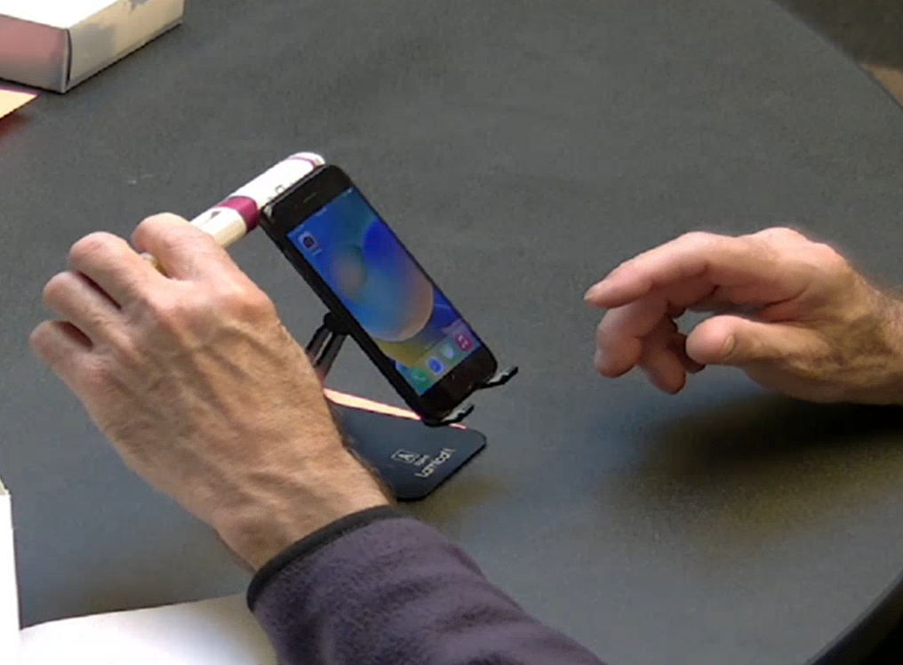
NFC Workflow (N)
While NFC was not well understood and participants often struggled, automated data entry was highly valued.
Experience with the technology
More than half of the participants had knowledge/ experience with NFC technology, but more commonly with credit cards than phones.
Label activation
Trained participants typically took 1-5 times to successfully activate the label.
Untrained participants could take up to 20 times before successful activation; only 1 untrained participant was able to successfully activate on the first try.
Failed attempts were often attributed to the tech being ‘finicky,’ requiring a very specific tap motion and location.
Data entry
Many expected the use of either technology to auto-populate the dose data; this was greatly appreciated as a means to save time/ steps and mitigate any potential for error.
Some also felt this would serve as a reassurance/ confirmation (e.g., that they are taking the right medication, its not expired, etc.).
A participant taps the NFC smart label against the back of the phone.
Notes:
Add Near Miss F count

Slide 27
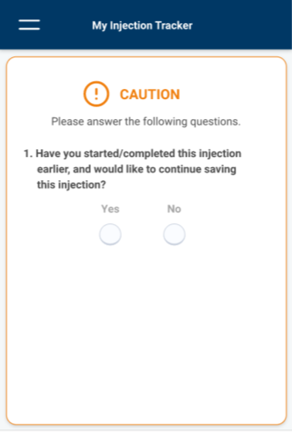
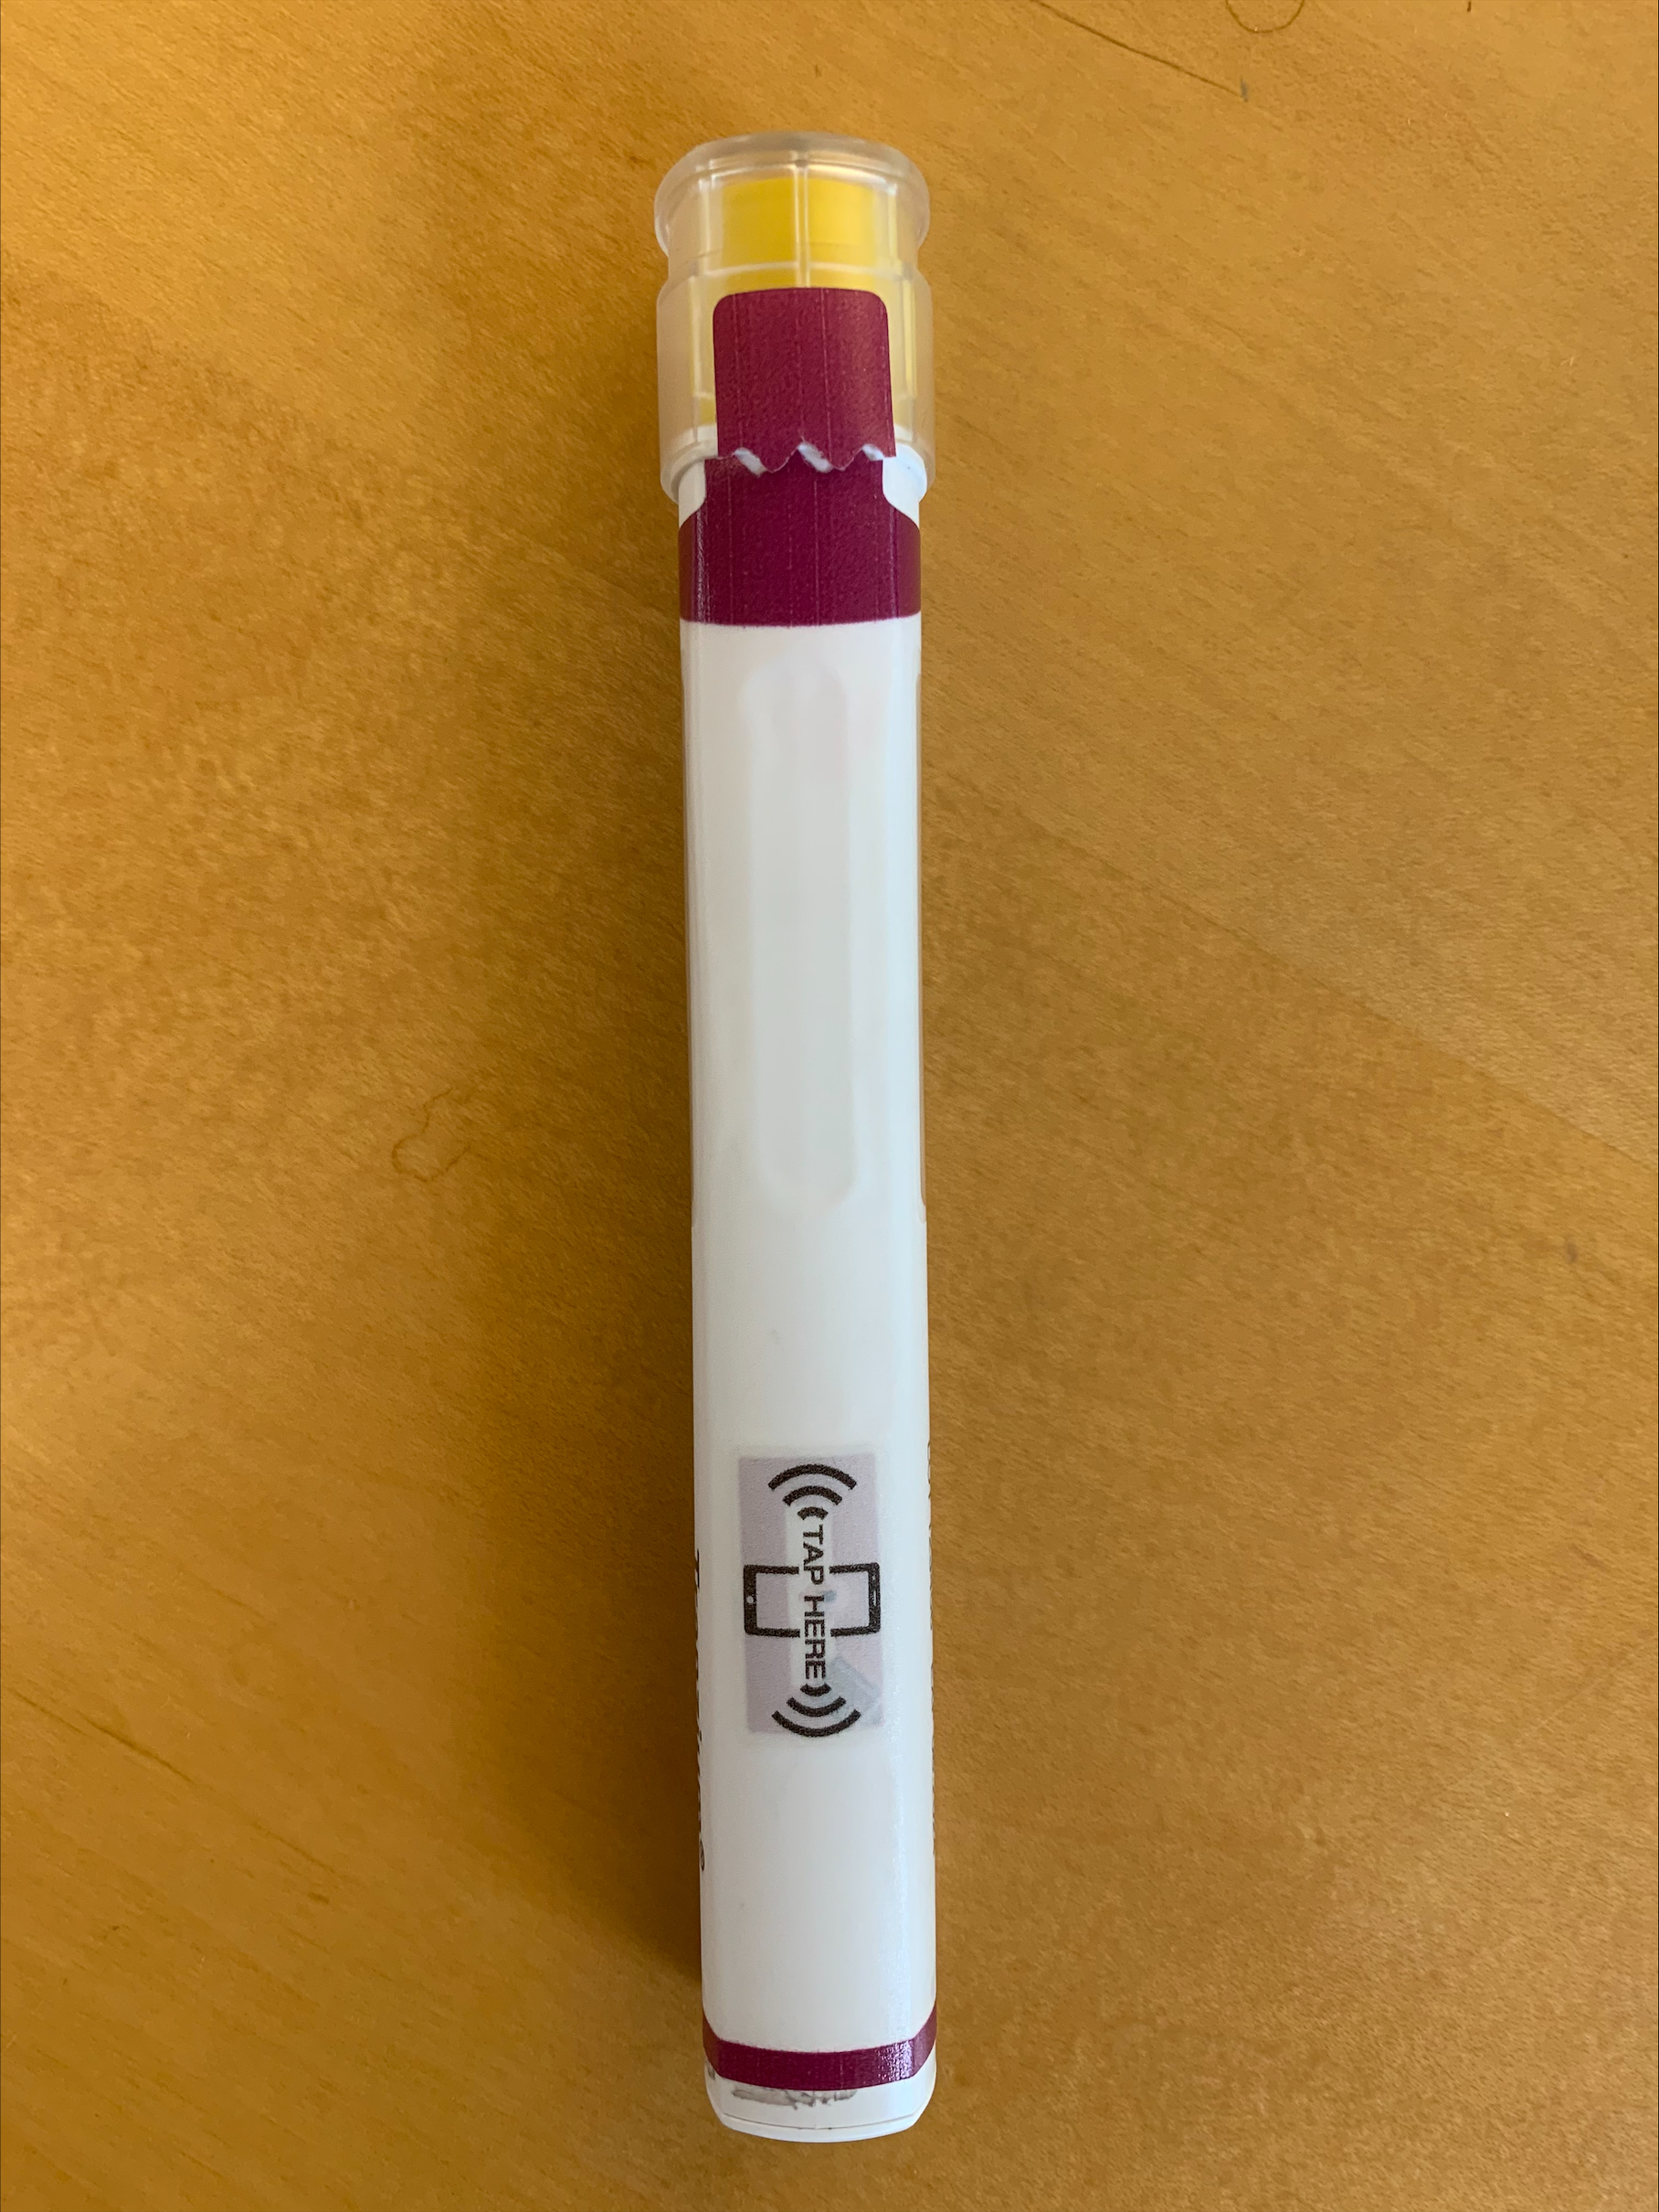
NFC Workflow (N)
Alerts, particularly tamper evidence, are considered important safety features.
Tamper evidence
Participants really appreciated this safety measure (both the tamper evident label itself and digital alert).
Many didn’t initially notice the torn label, leading them to feel the digital alert was critical (Note: participants were not asked to open this device, recognition of tamper evident label was based on visual inspection only).
Redundant entry
Most participants felt this feature was unlikely to be utilized, as they would discard their used device immediately after injecting.
Some mentioned maybe this would be helpful if they were interrupted immediately after injecting or for those with dementia/ cognitive challenges.
Current Trulicity users often mentioned that their device doesn’t allow you to inject a second time (the device itself is de-activated), which they appreciate.
Despite feeling the scenario was unlikely, most still appreciated the feature as an additional safeguard.
Tamper evident alert in Workflow N
Label demonstrating evidence of tampering

Slide 28
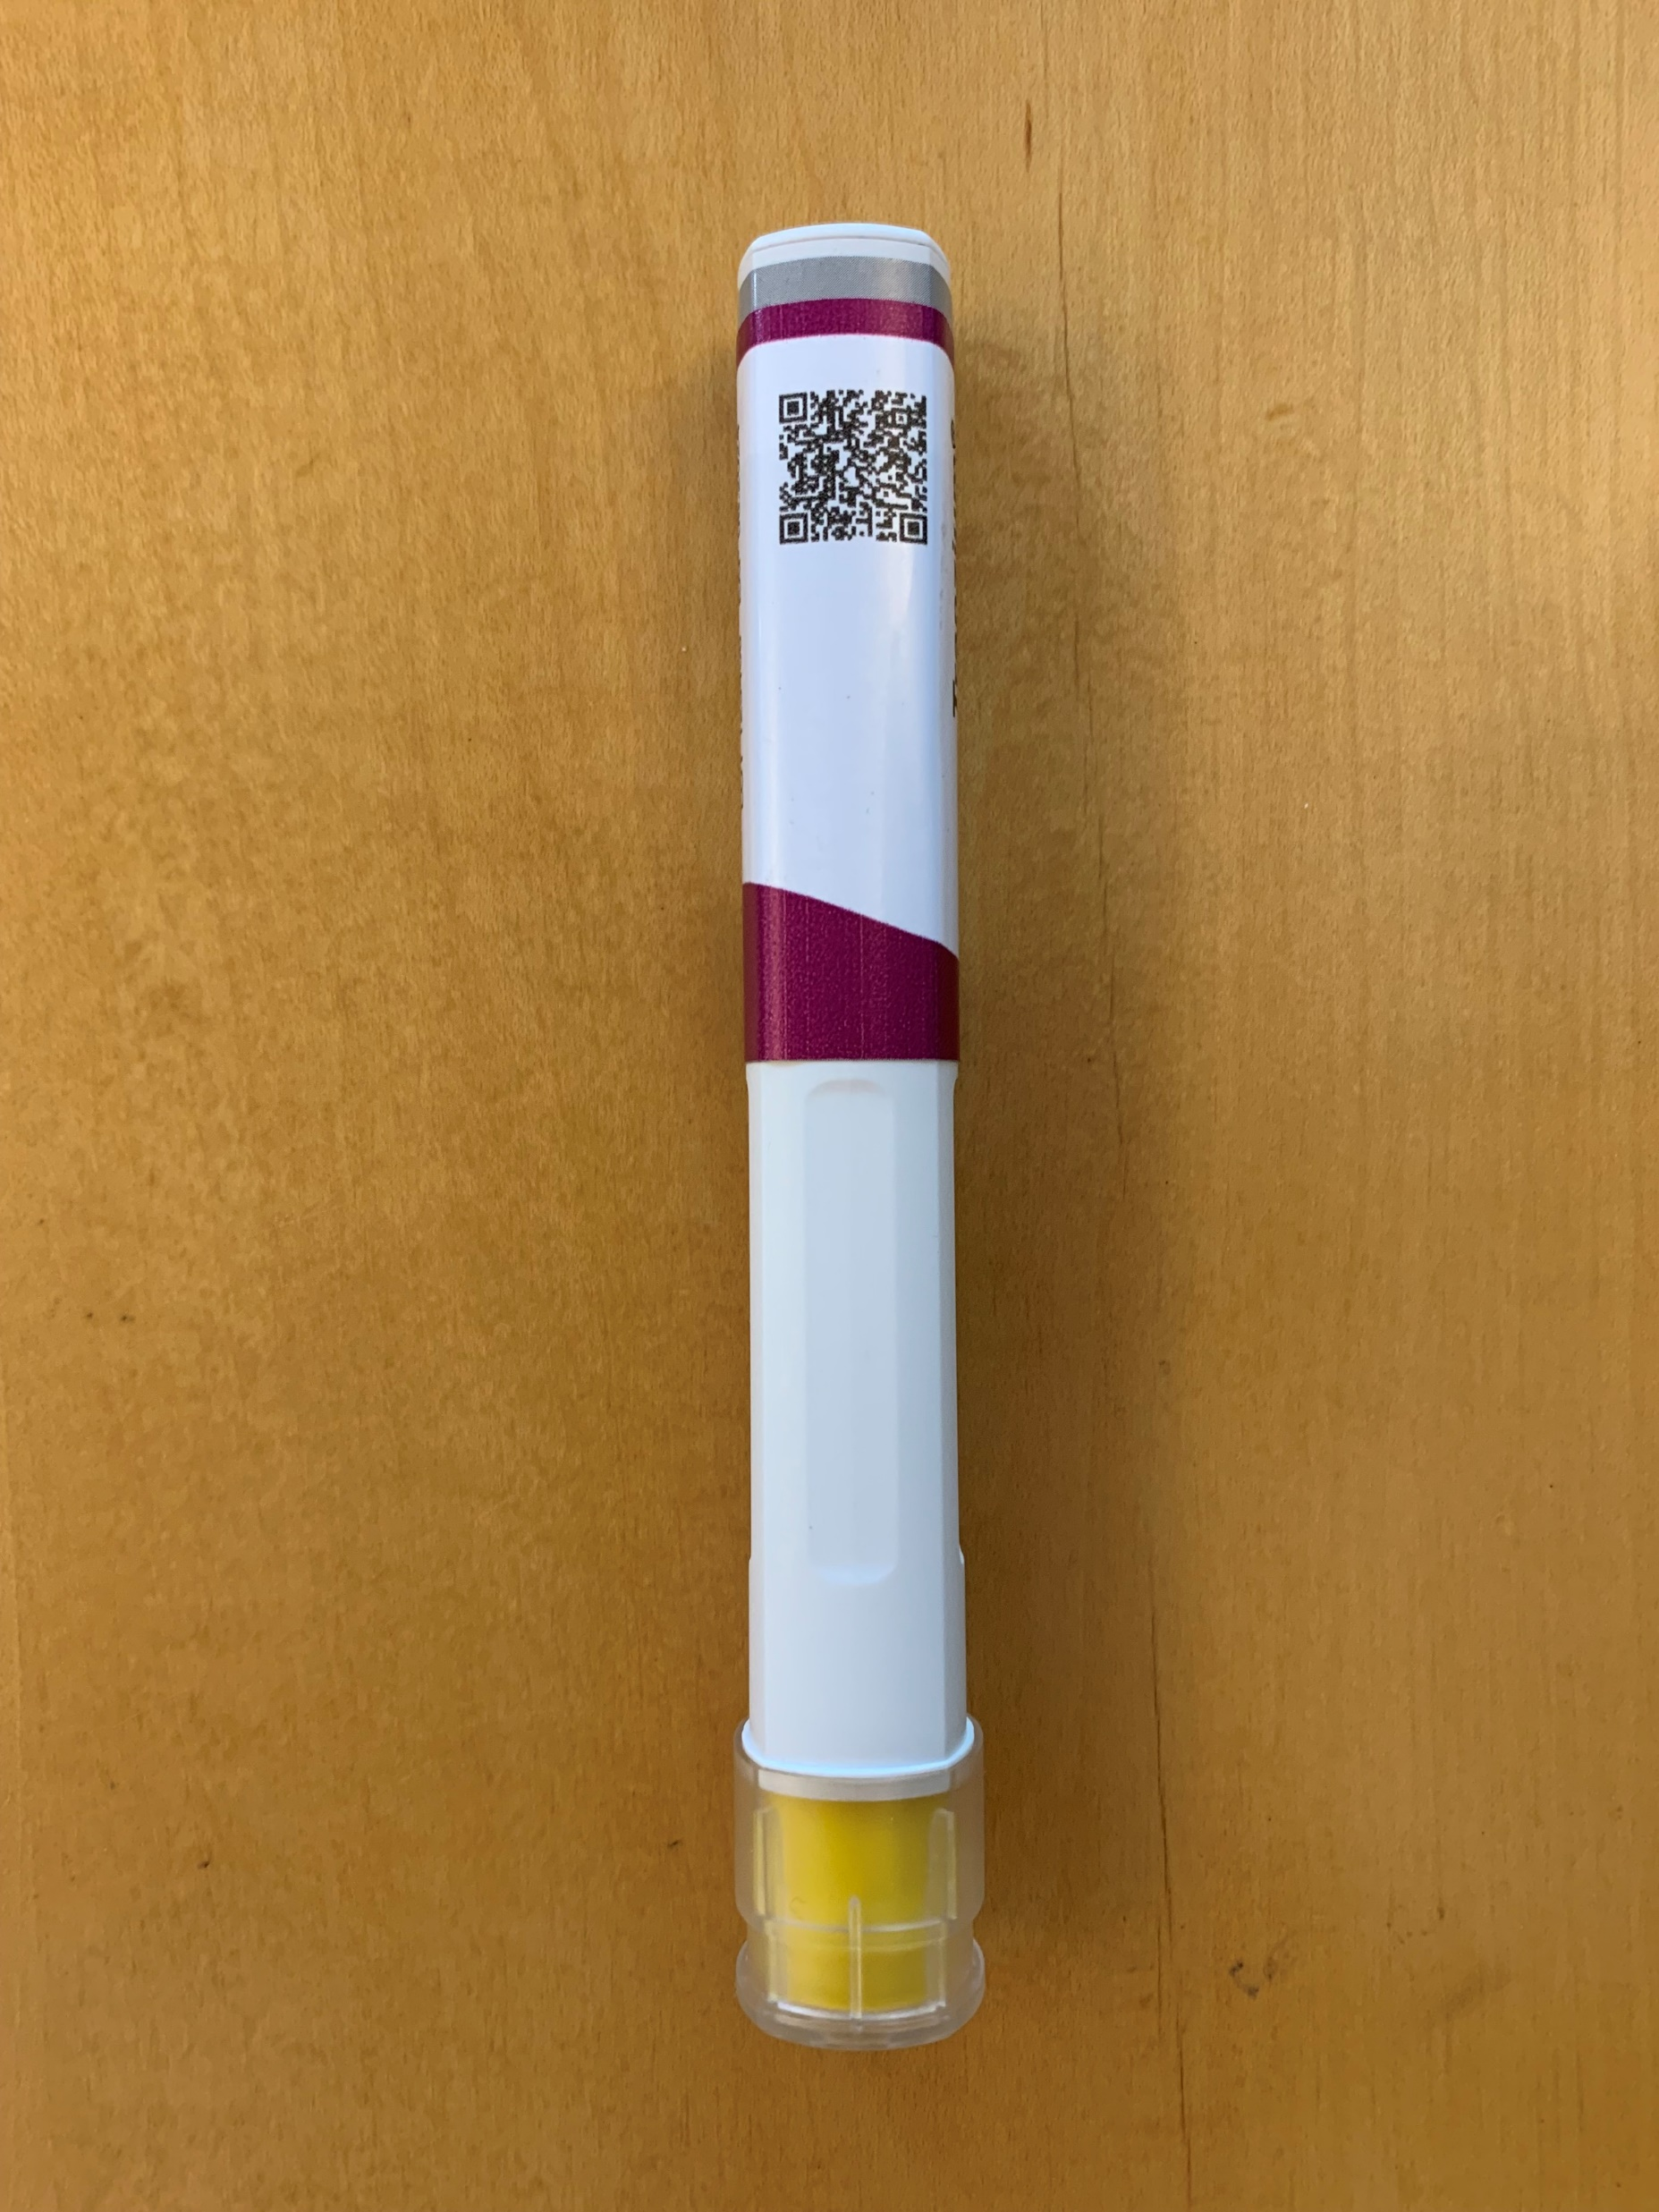
QR Code Workflow (Q)
QR codes were a more familiar technology but challenges in activation remain.
Experience with the technology
The majority of participants had knowledge/ experience with QR codes, often mentioning using these to access restaurant menus post-pandemic.
Some have a QR code scanner on their phone and use this rather than the camera.
Label activation
Trained participants could activate the label in just a few attempts, usually fairly quickly. Untrained participants often required multiple attempts.
Failed attempts were often resolved by trial and error – typically changing the distance between the phone and printed QR code. Some also struggled to tap on the link without it “disappearing.” Many noted that this interaction requires an additional step (i.e., opening the camera/ reader) compared to NFC.
Data entry
Nearly every participant envisioned trying the camera for data entry but felt they would resort to manual entry as-needed depending on the accuracy and consistency of camera use.
Smart label with QR code

Slide 29
Technology & Workflow
Recommendations
Pursue the NFC workflow, such that dose data automatically transfers/ populates.
Recognize that NFC is not well understood (in the US) and label activation is likely to be a challenge. Explore ways to better support users in understanding the technology and interaction (e.g., IFU, label graphic and orientation, etc.).
Include tamper evidence; the redundant entry alert is likely unnecessary.
Encourage label activation prior to uncapping/ use (e.g., when removing from the refrigerator) such that tamper evidence doesn’t introduce additional time/ effort and users can benefit from all features (including warming timer, if desired), however allow, but allow/ account for later activation.

Slide 30
UX INTERACTION

Slide 31
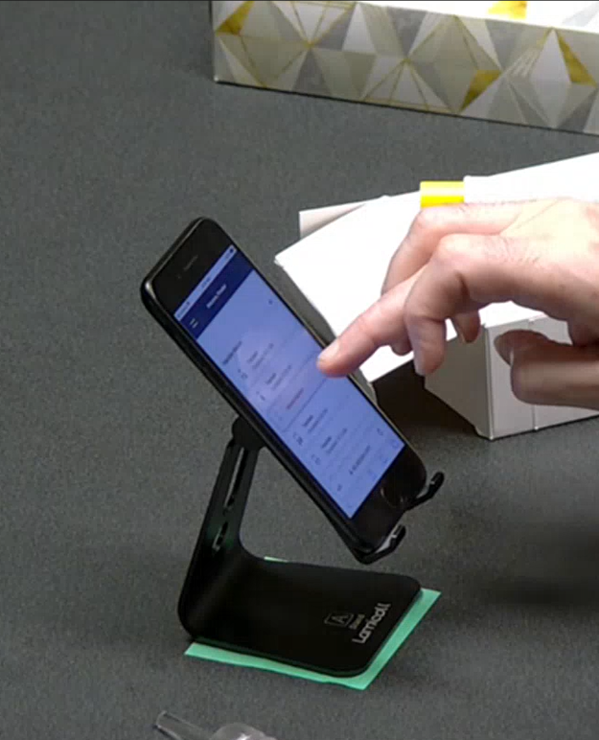
Overview
Overall, the app was intuitive for participants to navigate and comprehend, with some suggestions for improvement.
Participants went through the workflow generally as intended, intuiting the function of the buttons and knowing when the workflow was over.
They found the process to be easy from end-to-end with simple interaction. The green buttons were found to be a straightforward progression and the menu button was clear to use.
Many felt the text could be larger/ darker, noting they were straining to view/ read some text throughout their app use.
Participants often noted some of the text was difficult to see and/ or required their reading glasses.
“Things that are lighter either they don’t want you to read it or it’s not that important. I have eye issues so I can’t read it if it’s too light or too small.” –P27
Participants unanimously disliked the login requirement.
Participants wished that there was an option for the app to store your login information so that they wouldn’t have to “waste time” entering this every week. Many participants noted that they struggle to remember login information or even have paper-based lists of passwords to keep them straight. Alleviating this burden of remembering more information to log doses would ease the load on users.
“I imagine I would have to reference my notebook to see my login info (I wouldn't remember). It just seems like it could be easier.” –P3
A participant navigates through the injection history screen on the app.
Notes:
“I imagine I would have to reference my notebook to see my login info (I wouldn't remember). It just seems like it could be easier.” –P3

Slide 32
Overview
Recommendations
Ensure legibility throughout (both font size and color), recognizing that target user populations may suffer from eyesight impairments.
Seek to streamline individual login with each use or mitigate the need altogether.
Consider any differences in interaction (and implications on the user experience) between browser and app use; encourage app use if there are interaction efficiencies/ conveniences.
Notes:
“I imagine I would have to reference my notebook to see my login info (I wouldn't remember). It just seems like it could be easier.” –P3

Slide 33
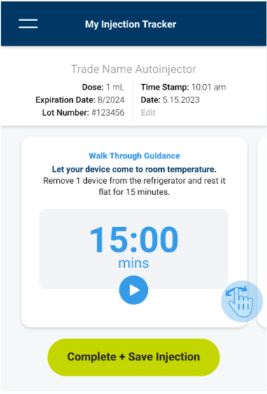
Home Screen
There was some confusion surrounding the timer and home screen.
Many “jumped” to the Complete + Save Injection button.
With the timer being inactive and the guidance often missed, many participants quickly moved to ‘Complete + Save Injection,’ then in some instances expressed hesitation, noting they would likely wait to do so (i.e., after injecting). Some asked when to do so (i.e., before or after injecting) perhaps confused by the verbiage which includes both steps (i.e., complete and save).
Almost all understood the purpose of the timer, however its perceived utility varied.
Some felt this timer was very helpful, both in facilitating the warming process and reinforcing the order of operations (i.e., scanning the label prior to using the device). These participants often requested that the timer audibly alarm when complete in case they had walked away from their phone and/or injection device.
Others felt they were unlikely to use the timer, scanning the label after the device had sat out for at least 15 minutes and they were ready to inject. These participants appreciated the optional treatment of the feature and “didn’t mind” its presence.
“I would tap the phone right before the injection. As time goes on, I know the steps. I'm going to make sure I have this out, and know that in 15 minutes, its time to start." –P4
The guidance was not initially noticed by most participants; only 10/32 found the digital QRG on their own.
Many didn’t think to swipe for additional information and ‘just missed it,’ while others did notice the blue ‘mickey mouse hand’ icon in the bottom right corner, they were unsure of its meaning.
“I just didn’t notice it.” –P23, talking about the additional guidance screens
Prototype N | Home screen
Notes:
I like the fact that it has a timer. I would like a vibration or an alarm with that P7
“the hand thing, I just passed it by. Wants to see just the three dots. “ p13
The little hand is not clear, maybe you should have 'swipe for step by step instructions' written out on the screen. p22

Slide 34
Home Screen
Recommendations
Ensure the timer has auditory and / or tactile feedback to alert the user when the warm-up time is complete.
Maintain the optional treatment of the timer feature.
Change wording of “Complete + Save Injection” to something more specific like “Log injection” as current verbiage was unclear to participants and caused some confusion.
Ensure text is legible (e.g., large font, higher contrast), especially for aged populations. Participants struggled to read the light gray text and the subtext below the headings.
Reconsider presentation of the QRG within the app to make it easier to find, especially on first use.
Prototype Q | Home screen

Slide 35
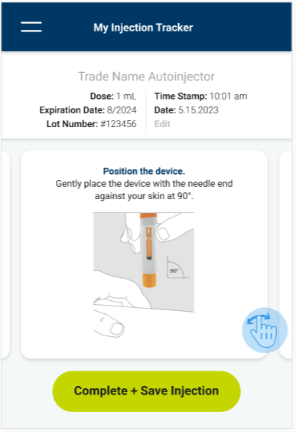
Guidance
Digital guidance was appreciated by participants.
Access to digital guidance is reassuring for users.
Continuous access to the QRG was reassuring for many participants, especially the many who missed it the first time. After finding this section, they liked information presented in a ‘step by step’ format. Many envisioned referencing this during initial use (i.e., first 1-3 times injecting), but also as-needed for a quick “refresher” and/ or as questions/ scenarios arise.
      “It’s telling you how to give a shot, so after the first time or the second time I probably won’t look at it.” -P32
Even those who preferred the paper format found it helpful to have a digital version as well.
While a few participants felt more comfortable referencing the paper instructions, having digital access as a back- up was still valued in case the paper instructions were misplaced or thrown away.
      “I prefer to have a hard copy. I want to concentrate on injecting myself correctly. I can't enter the data and read this at the same time.” -P5.
Prototype N | Injection Guidance

Slide 36
Guidance
Recommendations
Ensure digital QRG can be readily found after initial use, as some participants expressed a desire to reference this information later (if they were unsure, they were using the device correctly or as a ‘refresher”).
Continue to ensure more experienced users are not “slowed down” by guidance, as they are unlikely to regularly reference.
Consider the use of animations or videos to further communicate instructions and best practices (e.g., positioning the device at 90 degrees).
Notes:
It was a little off-putting to have the device look different from the QRG photo.” -P5.

Slide 37
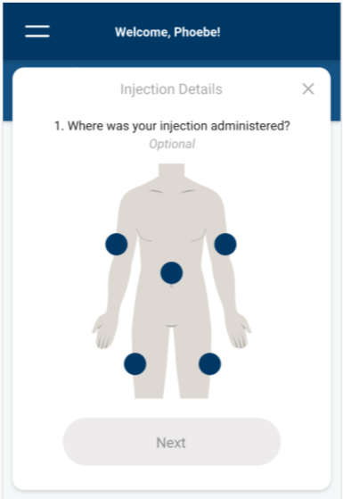
Injection Location + Notes
Tracking injection location was useful to participants (particularly for the injection experienced); however, self-reported notes were not.
Many participants imagined they would enter and reference their previous injection location to inform their next injection.
For those who envisioned alternating or rotating injection sites, many participants envisioned using the injection location to track where they had administered their last injection(s) to help determine where to inject next.
      “It could be nice if it would display where you injected the last few times.” –P25, injection experienced
Many desired more specificity for the abdomen.
Particularly if injecting exclusively into the stomach, participants often requested documentation that notes specific sides or quadrants of the stomach.
The open notes field was too vague and required too much effort to make use of.
Other than a few participants noting that they might enter a painful injection, few had ideas on ways to leverage the notes feature. Some commented if there was something of importance to note they would more likely call their care provider than capture within the app. Citing aversion to free-form text entry, some thought a drop-down menu could be more useful, and might also serve to suggest what might be important to capture.
      “In the event that you have pain, or a quick side effect, being able to write something is optional. It doesn’t hurt, but I wouldn't use it.” –P2
Prototype Q | Injection Location
Prototype N | Injection Location

Slide 38
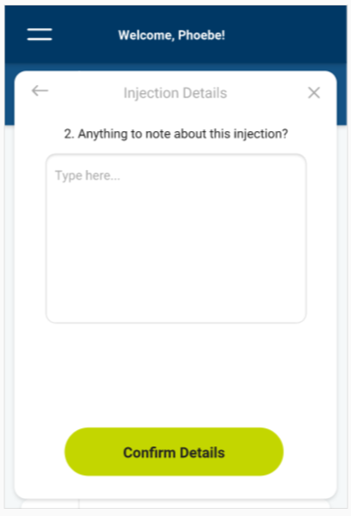
Injection Location + Notes
Recommendations
Allow users to quickly reference their previous injection site(s) prior to their next injection.
Consider allowing users to set up a site rotation plan so that the app can provide a recommendation for the next injection site, based on previous sites and use preferences.
Add quadrants to the abdomen option for ‘Injection Location’ to allow for more specificity.
Consider alternatives to free-form text notes (e.g., drop-down menu, checklist, etc.). Ensure this feature does not slow down the process of logging a dose or introduce additional steps. (Note in the prototype a separate window appears that users must then confirm even without entry.)
Prototype Q | Injection Notes

Slide 39
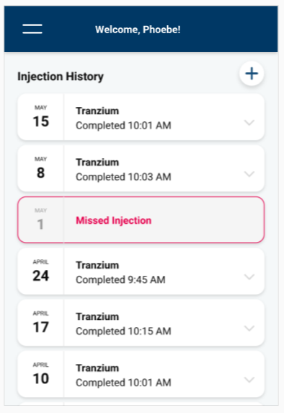
Injection History
Participants generally understood the intent and content within the injection history.
Some didn’t readily understand/ recognize the once weekly log.
In some instances, participants read and re-read the content and dates to then surmise that they had in fact taken each of the doses weekly. (With some participants ‘doing the math’ to confirm there was a difference of 7 days between posted dates.)
Many appreciated the indication of the missed dose but wondered about next steps and implications.
Several participants were quick to call out the missed dose but were surprised that a full week passed until their next injection, calling into question both how to mitigate missed doses and address them when they occur (do I take the dose when I realize I’ve missed or wait until the next injection?’).
Some expressed interest in integrating additional information and/ or data points.
Some participants were also interested in logging information including sugar levels, diet, activity, symptoms, and A1C. Many suggested this app integrate with their glucometer app to provide a more holistic picture.
      “I think the time stamp could be helpful. I would want to cross-reference with how I’m feeling to understand the impact the medication might have on how I feel. It helps you match it up with glucometer app data.” –P1
Prototype Q | Injection History

Slide 40
Injection History
Recommendations
Consider ways to more readily relate injection history to routine (e.g., calendar view) to reinforce understanding and ‘at a glance’ confirmation of regimen.
Explore ways to alert patients when a scheduled injection is missed, perhaps even in the absence of reminders.
Consider providing additional information for missed doses, e.g., “Can the dose be taken a day late?”
Ensure users are able to see all injections logged, from start of use.

Slide 41
FEATURES

Slide 42
Feature Preferences
RX Refill, My Care Team, And Reminders were most preferred overall.
Note: some participants selected more than one preferred feature.
Notes:
Multiple participants voted “All but symptoms” or “All but community”

Slide 43
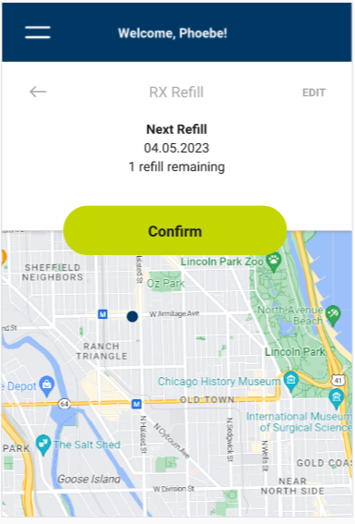
RX Refill
The RX refill feature proved most popular, especially if linked to one's pharmacy.
Benefits / Drawbacks
Integrated to not require 'extra steps' (i.e., information is available when taking the medication)
Can serve as a confirmation even if using a pharmacy app/ auto-replenish
Could serve to identify nearby pharmacies if needed (e.g., when traveling)
Redundant/ Unnecessary with current tools
    “It takes some of the work away, makes you feel fancy really... I like that everything is connected and linked up.” –P26
    "I would like it to tell me how many refills I have left and which ones are ready. I have a current app that does this, but it has more steps.“ –P10
RX refill wireframe

Slide 44
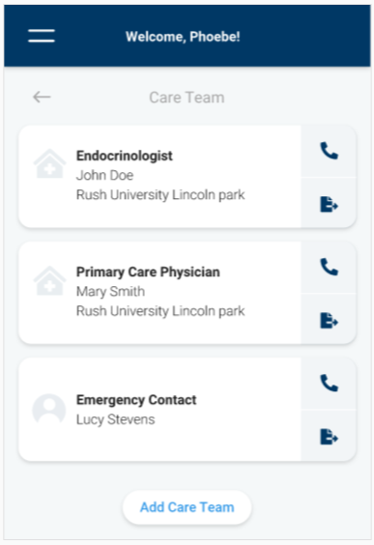
My Care Team
Many wanted the ability to share/ send data to their doctor directly through the app; few envisioned doing so with family members or non-HCPs.
Benefits / Drawbacks
Can facilitate more accurate doctor / patient communication
Links medication information with prescribers
Provides more immediate access to HCPs (particularly for caregivers)
Introduces questions about how, when and how often this data is reviewed
Thought by some to be unnecessary if sharing this information during an appointment
Requires HCP buy-in; some noted they’d only use it if their doctor asked them to
          “That's a great idea because you have the option to send it ahead of time, maybe even before a visit. Or if you forget, you could pull it up at the visit.” –P2
“I love this. When you go to see a specialist, it’s months down the line. You forget things that happened - its helpful for these discussions.” –P12
My care team wireframe

Slide 45
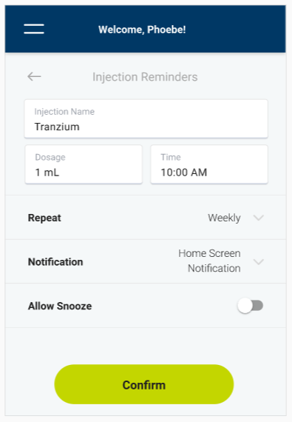
Reminders
Reminders were deemed worthwhile, even if providing just a small convenience.
Benefits / Drawbacks
Encourages user to stay on track
Integration with medication app could differentiate from standard phone reminders
Could sync with existing calendars to support planning
Redundant to current tools
Unnecessary for 'simple' treatment regimens
“I don't think that this has to be for everyone, but it would be good for those with memory issues or forgetful in general.” –P2
“Anybody who takes medicine on a weekly basis wouldn't use this much. It's simple but it's not necessary... a minor convenience.“ –P9
Reminder wireframe

Slide 46
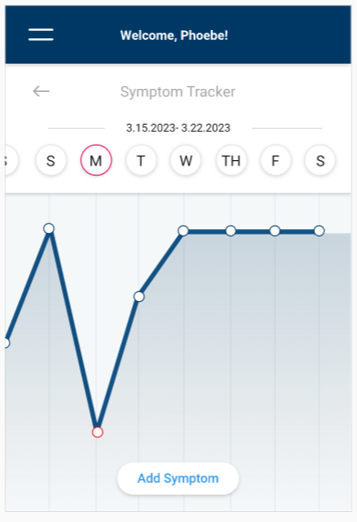
Symptom Tracker
Although the symptom tracker wasn't well received, this was highly influenced by patient indication (i.e., diabetes).
Benefits / Drawbacks
Could serve to document/ track medication side effects when first starting treatment
Was often confused with glucose readings, which are documented/ tracked elsewhere
Rating scale didn't resonate for diabetes (many felt there are no real "symptoms" of diabetes)
Freeform text would be time-consuming
“It doesn't seem like there are good days and bad days with diabetes. It doesn't exactly align. If it was some other medication, like depression, this could be more useful.” –P19
“If I didn't need this, I'd want to be able to bypass this.” –P27
Symptom tracker wireframe

Slide 47
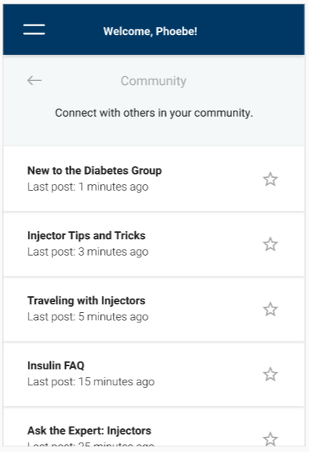
Community
Many shared the sentiment that the community feature 'could be helpful for others but not me.'
Benefits / Drawbacks
Could be a resource for FAQs (e.g., 'what to expect' or 'traveling with Tranzium')
Highly dependent on comfort level/ current use of online forums and social media
Potentially unreliable information
Privacy concerns
“There are different things that might come up. If you forget a dose, you can see what other people do in the situation.” –P24
“I would only use this if I felt I wasn't getting answers from my doctors. However, if I have good communication with her, I don't need this.” –P14
Community wireframe

Slide 48
Features
Recommendations
Consider pursuing all five features explored; with RX Refill, My Care Team and Reminders prioritized.
Consider including additional informational features such as onboarding (e.g., getting started with Tranzium) and FAQs.
RX Refill
Seek ways to link with pharmacy apps to provide up-to-date information regarding refills (e.g., confirm ready for pick-up).
If unable to link to one’s pharmacy, explore ways to provide refill information with as little user input as possible (next refill due).
My Care Team
Explore ways to facilitate “quick access” to relevant contacts and/ or HCPs.
Consider enabling data sharing with these contacts – note that format and frequency (of sharing and viewing) may introduce questions/ concerns.
Alternatively, consider a view designed for data sharing with an HCP during an appointment.

Slide 49
Features Cont’d
Reminders
Explore ways to differentiate medication reminders from other phone reminders.
Consider ways to customize reminders based on user need (frequency, persistence, etc.).
Note that users expected these reminders to integrate with calendars.
Symptom Tracker
Seek ways to ensure symptom tracker format and content is relevant/ appropriate for target indication.
Strive for balance between relevancy and simplicity. While freeform text allows the most flexibility, the time required would likely preclude use.
Community
Consider ways to address/ mitigate concerns about accuracy of information provided and personal privacy.

Slide 50
APPENDIX

Slide 51
Smart Label Prototype Links
QR Code Flow: https://xd.adobe.com/view/eb83da53-0641-4cdd-adfd-aade634a2e74-bed0/
NFC Tag Flow: https://xd.adobe.com/view/ba3aea26-994b-408c-920f-4503141d40fc-ef69/
2nd Scan/TamperBreak: https://xd.adobe.com/view/2906cf5d-a37e-438d-8c8c-f531e4c2cbb0-7c55/
Error: https://xd.adobe.com/view/c0014a11-eb40-4e49-9780-75df2ace3008-9552/

Slide 52
QR Code Flow
Key
Button press navigation
On QR Scan
Auto progression navigation
Pop up details on home screen
Default to home screen

Slide 53
NFC Code Flow
Key
Button press navigation
On NFC Scan
Drop down sign in
Auto progression navigation
Pop up details on home screen
Default to home screen

Slide 54
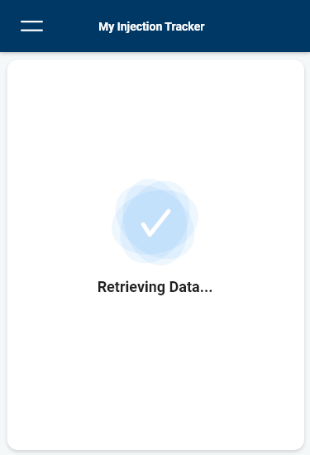
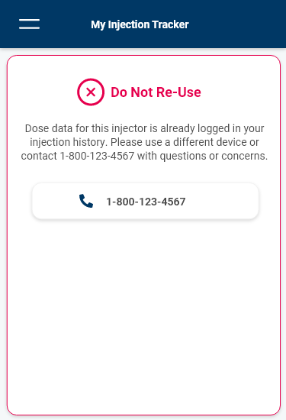
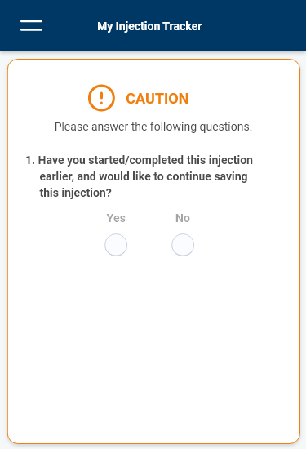
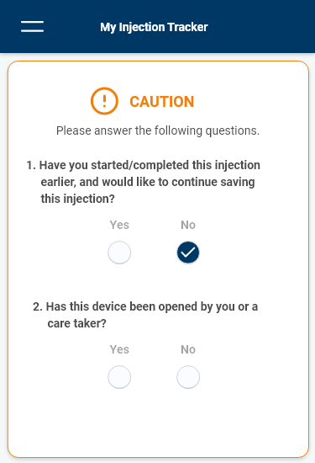
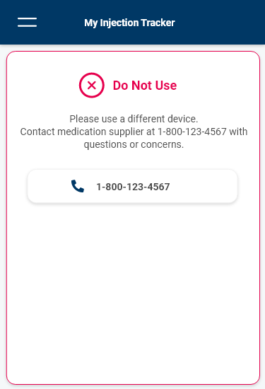
Alert Flows
Key
Button press navigation
Auto progression navigation
Progress to NFC flow
Unique ID previously saved
(i.e., redundant entry)
Tamper evidence questionnaire
Tamper evidence alert

Slide 55
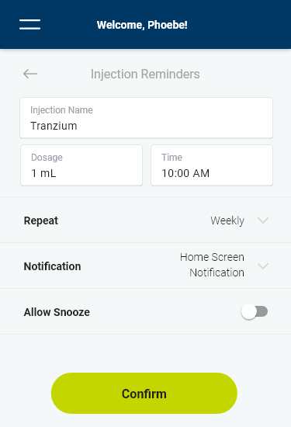
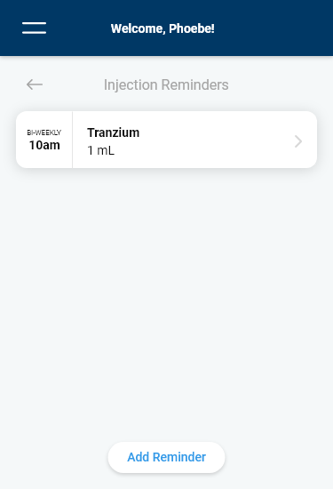
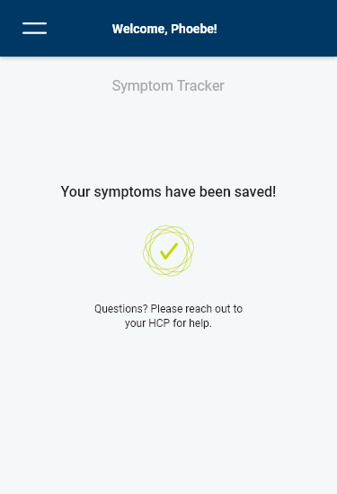
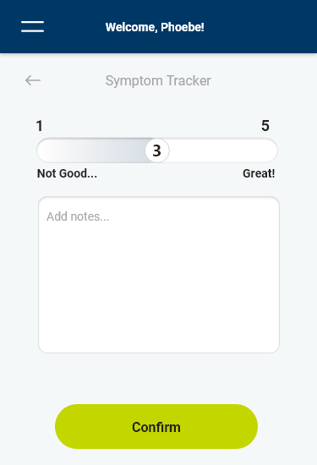
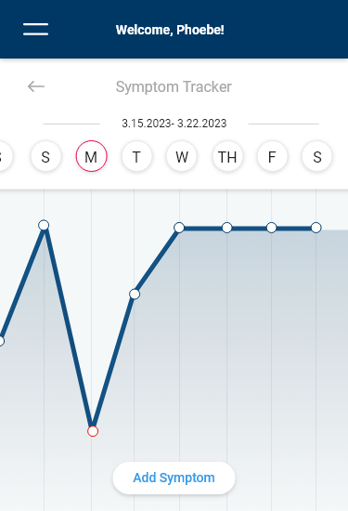

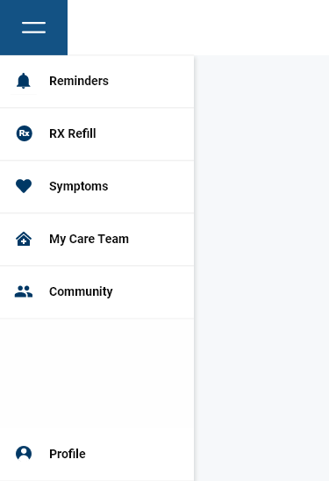
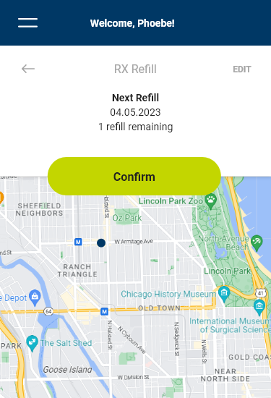
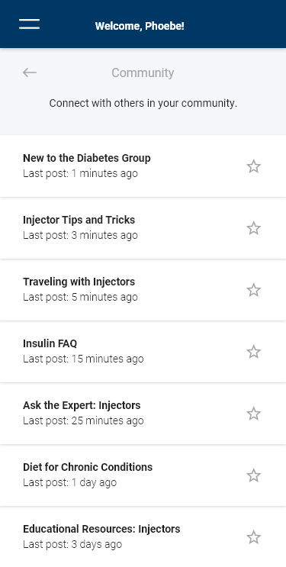
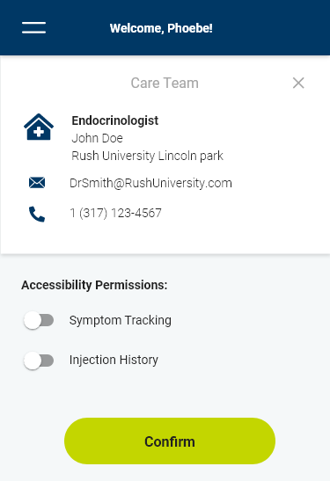


Features
Reminder Flow
Symptoms Flow
Rx Refill
Menu: Homescreen
Community
Care Team Flow

Slide 56
Label Activation Success
Success: Participant was able to activate the label with little or no help from moderator (despite number of attempts)
Near Miss: Participant was close to failing to activate the label but was able to activate it with significant delay or help from moderator
Failure: Participant is unable to activate the label and moderator must complete the process for them.

Slide 57
Participant Grid
P# | Trained | Counterbalance (first concept) | Gender Identity | Age Range | Experience Injecting?
1 | Trained | Q, N | Female | 50-64 | Yes
2 | Trained | N.Q | Male | 30-49 | Yes
3 | Trained | Q, N | Female | 65+ | No
4 | Trained | N, Q | Female | 50-64 | Yes
5 | Trained | Q, N | Female | 65+ | No
6 | Untrained | N, Q | Male | 50-64 | No
7 | Untrained | Q, N | Male | 50-64 | No
8 | Untrained | N, Q | Male | 65+ | Yes
9 | Untrained | Q, N | Male | 65+ | No
10 | Untrained | N, Q | Female | 50-64 | Yes
11 | Untrained | Q, N | Male | 30-49 | No
12 | Trained | N, Q | Female | 30-49 | No
13 | Trained | N, Q | Male | 50-64 | No
14 | Trained | Q, N | Male | 50-64 | Yes
15 | Trained | Q, N | Male | 65+ | Yes
16 | Trained | N, Q | Male | 30-49 | No
17 | Trained | Q, N | Female | 50-64 | No
18 | Untrained | N, Q | Male | 30-49 | Yes
19 | Untrained | Q, N | Male | 50-64 | No
20 | untrained | N,Q | Female | 65+ | Yes
21 | Untrained | Q, N | Female | 30-49 | Yes
22 | untrained | N, Q | Female | 30-49 | Yes
23 | untrained | Q, N | Male | 50-64 | Yes
24 | Trained | N, Q | Female | 30-49 | Yes
25 | Trained | Q, N | Male | 65+ | Yes
26 | Trained | N, Q | Female | 50-64 | No
27 | Untrained | Q, N | Female | 50-64 | No
28 | Untrained | N, Q | Female | 30-49 | No
29 | Trained | Q, N | Male | 65+ | Yes
30 | Untrained | Q, N | Male | 65+ | No
31 | Trained | N, Q | Female | 65+ | Yes
32 | Untrained | N, Q | Male | 50-64 | Yes

Slide 58
PHEW! That was long.

Slide 59
PROJECT INFO
SKILLS
HOW TO APPLY THEM
SMART LABELS
GOAL: Help Type-2 diabetes patients better track their doses
SOLUTION: Use human-centered design to create digital “smart label” on medication
IMPACT: Learning preferences for potential device users
  DOCUMENTATION: Take notes, take videos, rewatch videos and review content
  CREATING A PROTOCOL: Heavy base of research, iteration, practice
  INTERVIEWING & MODERATING: Setting the tone, remaining neutral, guiding the conversation
  STORYTELLING: With enough research, it’s easier to tell more complex stories
  DESIGN BY COMMITTEE: Getting interdisciplinary input is critical
  KNOWING YOUR STRENGTHS: Are you a researcher, an interviewer, a designer, all 3?

Slide 60
CHANGES
01.
What changes would you have made to our project?
STORYTELLING
02.
How would you have told this story differently?
QUESTIONS
MISSING PIECES
03.
Is there anything you think my team and I missed?

Slide 61
INTERVIEWING
01.
I had much more confidence in moderation and question writing.
LEADERSHIP
02.
Having opportunities to teach others is critical.
HOW DFA HELPED
KNOW THE PROCESS
03.
Understanding HCD allows you to predict next steps and guide conversation

Slide 62
PROJECT INFO
SKILLS
HOW TO APPLY THEM
MOLECULE MAKER LAB
GOAL: Democratize molecular making for all ages, lowering the barriers to scientific education
SOLUTION: Develop digital interfaces and physical prototypes for chemists of all ages
IMPACT: Creating the world’s first web-based molecule builder and inspiring new scientists
  DIGITAL DESIGN: Iteration, co-creation sessions, card-sorting
  PERSONA CREATION: Synthesizing research, MIRO / MURAL / FIGMA, Journey Maps, Competitive analysis
  REAL-WORLD PRESENTATIONS: In-person, virtual, public speaking
  PRACTICE YOUR CRAFT: Spend a little time each week practicing a skill!
  STEREOTYPING / REALISM: Experimenting with different research methodologies, basing findings off research
  NEW WAYS TO EXPLORE: Where else in your life can you teach / learn?

Slide 63

PROJECTS
PORTFOLIOS
REAL-WORLD SKILLS
Molecule Maker Lab
Design Strategy and Curriculum Design

Slide 64
CHANGES
01.
What changes would you have made to our project?
STORYTELLING
02.
How would you have told this story differently?
QUESTIONS
MISSING PIECES
03.
Is there anything you think my team and I missed?
Notes:
More experimentation
More interactive things, more diagrams of research
More testing with non-college student college-aged kids

Slide 65
SOFTWARE SKILLS
01.
Honing your Adobe, Figma, MURAL, and MIRO skills go a long way.
INTERDISCIPLINARY TEAMS
02.
Working “cross-functionally” is huge in the real world.
HOW DFA HELPED
STAKEHOLDER MANAGEMENT
03.
Working with outside clients is a critical part of the HCD process

Slide 66
PROJECTS
PORTFOLIOS
REAL-WORLD SKILLS
Molecule Maker Lab
Design Strategy and Curriculum Design

Slide 67
PORTFOLIOS

Slide 68

SIMPLICITY
Don’t start by biting off more than you can chew.
portfolios
PASSION
It should show your work, but also your love and creativity.

Slide 69
EXAMPLES
https://imemi.me/portfolio Very concise portfolio
http://garrickli.me/ Excellent Storytelling https://anmol.anubhai.com/ Very research-focused https://jeremydembowski.com/ Design-focused
portfolios
Notes:
Make this into clickable shorter links

Slide 70
DOCUMENTATION
Take pictures of everything! It makes your portfolio so much easier.
portfolios
NETWORKING
Get critiques from other people! Reach out to your network.

Slide 71

PROJECTS
PORTFOLIOS
REAL-WORLD SKILLS
WHAT I LEARNED IN DFA

Slide 72
REAL-WORLD SKILLS

Slide 73
SOFTWARE SKILLS
01.
Honing your Adobe, Figma, MURAL, and MIRO skills go a long way.
INTERDISCIPLINARY TEAMS
02.
Working “cross-functionally” is huge in the real world.
HOW DFA HELPED
STAKEHOLDER MANAGEMENT
03.
Working with outside clients is a critical part of the HCD process

Slide 74
INTERVIEWING
01.
I had much more confidence in moderation and question writing.
LEADERSHIP
02.
Having opportunities to teach others is critical.
HOW DFA HELPED
KNOW THE PROCESS
03.
Understanding HCD allows you to predict next steps and guide conversation

Slide 75

SKILL WRAP-UP
DOCUMENTATION
KNOW YOUR STRENGTHS
Elaborate on what you want to discuss.
Then emphasize them! And continue to work on the others.
BE MULTIDISCIPLINARY
ASK QUESTIONS
Understand the process from many points of view.
Get critiques, get advice, and talk to people in your network.
Notes:
T shaped knowledge

Slide 76
QUESTIONS
Feel free to contact me!
alastairmerrett318@gmail.com
https://www.linkedin.com/in/ally-star/

